Slide 1
Welcome
Business Affairs
FY17 Quarterly Update

Slide 2
Finance Systems Management
Currently testing a “new” New Fund Request System for all charts
  New links will be updated on the HSC Finance El Paso Portal
  Instructions will also be update and placed on the portal
Looking into options for replacing TEAMApp-Starting from scratch

Slide 3

Property Management
Anticipated changes to Annual Inventory Certification
  Certification complete by April 30
  All scanning will only be done by departments
    Can setup as many unique users as need by Dept
Testing Phase for New Property Inventory System

Slide 4
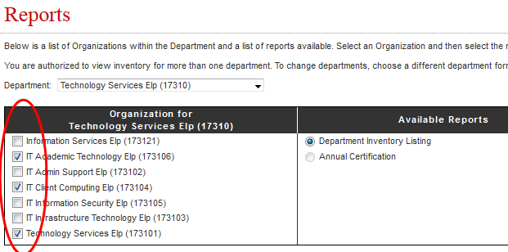
Property Inventory System
Sneak Peek
Multi-Dept Select

Slide 5
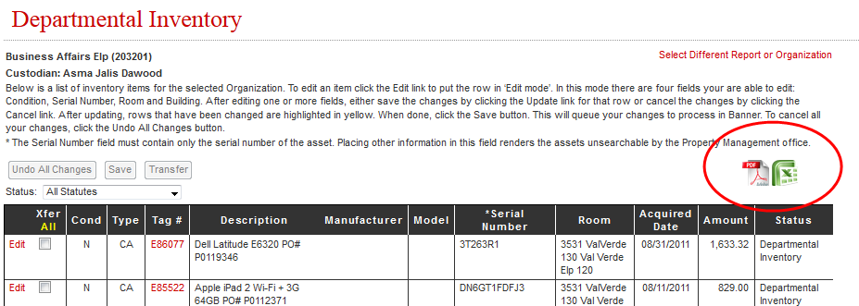
New Export Abilities

Slide 6
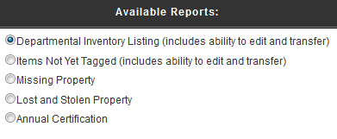
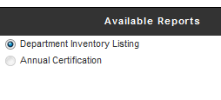
Changes in Report

Slide 7
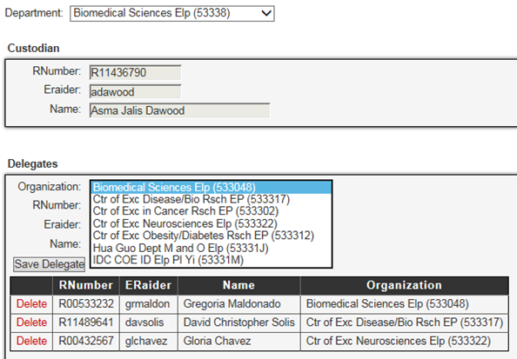
Custodian & Delegate Changes

Slide 8
Budget Office Updates
FLSA Changes
Converted exempt positions and jobs to non-exempt status effective 11/1/2016
Updated salaries on exempt jobs to new minimum threshold effective 11/1/2016
Cell Phone Allowances
Rolled Cellphone Allowances to primary position base salaries effective 11/1/2016

Slide 9
Accounting Services
TTUHSC El Paso

Slide 10
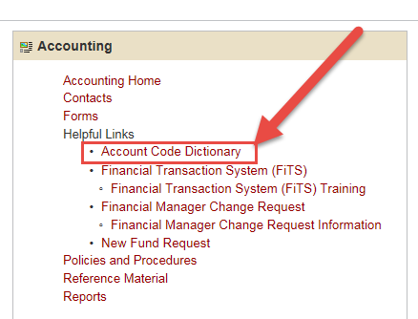
Account Code Dictionary

Slide 11
Account Code Dictionary
Dictionary Module- Will allow the user to search by keyword or account code.
Please note only expense account codes are available at this time.

Slide 12
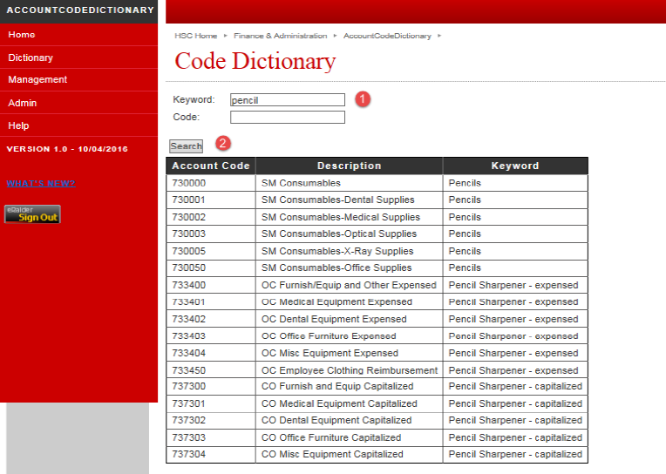
Account Code Dictionary- Keyword Search
If searching by keyword, the dictionary will display all account codes applicable for the item entered.

Slide 13
Account Code Dictionary- Account code search
If searching by account code, the dictionary will display the account code description and account type. For example:
Account Code: 733404
Description: OC Misc Equipment Expensed
Account type: 70- Expense

Slide 14
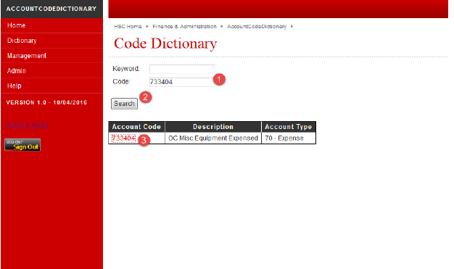
Account Code Dictionary- Account code search
All related keywords to the account code entered can be accessed by clicking on the account code.

Slide 15
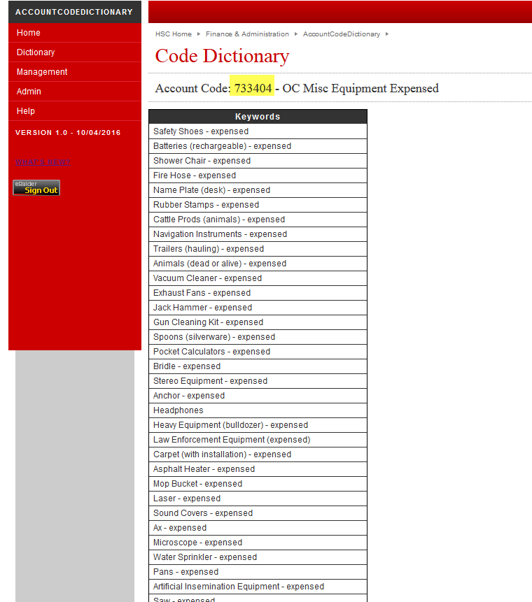
Account Code Dictionary- Account code search

Slide 16
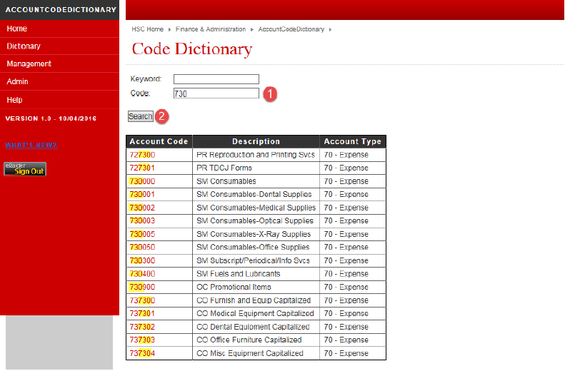
Account Code Dictionary
The user may also use a wildcard feature to search multiple account codes at a time

Slide 17
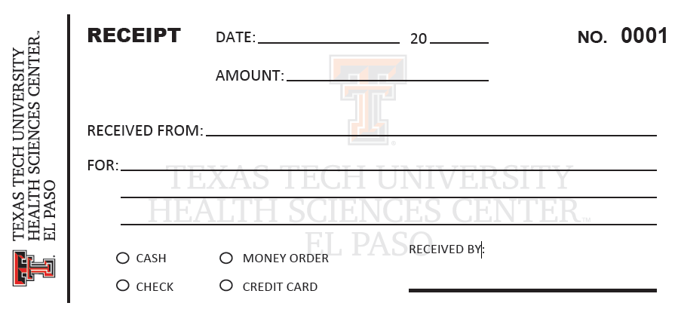
New receipt forms are available!

Slide 18
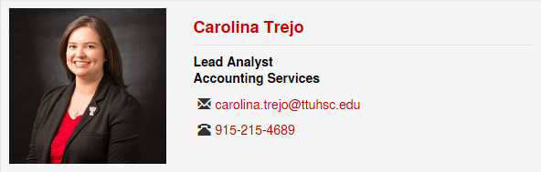
New staff members
We are excited to introduce our newest member of our team- Carolina Trejo

Slide 19
Contracts & Grants Accounting
TTUHSC El Paso

Slide 20
Contracts & Grants Accounting Update
New grant financial status report for principal investigators
  Automatically emailed to PIs and fund managers the 12th day of the month, showing cumulative revenues and expenses and available budget balance per grant through the end of the prior month
  For sponsored programs where the PI and the fund manager is the same person, the recipient will receive two emails. Disclosure included in the body of the email.

Slide 21
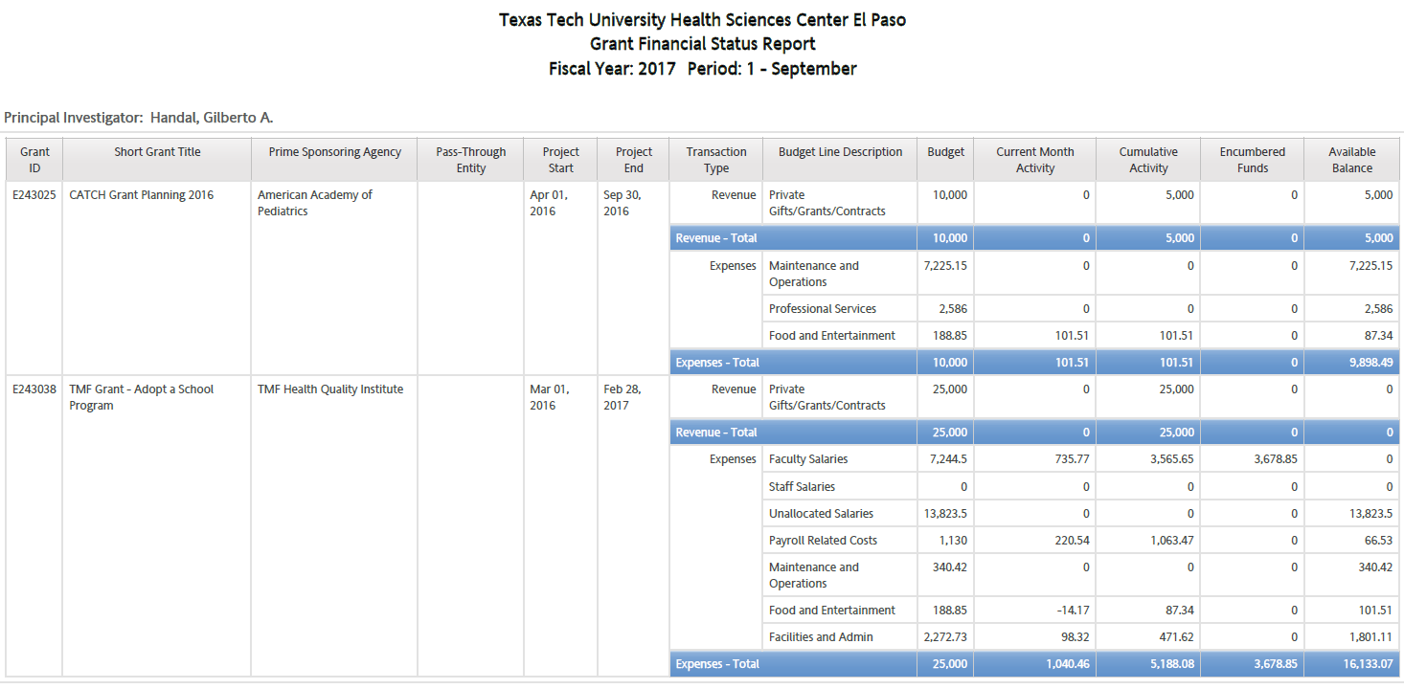

Slide 22
Contracts & Grants Accounting Update
Important Reminders
  Regularly review the expenses on your sponsored program funds (fund codes starting with 21, 22, 23, and 24) to make sure costs are being allocated to the appropriate fund
    Monthly review is recommended
    Especially important near the end of the grant period and fiscal year
    Cost transfers should be avoided as much as possible. When a cost transfer is required, it should be supported by a reasonable and detailed explanation
  Regular purchase order/open encumbrance reviews should be standard practice in your department
    Make use of available Cognos reports
    Promptly request the closure of invalid encumbrances or the move to an alternate FOAP for valid encumbrances that will not be received by the grant end date
  Findings from FY16 Year-End

Slide 23
Contracts & Grants Accounting Update
Upcoming workshop on grant administration put together by the Office of Sponsored Programs, Institutional Advancement, and C&G Accounting

Slide 24
Procurement Services
Purchasing

Slide 25
Holiday Events
Operating Policy 72.16 Official Functions, Business Meetings, and Entertainment
  Each department is allowed one annual event, usually at Thanksgiving or Christmas. The expenditure for the food is limited to a total cost not to exceed $25 per employee or $50 for employee and spouse/guest
  Pre-Approval Form
    All expenses should be included
  Alcohol Request Template

Slide 26
Holiday Events
Alcohol Request Template
  Hosted or Cash Bar
  Vendor Must Meet the following requirements
    Alcohol can only be served by vendors properly licensed by the Texas Alcoholic Beverage Commission (TABC) to serve or sell
    All servers must be TABC certified and follow the TABC rules concerning the serving and dispensing of alcohol
    The vendor is required to provide proof of licensure and to ensure all servers are TABC certified
    The event agreement from the vendor/caterer must contain a clause indemnifying TTUHSCEP and TTUS along with evidence of insurance compliant with current TTUHSCEP and TTUS standards
  Outside alcohol cannot be brought in to your event by employees
  Submit at least 30 days prior to your event
    President’s Approval is required
    Proper Documentation must be confirmed
    Notification to the TABC may be required
  Include all documentation along with Pre Approval Form

Slide 27
Holiday Events
Deposits
  Create a purchase order
  Quote must state prepayment is required
If an agreement is requiring a TTUHSCEP signature please submit with your requisition and include in the comments
Include Documentation
  Quote
  Fully Approved Pre-Approval Form
  Fully Approved Alcohol Request Template

Slide 28
Quotes/Invoices
Customer Name (Should no longer be Lubbock)
  TTUHSCEP
    5001 El Paso Drive
    El Paso, TX 79905
Bill To Address
  TTUHSCEP
  Accounts Payable
    5001 El Paso Drive
    El Paso, TX 79905

Slide 29
Receiving/Invoices
Operating Policy 72.10 Invoice Processing and the Prompt Payment Law
  Enter receiving information in TechBuy within 3 days after the good/services are received/completed. The receipt date should be the actual date goods/services were received /completed
  To comply with the State of Texas Comptroller rules, invoices received directly from the vendor by a department or Accounts Payable must be date stamped on the day the invoice is received
    Applying incorrect receiving date to avoid late payment penalty is considered falsifying
Forward all invoices via inter-office mail to Accounts Payable or email to accountspayableelp@ttuhsc.edu
  If you receive an invoice from the vendor by email, forward the original email from the vendor or print the invoice and date stamp
    The date the email is received is used to begin calculating the Net 30 days
  If you receive an invoice by postal mail, date stamp the invoice
    The date the invoice is received is used to begin calculating the Net 30 days
  If an invoice does not include the date stamp or the original email is not included, AP uses the date on the invoice to calculate the Net 30

