Slide 2
Finance Systems Management
Quarterly Update

Slide 3
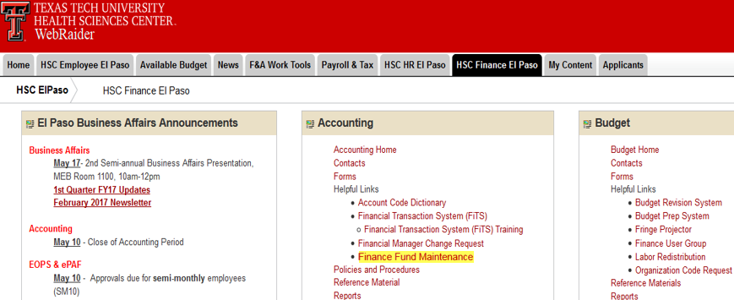
Finance Systems
Finance Fund Maintenance went live May 15

Slide 4
Property Inventory
Annual Inventory Certification is 100% complete

Slide 5
Property Inventory
Annual Inventory Certification is 100% complete
Temporary Use Forms- HSCEP OP 63.10
  “The department head ensures that the Temporary Use of Property Authorization form (Attachment D) is submitted to Property Management and Texas Tech Police whenever property is temporarily removed from the department”

Slide 6
Property Inventory
Annual Inventory Certification is 100% complete
Temporary Use Forms- HSCEP OP 63.10
  “The department head ensures that the Temporary Use of Property Authorization form (Attachment D) is submitted to Property Management and Texas Tech Police whenever property is temporarily removed from the department”
Favorable feedback regarding new Property Inventory System

Slide 7
Property Inventory
Annual Inventory Certification is 100% complete
Temporary Use Forms- HSCEP OP 63.10
  “The department head ensures that the Temporary Use of Property Authorization form (Attachment D) is submitted to Property Management and Texas Tech Police whenever property is temporarily removed from the department”
Favorable feedback regarding new Property Inventory System
Plans to add additional features to the Property Inventory System

Slide 8
Property Inventory
Annual Inventory Certification is 100% complete
Temporary Use Forms- HSCEP OP 63.10
  “The department head ensures that the Temporary Use of Property Authorization form (Attachment D) is submitted to Property Management and Texas Tech Police whenever property is temporarily removed from the department”
Favorable feedback regarding new Property Inventory System
Plans to add additional features to the Property Inventory System
Internal Asset Reviews will begin in May

Slide 9
Budget Office
Quarterly Update

Slide 10
Budget Office Updates
Budget Prep – DPT Phase
Salary Planner, Budget Development, and Transfer System will be available on line starting May 26
DPT Phase will be closed June 16
EOPS
Updated EOPS approval routing sheet sent out this month, if you did not get a copy please email the Budget Office

Slide 11
Accounting Services
Quarterly Update

Slide 12
Encumbrances
What is an encumbrance?
  Funds reserved / committed for a financial obligation. Funds are set aside after the approval of a request to pay for goods or services provided to TTUHSC El Paso.
What is the purpose of an encumbrance?
  The main purpose of encumbrances is to avoid budget overspending.
How do encumbrances affect your budget?
Budget – Actuals – Encumbrances = Available Budget Balance

Slide 13
Encumbrances
Types of encumbrances:
General Encumbrances:
- (EI) Purchase orders transitioned from chart H to chart E
- (EV) Travel Encumbrances
- (QV) Communication Services
Purchase Orders Encumbrances:
- (P0) Transactions submitted through TechBuy System
Labor Encumbrances:
- (PR) Payroll related

Slide 14
General Encumbrance - EI
Created when transferring P0’s from chart H to Chart E
Given the document prefix -EI in order to be identified on financial reports.
Created prior to FY16, therefore the likelihood of these being valid is very low.
Review these thoroughly and determine the appropriate course of action.
If no longer valid or the amount due has changed, a PO/Encumbrance change request must be submitted.

Slide 15
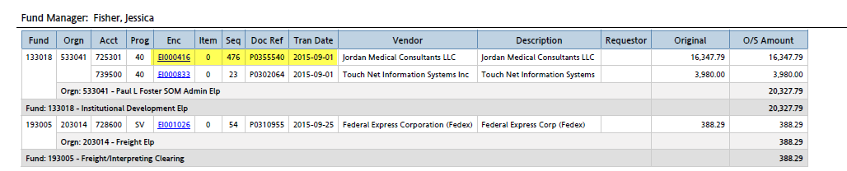
General Encumbrance - EI
The PO associated with old encumbrances beginning with EI- will be listed under the document reference of the report. The PO number will need to be provided when requesting an encumbrance to be adjusted/closed.

Slide 16
General Encumbrances- Travel (EV)
Travel Encumbrances:
Created when the application is submitted.
Automatically released after approval of travel voucher.
If trip is cancelled, application must be cancelled on the travel system in order to release the encumbrance and make your funds available.

Slide 17
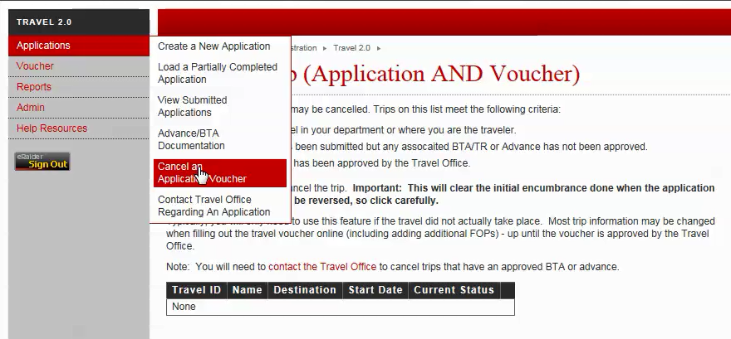
General Encumbrances- Travel (EV)
How do you close a travel encumbrance?

Slide 18
Purchase Orders – (P0)
Recorded after the approval of a requisition submitted through TechBuy.
How do I review if these are still valid?
- Determine if all goods/services have been received and that a receipt has been created for all items.
- Make sure that all invoices have been received. If not, contact the vendor to follow up on pending invoices.
- Make sure the encumbrance is related to a legitimate expense and that the PO/contract has not been voided/cancelled.

Slide 19
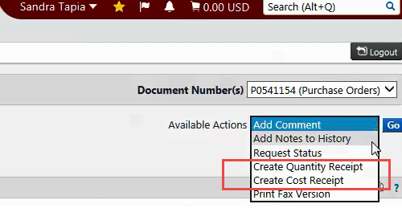
Purchase Order – (P0)
Receipt should be created as soon as items are received (Quantity Receipt) or services have been rendered (Cost Receipt).
Select the type of receipt that you need to create under the “Available Actions”, fill out information only for those items (or services) that were received
Once all the information has been entered, click on “complete”.

Slide 20
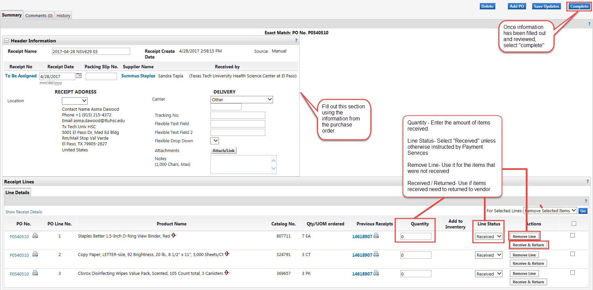
Purchase Order – (P0)

Slide 21
Purchase Orders – P0/Encumbrance Change Request
When do you request a PO/Encumbrance Change Request?
- If an encumbrance has been paid in full and has a zero balance, request to close PO.
- If an encumbrance has an outstanding balance and all items have been received, invoiced and paid, submit a change request to release funds.
- If the amount due has changed due to a change of price, number of units needed, item availability, etc., submit a change request to reflect changes on the outstanding amount of the encumbrance.

Slide 22
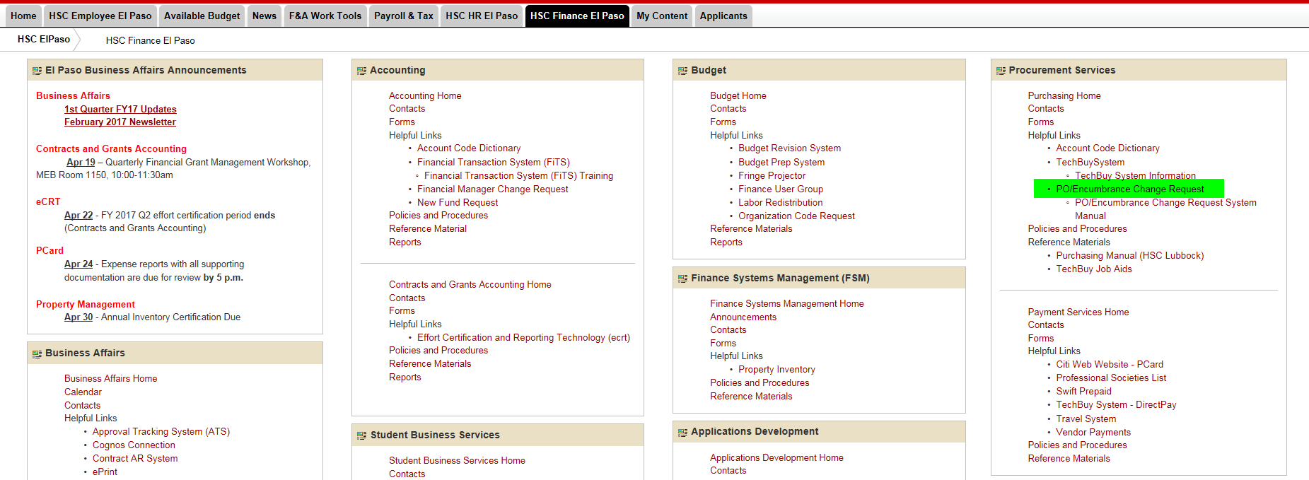
Encumbrance Change Request
System can be accessed from the WebRaider Portal → HSC El Paso Finance → Procurement Services
Contact Purchasing for further instructions on completing a PO/Encumbrance Change Request – PurchasingElp@ttuhsc.edu

Slide 23
Encumbrances- Education & General (state) Funds
Encumbrances on E&G (state) only roll one year. These encumbrances should be expended by the second year otherwise the encumbrances will systematically be closed.
E&G Encumbrances that rolled from FY16 to FY17 will not roll to FY18. If there is a legitimate business need to re-establish or keep an encumbrance open, contact purchasing as early as possible.

Slide 24
Encumbrances- Education & General (state) Funds
The encumbrance roll process also rolls associated budget to the next year to cover the encumbrance. The budget for the E&G Funds can only be used for the associated encumbrance.
When prior fiscal year encumbrances are released/closed the associated budgets will also be reversed and the funding will not be made available.

Slide 25
Encumbrance Review – Cognos Report
Public Folders > HSC El Paso Finance > Encumbrances, Invoices, and Checks > Open Encumbrances by FinMgr Fund & Orgn
Filters:
- Fund, Org, Account Code
- Department
- Vendor
- Encumbrance Type
Useful Information:
- Transaction Date
- Fund Manager
- Requestor (Name, Phone No., Email)
- Original and Outstanding amount

Slide 26
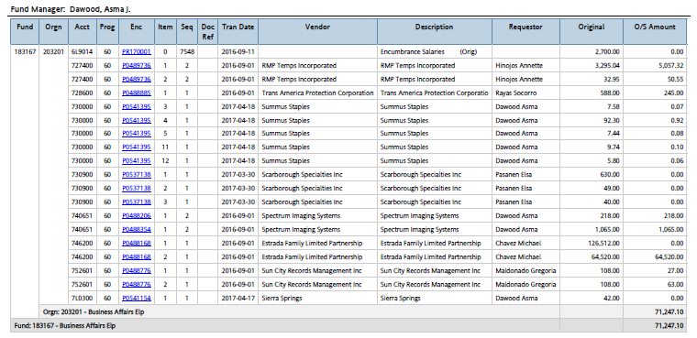
Encumbrance Review – Cognos Report

Slide 27
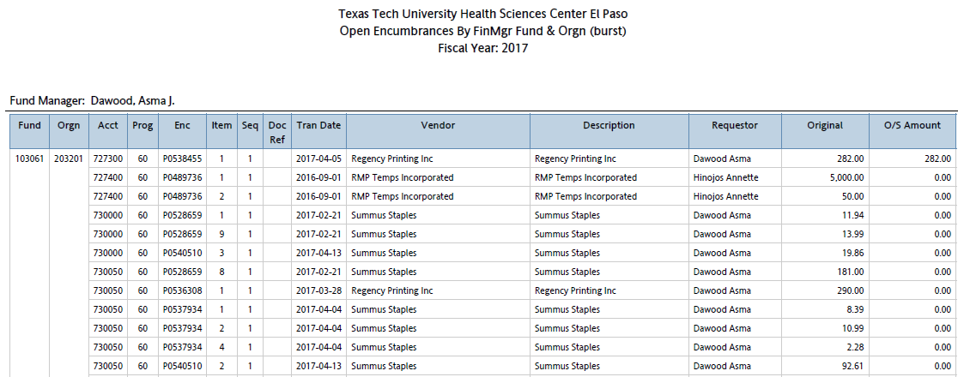
Encumbrance Review – Quarterly Report
Fund managers will receive a report on a quarterly basis listing all open encumbrances, please review and determine if all encumbrances are still valid or if they need to be adjusted/closed.

Slide 28
Year-End Deadlines
Per HSCEP OP 50.30 Year End Close Processes and Deadlines…
“Encumbrances – Requests for release, increases or decreases to any encumbrances must be received by Purchasing no later than the last business day prior to FYE, and should be submitted as early as possible to allow for processing by FYE. Requests after that date must first be submitted to the appropriate accountant in Accounting Services.”

Slide 29
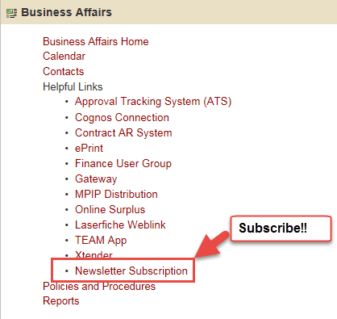
Year-End Deadlines
Year-End deadlines will be uploaded to our website and emailed to our newsletter subscribers.

Slide 30
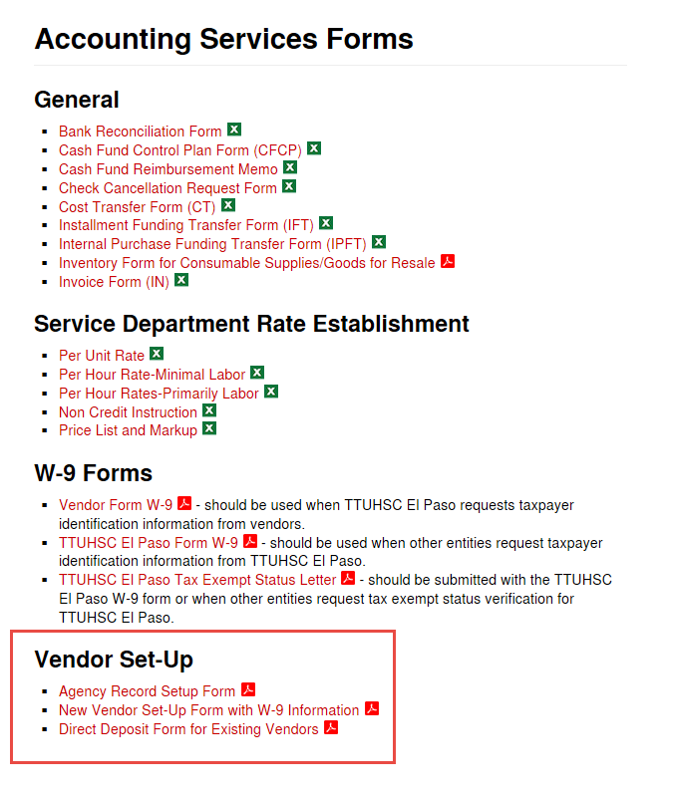
Vendor Team – El Paso
The vendor team recently transitioned to El Paso.
For vendor related questions please contact: vendorteamelp@ttuhsc.edu.
Forms will be available under: http://elpaso.ttuhsc.edu/fiscal/businessaffairs/accounting/forms.aspx

Slide 31


Slide 32
Purchasing
Quarterly Update

Slide 33
Purchasing Agenda
Encumbrance Change Request System
  Upcoming Enhancements
Coming Soon
  Year End Calendar
  Non-Compliant Report
Question & Answer Period

Slide 34
PO and Encumbrance Change
Request System
Information retrieved from the application is as of the close of the prior business day.

Slide 35
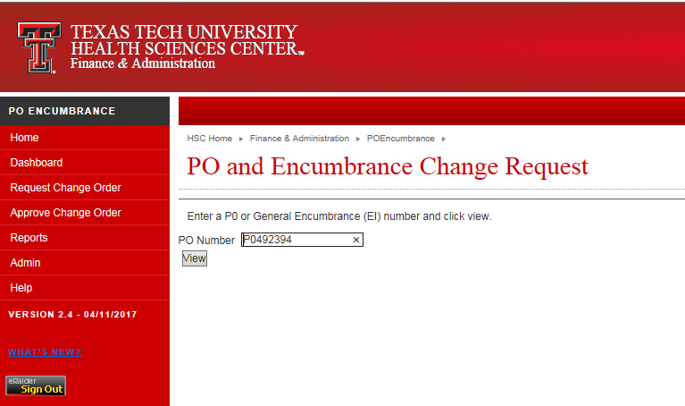
PO and Encumbrance Change
Request System

Slide 36
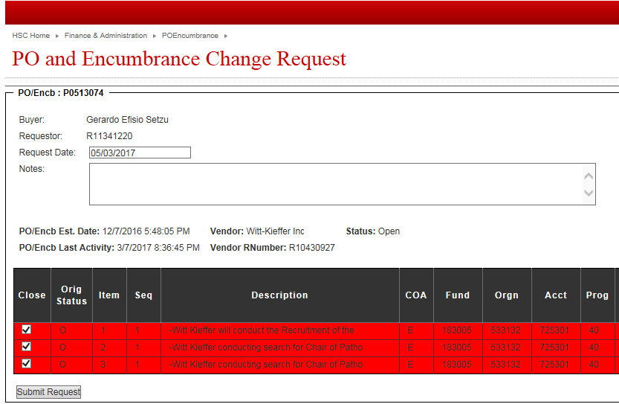
PO and Encumbrance Change
Request System
The application automatically defaults to “Close Status”
  If closing make sure all items have been fully paid
  Unselect check mark to request adjustments

Slide 37
PO and Encumbrance Change
Request System
Request Change Order Header Update
  Original PO Amount
  Change Order Adjustments
  Revised PO Total*
  Liquidations
  Outstanding Encumbrance Amount
  New Proposed Amount

Slide 38
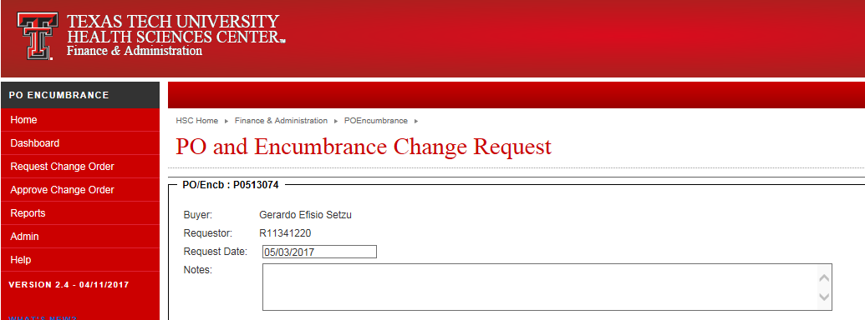
PO and Encumbrance Change
Request System
The Note Section will now allow up to 500 characters to be inputted

Slide 39
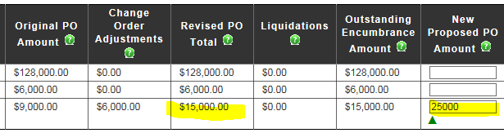
PO and Encumbrance Change
Request System
The green question mark icon will work as a tip and provide a brief explanation of what the column is referencing
Revised PO Total is a new column
  Original PO +/- Any Change Order Adjustments

Slide 40
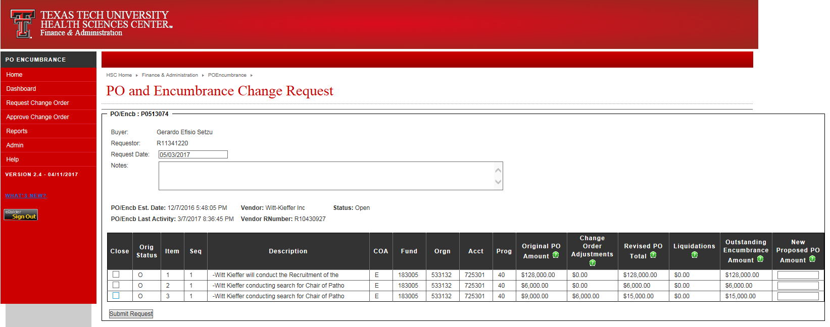
PO and Encumbrance Change
Request System

Slide 41
Year End
Review encumbrances
The IS System Office generates automatic PO closures as the fiscal year end approaches.
  PO’s below the amount of $25 may close automatically, if you have standing PO’s that should remain open increase the encumbrance on the PO.
Orders using FY 2017 funding requiring a Bid or RFP to be performed by Purchasing must be submitted to Purchasing by 5/26/2017 to ensure completion by year end.
  Detailed Year-End Calendar will be out soon.

Slide 42
New Non-Compliant Report Coming
A new Cognos Burst Report has been created to identify Non-Compliant POs.
  A non-compliant PO is when the service or good has been received prior to a purchase order being submitted and approved.
This report will be burst out monthly to fund managers and reported to management.

Slide 43
Payment Services
Quarterly Update

Slide 44
Agenda
Accounts Payable
  Receipts
  Invoices
  Policy Updates
  Late Interest Burst Report
Travel
-Policy Updates
-Mileage vs. Rental Car Reimbursement
• Question & Answer Period

Slide 45
AP Receiving/Invoices
Operating Policy 72.10 Invoice Processing and the Prompt Payment Law
  Enter receiving information in TechBuy within 3 days after the good/services are received/completed. Receipt date should be the actual date goods/services were received /completed.
  Invoices received directly from the vendor must be date stamped on the day the invoice is received.
    Applying incorrect receiving date to avoid a late payment penalty is considered falsifying
Forward all invoices via inter-office mail to AP or email to accountspayableelp@ttuhsc.edu
  If you receive an invoice from the vendor by email, forward the original email from the vendor or print the invoice and date stamp
    The date the email is received is used to begin calculating the Net 30 days
  If you receive an invoice by postal mail, date stamp the invoice
    The date the invoice is received is used to begin calculating the Net 30 days
  If an invoice does not include the date stamp or the original email is not included, AP uses the date on the invoice to calculate the Net 30

Slide 46
Invoices
Quick Tip: 2 types of receipts
  Cost receipt is for Services
  Quantity receipt is for Items/Goods
In the notes section under the receipt, identify what invoice number the receipt is for.
Do not wait for an invoice to be received or a request from AP for receiving information. If the item or service has been received, a receipt should be created in TechBuy.
Invoices must be reviewed for accuracy before they are attached to the Comments of the PO and sent to AP for processing.
Ensure there is enough funding in the purchase order for the payment before submitting the invoice for processing.
Receiving in TechBuy does not trigger payment. The invoice will still need to be sent to our office for processing.

Slide 47
New Late Interest Burst Report
A new Cognos Burst Report has been created to identify funds that have incurred late interest on the purchases of goods or services.
This report will be burst out monthly to fund managers.
Prompt Pay Law
State law requires payments to be scheduled in accordance with Texas Government Code, Chapter 2251, which outlines the procedures for the payment of goods and services and the procedure for calculating and paying interest on late payments. A payment is considered late on the 31st day after the later of (1) the date of the receipt of the goods or the performance of service is complete, or (2) the date of receipt of the invoice.

Slide 48
Policy Updates
HSCEP OP 72.10 Invoice Processing and the Prompt Payment Law, has been updated to ensure invoices are submitted to our AP office with sufficient time to be able to process. The major changes in policy are:
Section 3. Prompt Pay Law
A. It is the responsibility of the department to submit invoices to Accounts Payable in a timely manner in order to avoid late interest charges. Departments should forward all invoices to Accounts Payable as soon as possible, but they must be submitted within at least 14 days of receipt of goods and services. All invoices received from departments are processed in the same workflow as invoices that are sent directly to Accounts Payable from the vendor.

Slide 49
Travel Policy Updates
HSCEP OP 79.06 Reimbursement of Travel Expenses, has been updated to ensure the University is using the most cost effective methods as we have an obligation to show that we are responsible stewards of all funding, regardless of the source. The major changes in policy are:
Section 2. Responsibility of the Traveler
The traveler should ensure that each travel arrangement is the most cost-effective considering all relevant circumstances.
Section 4. Meals and Lodging, c. Prohibited Reimbursements
Meals or lodging expenses deemed lavish or extravagant by the department.
Section 5. Transportation, b. Mileage Incurred with Personal Vehicle
For travel greater than 100 miles to a location, a department must reduce the reimbursement for use of personal vehicles to the lessor of (1) the standard rate times miles traveled, or (2) the rental of an automobile, plus an allowance for gas. The Mileage Calculator worksheet must be completed and attached to the supporting documentation.
Section 5. Transportation, f. Parking and Tolls
Airport parking reimbursements at rates other than the long-term parking rate charged at El Paso International Airport should include a statement on the voucher as to why the travel arrangement was the most effective, considering all relevant circumstances.

Slide 50
El Paso Airport Parking Rates
PARKING OPTIONS AT EL PASO INTERNATIONAL AIRPORT
The Short-term Parking Lot: | first 10 mins free; first & each add'l hr $1, up to daily max $15.
The Long-term Parking Lot | first 10 mins free; first & each add'l hr $1, up to daily max $5. (no weekly rate).
Premium reserved parking | first 10 mins free, first and each add'l hr $1, up tdaily max $20/day.
Valet Parking (Fastspot) | $7.95 Daily: Covered Self Park $7.95 Daily: Covered Valet $38.92 Weekly: Covered Self Park $38.92 Weekly: Covered Valet

Slide 51
Student Business Services
Quarterly Update

Slide 52
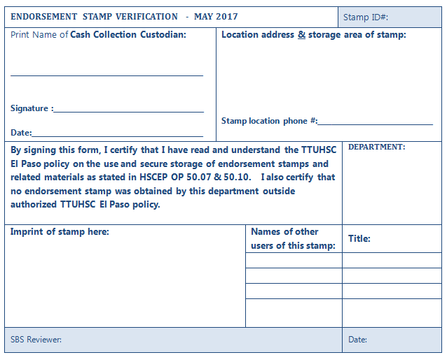
Annual Endorsement Stamp Verification - Due to Student Business Services by 5/31/17

Slide 53
Annual Endorsement Stamp Verification - Due to Student Business Services by 5/31/17
Complete one form per endorsement stamp
Provide the name of the cash collection custodian
Provide the location where the endorsement stamp is located/stored
Provide the department name
Provide the name of the users who have access to the endorsement stamp
Provide an imprint of the stamp in the area provided on the form
Be sure to sign the form
Completed forms should be sent to Elsa Pasanen via intercampus mail
Review HSCEP OP 50.07 – Cash Collections and 50.10 – Endorsement Stamps and Endorsement of Checks

Slide 54
Departments with a Credit Card Terminal
Credit card terminals must be batched and settled daily.
The batch settlement report must be attached to the cash receipt
The final SBS approver will enter the deposit number on the cash receipt
Accounting Services will no longer provide the deposit amount to the department
Accounting Services will only contact departments at month end if it is determined that a credit card deposit was received and there is no corresponding cash receipt or if there is a discrepancy between the cash receipt and the credit card deposit amount which requires further research
Review HSCEP OP 50.08 for more information

Slide 55
Cash Collection Policies
http://elpaso.ttuhsc.edu/elpaso/opp/
http://elpaso.ttuhsc.edu/fiscal/businessaffairs/studentbusserv/policy.aspx
Portal/HSC Finance El Paso/Policies and Procedures

Slide 56
Departments Receiving Student Fee Revenue
The Global Fee Document review process will begin in June and will be presented for approval by the BOR in December
All new fee or fee increase requests will require justification
More details and instructions will be provided in June

