Slide 2
Budget Office

Slide 3
Budget Office Update
Employee one-time payments (EOPS) Tips
Submit early to ensure timely review and approval by all approvers in the chain.
  Refer to the pay schedule found on the “Payroll & Tax” tab of the employee portal to check semi-monthly (SM) cutoff dates. Monthly (MN) payroll processing generally starts on the last week of each month.
Please follow the EOPS approval routing sheet provided by the Budget Office to avoid resubmissions.
Based on the earn code selected, make sure:
  Funding is available in the appropriate budget account code.
  Budget revisions are submitted when necessary.

Slide 4
Budget Office Update
EOPS Tips
Use the table below to find the appropriate budget account codes.
Earn Code | Description | Budget Account Code
ADC | Additional Compensation | 6008
AWD | Award | 6008
CLO | Clothing Allowance | 6008
FOC | Faculty On-call Pay | 6009
LSP | Lump Sum Payment | 6008
MOV | Taxable Moving Expense | 6008
MSC | Non Cash Misc Fringe Benefit | 6007
NMV | Non Taxable Moving Expense | 6008
NTP | Non Taxable Tuition Pay | 6008
OTB | Other Taxable Benefit | 6008
SPA | Special Augmentation | 6004
TSP | Temp Worker Sponsored Programs | 6008

Slide 5
Accounting Services

Slide 6
Contract Accounts Receivable (AR)
Accounting Services

Slide 7
Contract AR System
The Contract AR system is available to all users who need to record a receivable related to a revenue contract agreement.
TTUHSC El Paso Accounts Receivable
Refers to money that TTUHSC El Paso has earned by providing goods/services, but has not yet received.
To keep track of receivables, TTUHSC El Paso records the amounts to be received on balance sheet account 130450.

Slide 8
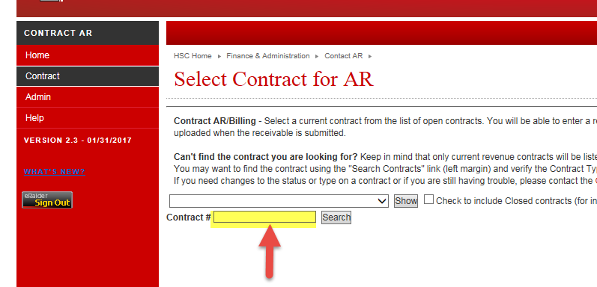
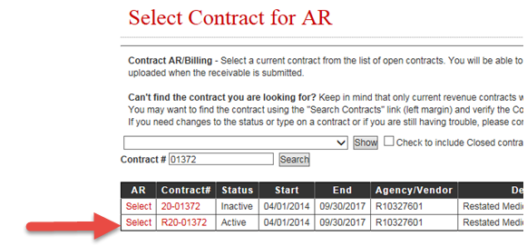
Contract AR System
Enter the contract no. and click “Search.”
Click “Select” in the AR column for the active contract.

Slide 9
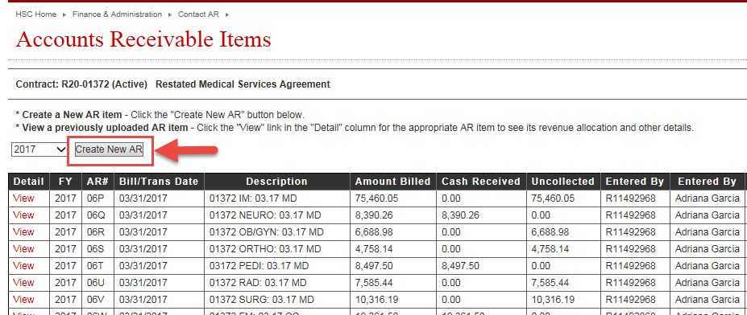
Contract AR System
xxx
xxx
xxx
xxx
xxx
xxx
xxx
xxx
xxx
xxx
xxx
xxx
xxx
xxx
xxx
xxx
xxx
xxx
xxx

Slide 10
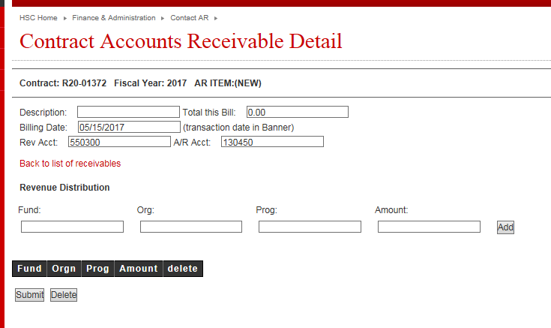
Contract AR System

Slide 11
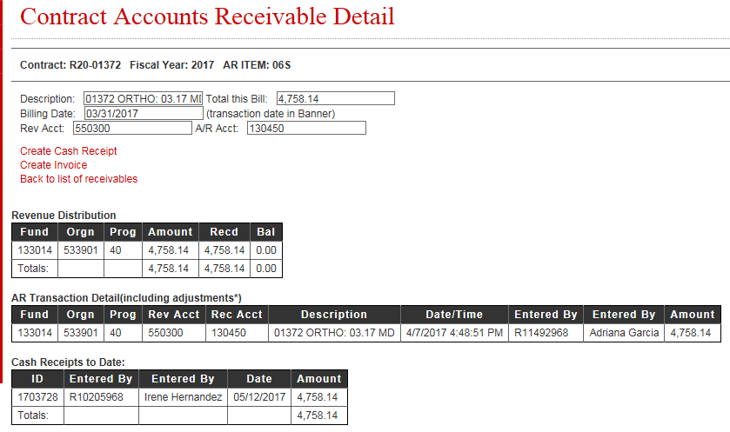
Contract AR System
xxx
xxx
xxx
xxx
xxx
xxx
xxx
xxx

Slide 12
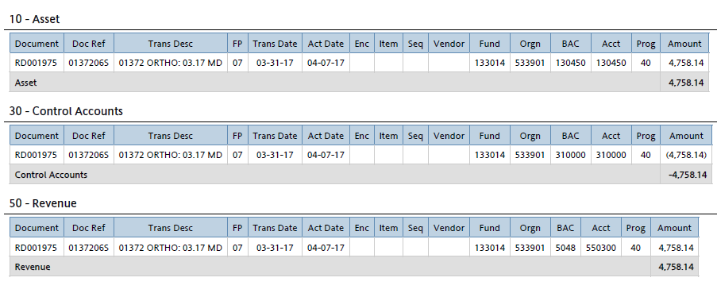
Contract AR System
Transactions created in the Contract AR system are recorded in TTUHSC El Paso ledgers with an RD document.
The document reference number for these transactions includes the following contract/AR information:
- First five digits are the contract number
- Last three digits are the AR
xxx
xxx
xxx
xxx
xxx
xxx

Slide 13
Contract AR System
Receivables should be created after services have been provided and the invoice has been sent to the vendor. Do not wait until your office receives payment to record the receivable.
For adjustments to ARs that have already been created, please contact Accounting Services at accountingelp@ttuhsc.edu.

Slide 14
Procurement Services

Slide 15
Procurement Services
Travel system
Purchase order encumbrance change request system
HSCEP OP 72.16, Official Functions, Business Meetings, and Entertainment
Information Technology purchases

Slide 16
The Travel System Is Going 100% “Paperless”
Beginning in fiscal year 2018, supporting travel documentation to travel and advance travel requests will need to be electronically attached via the Travel System.
Our travel office will no longer accept documentation sent via campus mail. Instead, supporting documents must be electronically filed in the Travel System. Please find detailed instructions regarding this new process below.
Attaching Documents Electronically in the Travel System
Supervisor/Approvers please ensure you are opening and reviewing the supporting documentation.
  Verify that the dates of travel are correct.
  Amounts match
Important: Use a black marker to redact all credit card numbers, bank account numbers, and other personally identifiable information.

Slide 17
PO/Encumbrance Change Request System
Upcoming Changes
  An email notification will be sent to the fund manager whenever a change order has been approved to increase or decrease the original purchase order.
    A link to view a PDF of the request will be provided.

Slide 18
HSCEP OP 72.16, Official Functions, Business Meetings, and Entertainment – Revisions
Pre-approvals
  Expenses for official functions, business meetings, and entertainment that either (a.) aggregate to $300 or more, or (b.) involve no outside guest must be approved by the:
    Department head
    Dean
    Chief financial officer (CFO) and chief operating officer (COO)
  President’s approval is required for events amounting to over $5,000 and whenever the event will have alcohol.
  These changes apply to all fund sources.
  Requests should be submitted at least 30 days prior to the event and in advance of incurring any expense.
  Prior written approval by the dean and both the CFO and COO is required if the total of all costs of the event exceeds 10 percent of the total estimated cost on the pre-approval form.

Slide 19
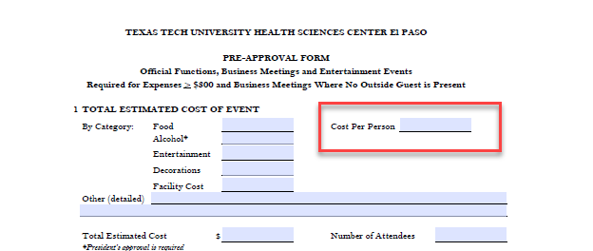
HSCEP OP 72.16, Official Functions, Business Meetings, and Entertainment – Revisions
Pre-approvals
  Revision to the Pre-Approval Form
    Cost Per Person

Slide 20
Official Functions
Retirement Events
  Expenditures for food and beverages are limited to a total cost of $2,500; or $35 per employee; or $70 per employee and spouse/guest.
Limitations
  Expenditures for food and beverages are limited to a total cost of $35 per employee, or $70 per employee and spouse/guest.

Slide 21
Business Meetings
Meals provided for employees at business meetings will not be allowed unless an outside guest (excluding vendors) is present and a clear business purpose can be identified.
  A complete list of attendees, including their titles and departments/companies/institutions, is required.
  Exceptions will require prior written approval by the dean and both the CFO and COO using the pre-approval form.
    Requests must be submitted at least thirty days prior to the meeting and in advance of incurring any expenses.
  Expenditures and reimbursements for alcohol will only be allowed at recruitment events.

Slide 22
Purchasing of Hardware and Software
Contact the IT Help Desk for:
  Software purchases – a third party software approval form will be issued.
  Hardware purchases – IT will issue a quote from the selected vendor, including:
    Standardization of quality, compatibility, and warranties.
For New IT Projects:
  Visit the Project Management Office in IT :
    http://elpaso.ttuhsc.edu/it/campustechnology/pmo/default.aspx

Slide 23
Student Business Services

Slide 24
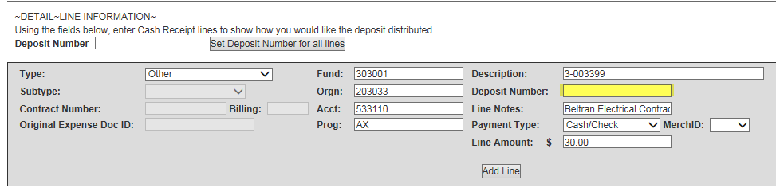
Cash Receipt Do’s and Don’ts
Always leave the deposit field blank on all cash receipts.
Only Student Business Services and the Medical Practice Income Plan (MPIP) Business Office should enter deposit numbers on cash receipts.

Slide 25
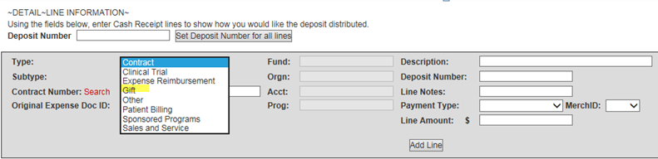
Cash Receipt Do’s and Don’ts
Use “Gift” as the cash receipt type for all gifts and donations.
Do not use “Other” as the cash receipt type for gifts or donations.
The Cash Receipt System will automatically route all “Gift” cash receipts and supporting documentation to the Office of Institutional Advancement (IA).
All cash receipts coded to the miscellaneous income account (570004) are reviewed by Accounting Services.

Slide 26
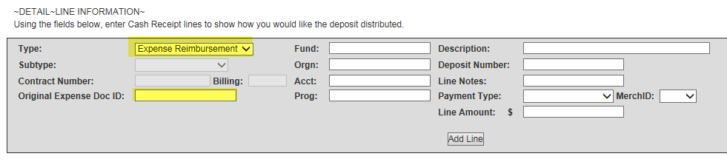
Cash Receipt Do’s and Don’ts
Expense reimbursements are not revenue and should not be processed as “Other” cash receipts.
Expense reimbursements are processed as reductions from the original expenses incurred; therefore, you must reference the original expense document ID.

Slide 27
Cash Receipt Do’s and Don’ts
Notify the mail room at mailroomelp@ttuhsc.edu in advance of sending a check via intercampus mail.
The mail room will work to achieve a timely pick-up and check delivery.
Use the proper mail stop code:
  Central Cashier (CSB) – MSC 51025
  Student Business Services (Val Verde) – 51011
  MPIP Business Office (Pellicano) – 51024

Slide 28
Reminders
Credit card terminals must be batched and settled at the end of each business day.
The batch settlement report must be scanned and attached to the credit card cash receipt.
Only the “Submit” button will submit a cash receipt for either intermediate or final approval.
The “Forward” and “Save” options do not submit a cash receipt for intermediate or final approval.
If a cash receipt is forwarded to you, you must submit it before it can be given intermediate or final approval.

Slide 29
Need Assistance?
Email cashreceiptselp@ttuhsc.edu
or
Call Student Business Services at 915-215-5680
Cash Receipt System training is provided every April and October.
Upcoming training sessions are announced in The Scope.

Slide 30
General Services

Slide 31
General Services
Mail stop codes
Viewing surplus items
Tracking packages

Slide 32

Mail Stop Codes

Slide 33
Viewing Surplus Items
Public surplus website
  http://publicsurplus.com/sms/ttuhscelpaso,tx/browse/home
In-person
  Schedule an appointment by emailing surpluselp@ttuhsc.edu.
  Hours: Fridays from 9 a.m. – 11:30 a.m.

Slide 34
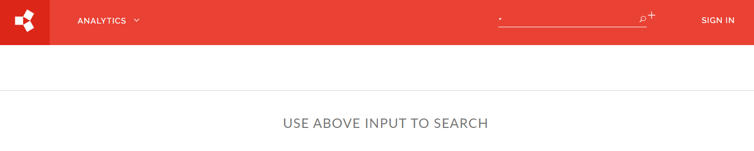
Tracking Packages
SCLogic package tracking
  http://elpwebship/IntraOmni/Mailroom

Slide 35
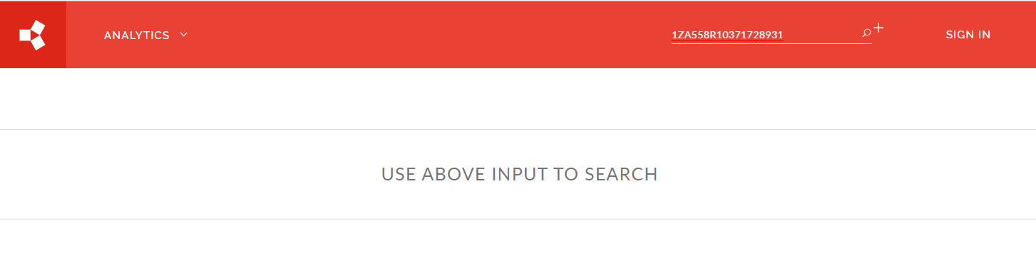
Tracking Packages
Input carrier tracking number

Slide 36
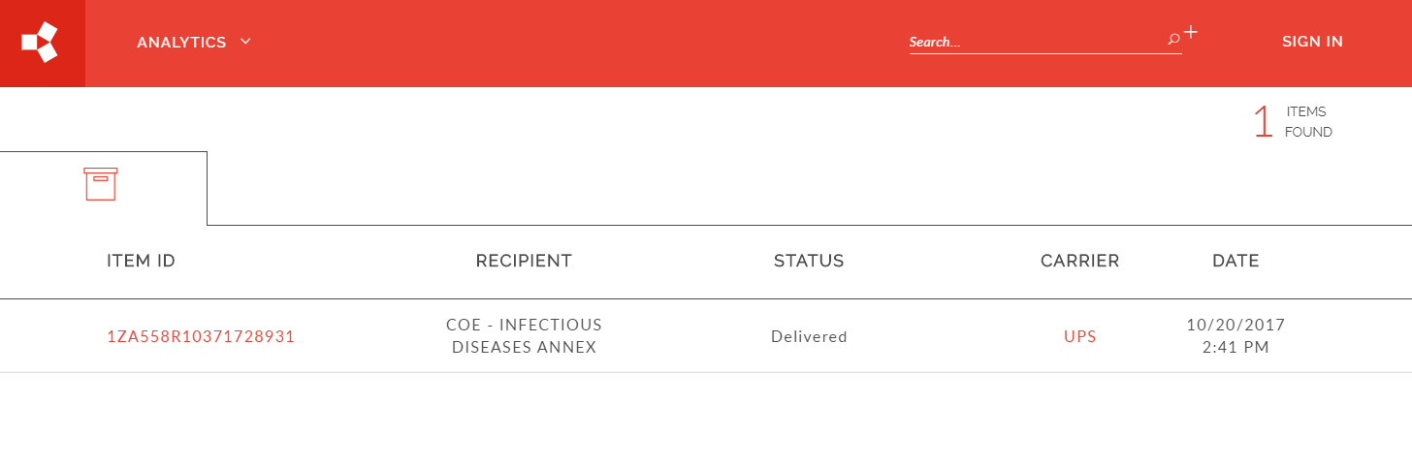
Tracking Packages
Select the hyperlink for additional information

Slide 37
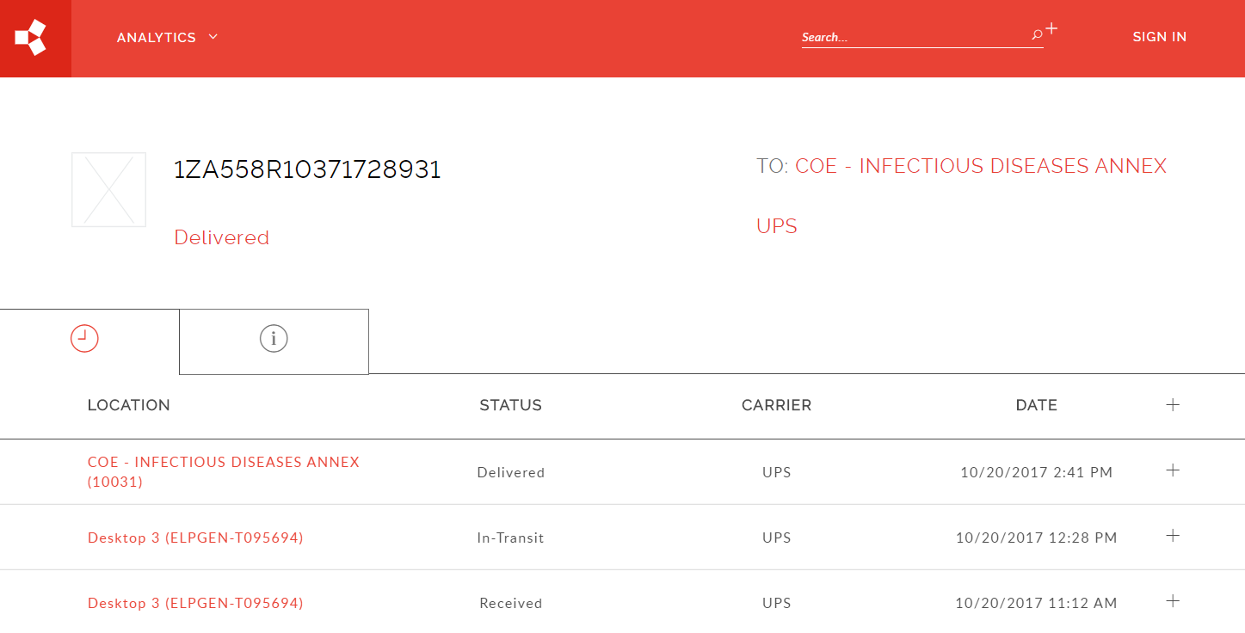
Tracking Packages
Select the + sign to drill down into each status

Slide 38
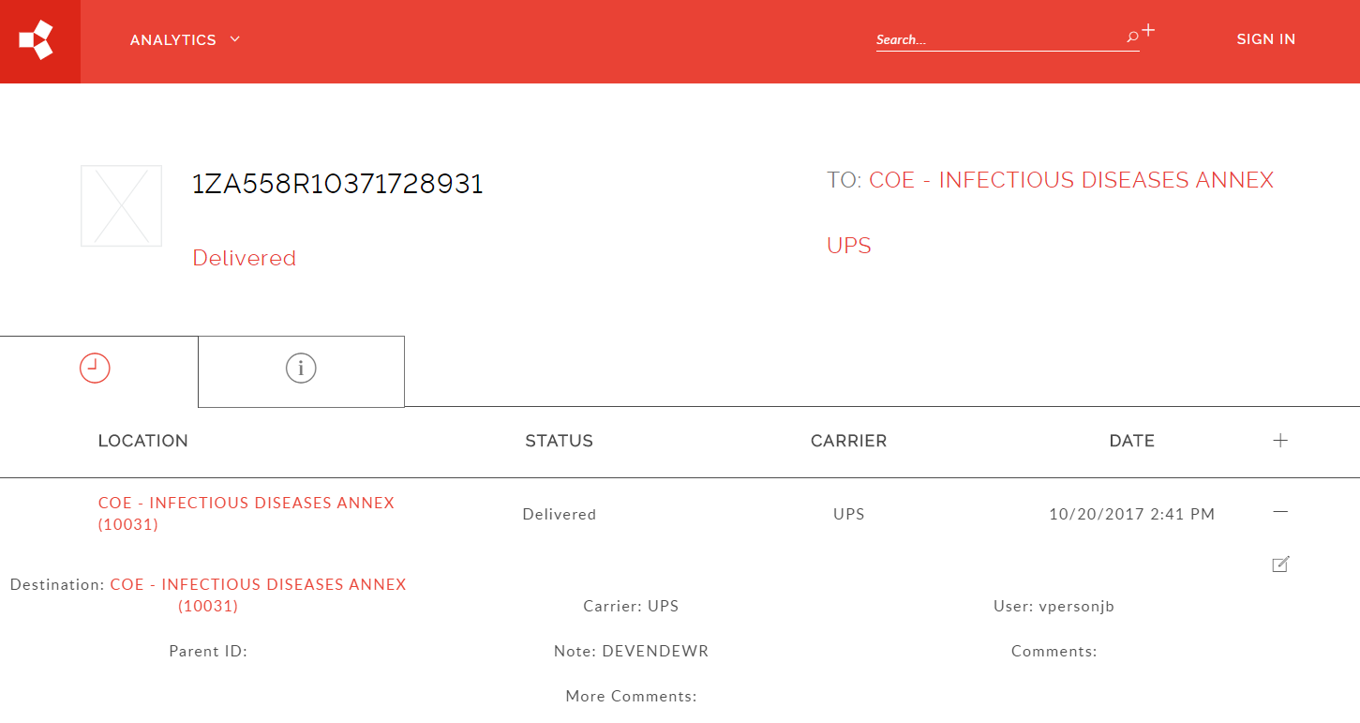
Tracking Packages

Slide 39


