Slide 2
Budget Office
Quarterly Update

Slide 3
Electronic Personnel
Action Form (EPAF)
Verify effective dates.
Be aware of payroll processing deadlines.
Enter comments when resubmitting.
Follow EPAF approval routing queue.
Ensure sufficient budget is available in appropriate account.

Slide 4
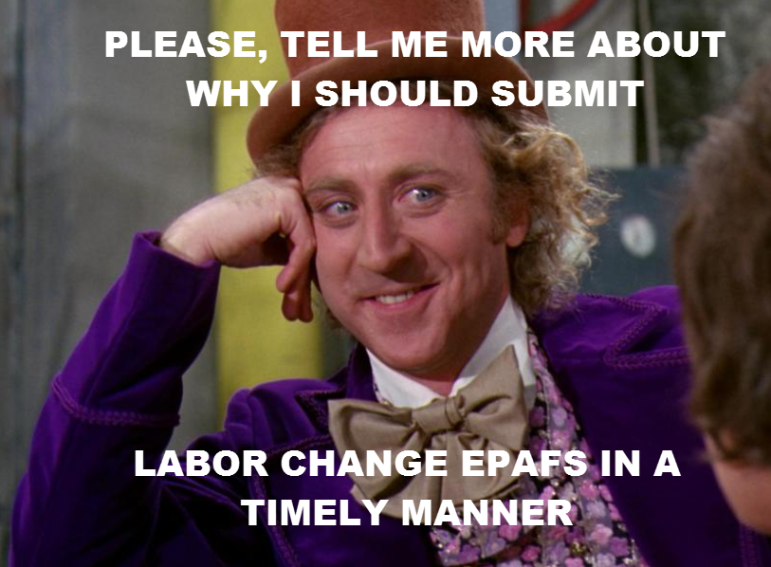

Slide 5
Labor Redistributions (LRD)
Select posting date
  - Should be the date of submission OR
  - Consider future-dating
Grant-related LRDs route to Contracts & Grants Accounting for approval.
Allow time for budget revisions to process before submitting LRDs.
  - Consider associated fringe costs
LRDs should not be in “in process” status for more than 3 days.

Slide 6
Employee One-Time Payments
(EOP)
Attach rejection email when resubmitting previously returned EOPs.
Ensure funding is available in correct BAC per earn code.
  - Consider associated fringe costs
Follow EOP approval routing sheet.
Be cognizant of payroll deadlines.

Slide 7
Thingamajiggy ☺
BAC | Budget Items
6004 | SPA
6005 | Longevity
6006 | Vacant positions, new positions, additional funding for new hires, reclassifications, salary reviews
6007 | Fringes
6008 | ADC, AWD, LSP, MOV, NTP, OTB, OTP
6009 | FOC

Slide 8


Slide 9
Student Business Services
Quarterly Update

Slide 10
Credit Card Processing
Changes are coming soon:
TTUHSC El Paso will transition credit card payment processing from Global Payment Services to Bank of America.
The transition is expected to be completed in early 2019.
Departments with credit card terminals may require a new terminal.
All departments that accept credit card payments will be issued a new merchant ID.
Clinical departments solely using Phreesia will not be impacted.

Slide 11
Credit Card Processing
Changes are coming soon:
Touchnet will be disabled for approximately 4 hours during the conversion process.
Once the conversion to Bank of America is completed, you will no longer be able to perform credit transactions through the previous processor.

Slide 12
Credit Card Processing
What remains the same:
Credit card terminals must be batched and settled daily.
Credit card payment transactions must be cash receipted daily.
  - Be sure to select the correct merchant ID from the drop-down list.
The daily settlement report must be attached to the cash receipt.
It is the department’s responsibility to reconcile all credit card payments back to the general ledger to ensure that all credit card payments processed through a terminal or through TouchNet are reflected as revenue.

Slide 13
Credit Card Processing
Credit Card Refunds:
Each department is responsible for processing credit card refunds, whether online or through a terminal.
It is the department’s responsibility to confirm that the original payment transaction was processed prior to issuing a refund.
Credit card refunds originating through a credit card terminal must be cash receipted and all supporting documentation must be attached to the cash receipt.

Slide 14
Contact Student Business Services at sbselp@ttuhsc.edu
Or call 215-5680
For questions regarding cash receipts or the Cash Receipt System, email cashreceiptselp@ttuhsc.edu

Slide 16
Payment Services
Quarterly Update

Slide 17
Travel Services

Slide 18
New: State Travel Agency and State Grant Fund Travel Requirements
The Texas Administrative Code (TAC) Section 20.413 directs the use of a state-issued travel card for all travel expenditures using state grant funds (funds beginning with 22).
Beginning Sept. 1, 2018, all TTUHSC El Paso employees should use the state-issued travel card to purchase travel services when traveling on state grant funds. Travel services for airfare shall be charged to the state-issued travel card. Travel services for lodging, rental vehicles and other necessary travel expense shall be charged to the state-issued travel card, when feasible.

Slide 19
New: State Travel Agency and State Grant Fund Travel Requirements
A TTUHSC El Paso employee who expects to travel on official state business using state grant funds should apply for a state-issued travel card (HSCEP OP 79.11). Instructions outlining the application process can be found on the Payment Services website under Helpful Links-Travel-Application Procedures.
To meet the requirements of TAC Section 20.413, employees who are denied a travel card and traveling on official state business using state grant funds will be instructed to use the state-contracted travel agent National Travel Systems (NTS). The airline ticket will be charged to the Business Travel Account (BTA) (HSCEP OP 79.05).

Slide 20
New: State Travel Agency and State Grant Fund Travel Requirements
If your department will be arranging the travel for a prospective employee or non-employee regardless of the type of funding, the BTA should be used along with the state-contracted travel agent National Travel Systems (NTS).

Slide 21
National Travel Systems (NTS)
Office Hours: Monday through Friday, 8 a.m. – 5 p.m. CST
Service Fee: Domestic Air Reservation $11.79, International Air Reservation $19.99
Dedicated Line for Texas Tech Travel:
  1-800-814-3336 ext. 209
  TTUTravel@nationaltravelsystems.com

Slide 22
Purchasing Card

Slide 23
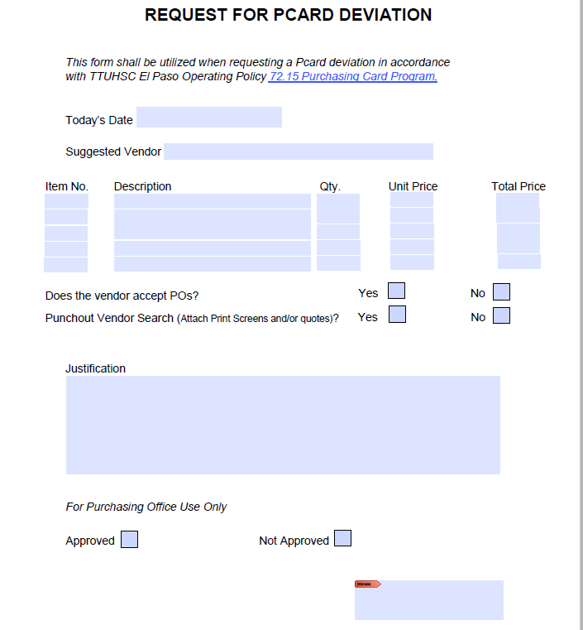
Purchasing Card
What’s New?
Request for Pcard Deviation form effective Jan. 1, 2019.
PurchasingELP@ttuhsc.edu

Slide 24
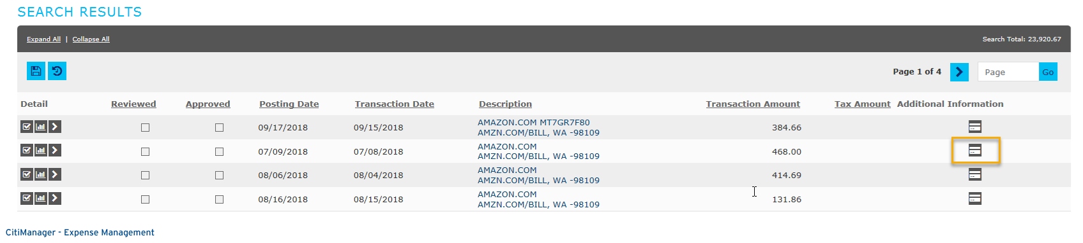
Purchasing Card
Transaction Review Tip:
When reviewing transaction activity within Citi Bank, additional information about the purchase may be available for your review.
Amazon purchases do feed detail information about each item purchased.

Slide 25
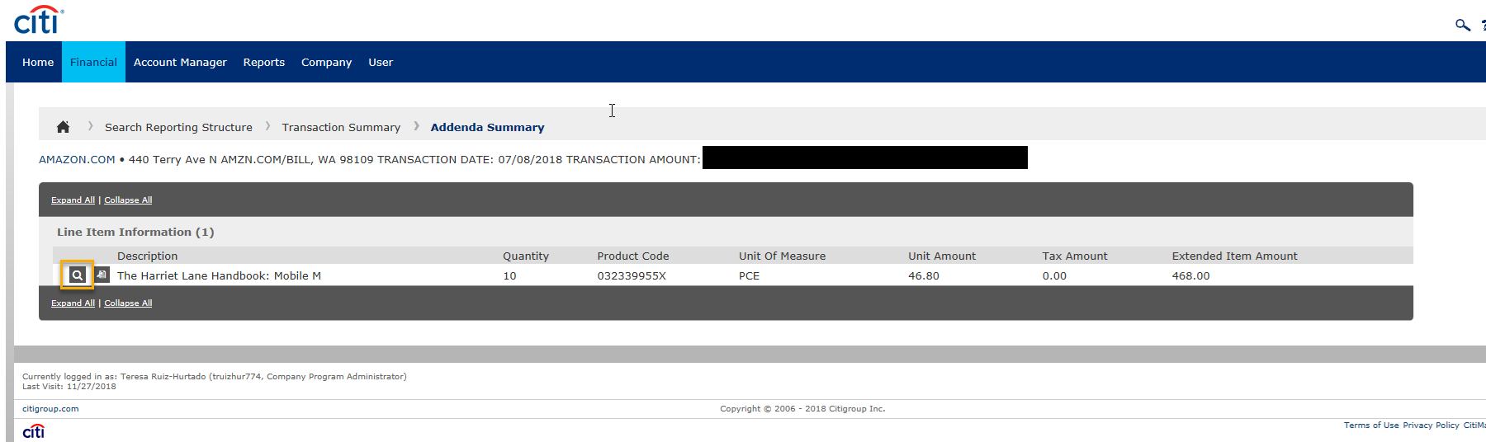
Transaction Review Tip:
Select icons for additional detailed information.

Slide 26
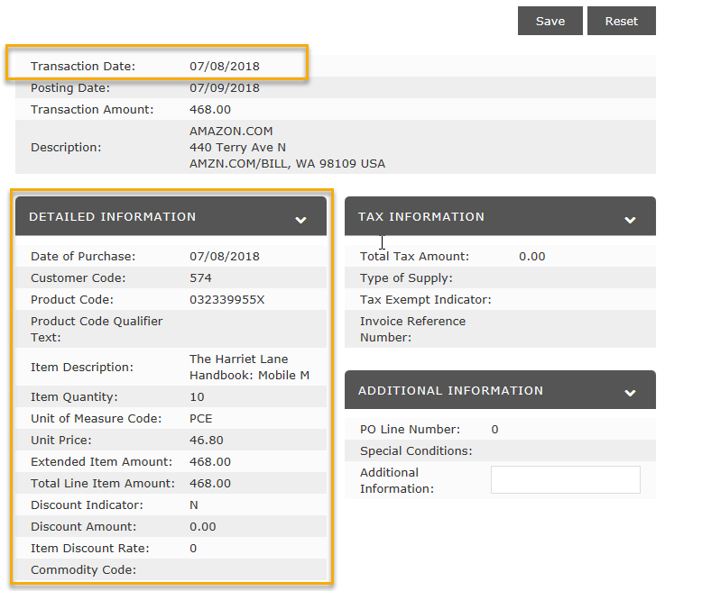
Transaction Review Tip:
Approvers can request this information from their Pcard holders or can contact Payment Services.
Additional information may vary dependent on the vendor.

Slide 27
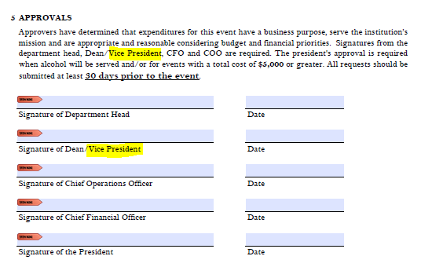
Revision to Pre-Approval Form
What’s New?
For university support departments, the responsible Vice President signature will now be required.

Slide 28
Purchasing

Slide 29
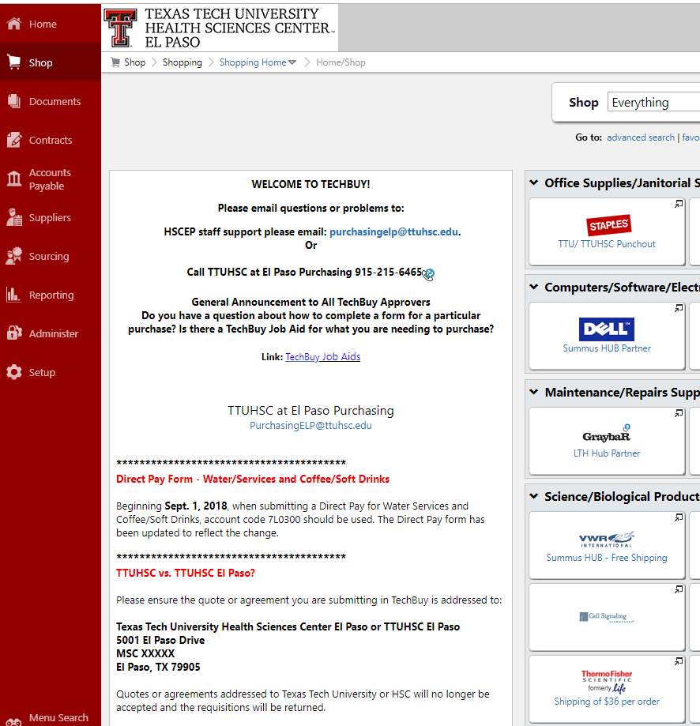
TechBuy Homepage
What’s New?
Please visit the TechBuy Homepage for new Purchasing announcements.

Slide 30
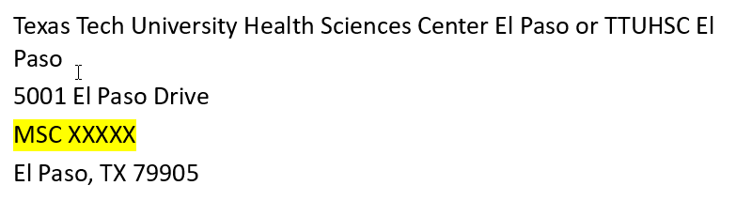
Purchasing Department
TTUHSC vs TTUHSC El Paso
  Please ensure the quote/agreement you are submitting in TechBuy is addressed to:
  Quotes or agreements addressed to Texas Tech University or TTUHSC will no longer be accepted and the requisition will be returned.

Slide 31
Purchasing Department
Recruitment Search Firms
  A total of 17 vendors were awarded a contract.
  The updated list can be found on the Purchasing website under Helpful Links: Search Firms Awarded Contracts.
  Departments should carefully review the contract prior to determining which firm to use. Each contract varies regarding the terms and conditions, particularly relating to payment and retention terms.
  Contact Purchasing if you would like to review the pricing schedule for a particular contract at PurchasingELP@ttuhsc.edu.

Slide 32
New TechBuy Workflow
IT workflow
  The IT department is reviewing all IT-related purchases to ensure compliance and continuity.
    Attach all quotes including the IT Help Desk quote regardless if it is a punch-out purchase.
Prior to submitting new IT software purchase requisitions, please fill out the 3rd party Software Assessment form. (It can be obtained from IT help desk).
For purchases of external hard/flash drives, please contact IT Security to obtain a TTUHSC El Paso User Agreement for Removable Media form at ElPasoITSecurity@ttuhsc.edu

Slide 33
New TechBuy Workflow
Physical Plant Workflow
  Physical Plant will be reviewing all furniture purchases.
    For new furniture purchases, please contact Physical Plant at 915-215-4500 or submit a work order (WO) online. The WO will be reviewed by Engineering Services to ensure compliance with HSCEP OP 61.19 Furniture, Floorcovering, Window Treatments and Wallcovering before submitting your requisition.
Additionally, General Services has office furniture in surplus property that is available to departments. This furniture can be viewed on the Public Surplus website, or in person by appointment. For more information or to schedule an appointment, contact Surplus at 915-215-4401 or email SurplusElp@ttuhsc.edu.

Slide 34
New TechBuy Workflow
Contracts and Grants Accounting workflow
  The C&G Accounting department has begun reviewing requisitions for any capitalized items, promotional items and food and entertainment on grants.

Slide 35
New Bid Limits
Bid Limits: HSCEP OP 72.01 TTUHSC El Paso bid limits will be updated, effective Jan. 1, 2019.
  $0-$15,000 – No Bid Required
    Use vendor of choice, unless otherwise directed by Purchasing.
    Departments are encouraged to use contract vendors, to practice good faith and to award based on best value.
  $15,000.01 - $50,000 – Informal Bid Process
    Three responsive written quotes with a minimum of two certified Historically Underutilized Business (HUB) businesses (minority-owned or female-owned) are required unless the Proprietary Purchase Justification form is attached to the requisition and approved by Purchasing.
    Departments are encouraged to practice good faith and to award based on best value.
  $50,000.01 and Higher – Formal Bid Process
    The formal solicitation process is completed by the Procurement Department.
    Department assistance is required.
    All formal solicitations are posted on the Electronic State Business Daily (ESBD) by Purchasing.

Slide 36
Business Associate Agreement
A written contract or arrangement between a covered entity and a business associate that:
  Permits the covered entity to disclose protected health information (PHI) to the business associate;
  Allows the business associate to create or receive PHI on the covered entity’s behalf; and
  Allows the business associate to create, receive, maintain, or transmit ePHI on the covered entity’s behalf.

Slide 37
Business Associate Agreement
See HSCEP OP 52.13 – HIPAA Business Associate Agreements
  Attachment A – Business Associate Agreement
    Route via Contracting System for signature
  Attachment B – HIPAA/HITECH Business Associate Decision Tree
Contact Contracting Office to confirm if a BAA is on file.
For any questions on the BAA, please contact the Compliance Office.

Slide 39
Contracts and Grants Accounting
Quarterly Update

Slide 40
Sponsored Program Fund Management
Departments are responsible for monitoring all project fund activity throughout the term of the award. Departments should ensure the following:
Budgets are accurate and updated appropriately.
  BRs will be routed to OSP for approval. There are some adjustments which do not require sponsor approval.
Revenues have been received and are recorded according to the grant guidelines. Understand how revenue will be earned/received.
Encumbrances have been established using institutional purchasing guidelines and should be reviewed periodically.
Project costs are managed according to the grant guidelines and must comply with HSCEP OP 65.04. Expenses must relate to the project.
Cost sharing requirements are met and documented.
Effort reporting on the fund is accurate and certified.
Programmatic or progress reports required by the sponsor are completed.

Slide 41
Allowable Activities and Allowable Costs HSCEP OP 65.04
Direct cost vs. Indirect cost
Allowable - A cost or activity is specifically permitted or not specifically prohibited by the terms and conditions of the award and institutional policy.
  Common unallowable costs: advertising cost, alcoholic beverages, entertainment costs, alumni activities, bad debt expenses, fines and penalties.
Allocable - A cost must be distributed in reasonable proportion to the benefits received by the grant being charged.
Reasonable - A cost must reflect what a “prudent person” would pay under similar circumstances. Generally recognized as necessary for the performance of the sponsored project.
Consistent - Treatment of costs within the accounting system should be consistent.

Slide 42
Grant Financial Management Tips
Review transactions on grant FOPs at least once every two weeks and complete cost transfers (audit red flag for CTs over 90 days).
Review payroll reports at least once a month and ensure faculty/staff salary distribution fulfills effort commitments on grant proposals/applications.
- Longevity is considered salary, not fringe benefits.
- Avoid Labor Redistributions
Recalculate salary cap cost share every time there is a salary increase/secondary appointment and be up-to-date on the latest salary cap amount.
- NIH Salary Cap $189,600
- CPRIT Salary Cap $200,000
Review Open Encumbrances periodically.
  - If an encumbrance is valid, it may remain on the grant.
  - If the encumbrance is no longer valid, it should be released and the purchase order closed.
Do not create new purchase orders during the last two weeks of the grant unless essential items are still needed and goods/services will be received on or before the grant end date.
A grant cannot be closed until ALL encumbrances are closed.
Goods must be received prior to grant end date. If received after the end date, you will be asked to move off the grant.

Slide 43
Non-Compliant Purchase Orders
The ordering of products or services prior to the purchase order being issued is considered an obligation without authority and a violation of the Purchasing Operating Policies.
Non-compliant POs are not allowed on grants.
  Expenses stemming from a non-compliant PO on a non-sponsored fund cannot be cost-transferred to a sponsored fund.

Slide 44
LRD = Labor Redistribution
A labor redistribution, also known as LRD, is a type of cost transfer that moves salary and fringe benefit costs from one FOP to another. It allows a change to the salary distribution for past pay periods.
LRDs are sometimes necessary to move salary onto or out of a grant fund for past pay periods, but should be avoided or kept to a minimum by proactively changing the funding source of grant personnel through an ePAF as new grants begin and older grants end.
LRDs do not change an employee’s salary distribution for future pay periods. An ePAF must still be submitted to change the salary distribution for future pay periods.

Slide 45
Travel on Grant Funds: Key Points
Both employees and non-employees traveling on grant funds must follow Travel Operating Policies found in the Payment Services section of the Business Affairs website.
Travel chargeable to a sponsored program must be allowed by the sponsor and must be for the use and benefit of the institution and sponsored project.
Foreign travel must be approved by TTUHSC El Paso’s president per HSCEP OP 79.04.
Charges to grants for lodging and meals should follow U.S. GSA federal per diem limits. Amounts over GSA limits must be charged to a local FOP.
Tips are not allowed on federal and state grants.
Reimbursement of alcohol is not allowed on any funds.
Mileage reimbursement is capped at the state approved rate.
Travel vouchers using a grant fund are reviewed and approved by C&G Accounting.

Slide 46
Useful Cognos Reports
Budget Detail
  Inception to date: HSC El Paso Finance > Grants > Budget Account Code Summary for Grants – Combined Charts E & H
  By period (non MY Funds): HSC El Paso Finance > Finances Relative to Budget > Budget Account Code Summary
Grant Information Query
  HSC El Paso Finance > Grants > Grant Information Query- Awards
Open Encumbrances:
  HSC El Paso Finance > Encumbrances, Invoices, & Checks > Open Encumbrances by Fund and Orgn
Fund Balance
  HSC El Paso Finance > Fund Balance > Statement of Changes in Fund Balances for Excel
Transaction Detail
  Inception to date: El Paso Business Affairs > Contracts and Grants Accounting > Chart E Reports > Operating Transactions - Fund Orgn AT BAC Prog - ITD - Chart E and H
  By Period: HSC El Paso Finance > Transaction Detail > Operating Transactions for Excel for El Paso

Slide 48
Accounting Services
Quarterly Update

Slide 49
HSCEP OP 50.03 Fund Manager Designation and Responsibilities
“Fund managers are responsible for the financial and operational management of their funds. This is a very broad responsibility encompassing all aspects of fund management. These responsibilities include fund oversight, establishment of internal controls at the departmental level, transaction review, and financial responsibility.”

Slide 50
Fund Managers’ responsibilities…
Establish internal controls at the department level
- Segregation of duties, proper review and authorization of
transactions and activities, proper physical control to safeguard and protect TTUHSC El Paso’s assets.
Reconcile ledger transactions to departmental transactions
  - Useful Cognos reports: Operating Transactions for Excel for El Paso
Ensure compliance with fund purposes and/or restrictions
  - Fund managers should ensure compliance with state regulations, institutional policies, fund restrictions, expenditure restrictions,
  grant policies, and donor restrictions.
Be aware of institutional policies concerning fund management
  - Fund managers must be familiar with all TTUHSC El Paso operating policies and procedures in Sections 50, 54, 65, 72 and 79.

Slide 51
Fund Managers’ responsibilities…
Ensure sufficient budget is available
- Cognos report: Budget Account Code (BAC) Summary
Maximize cash flow through timely billing, collection and depositing of revenue
- Ensure maximum earnings and avoid negative cash balances.
Maintain positive fund balances throughout the fiscal year
Cognos report: Statement of Changes in Fund Balance for Excel
Assume responsibility for activities of delegated persons
- Fund managers must ensure delegated persons are properly trained for their roles. Fund managers are responsible for the use of the procurement card, even if signing authority has been given to another user.
Strive to achieve institutional HUB goals.

Slide 52
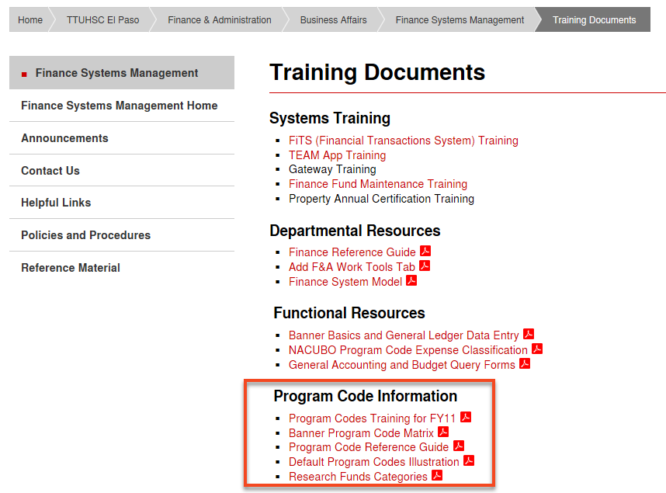
Fund Managers’ responsibilities…
Maintain correct program coding

Slide 53
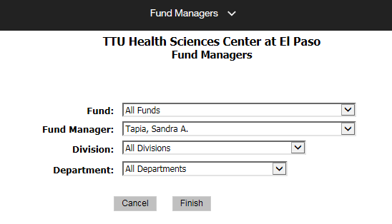
Which funds are my responsibility?
Cognos report “Fund Managers” will display the list of funds assigned to you.
HSC El Paso Finance > Chart of Accounts

Slide 54
Cognos Useful Reports
Budget Account Code (BAC) Summary
Operating Transactions for Excel for El Paso
Statement of Changes in Fund Balance for Excel

Slide 55
Budget Account Code (BAC) Summary
BAC Summary report will assist users in monitoring YTD activity and compare it against current budget.
The report allows users to filter by fund(s), fund manager and/or department.
Users have the option to review all the transactions making up the balances for Current Budget, MTD, YTD, or encumbrances by clicking on the amounts in blue.
The report is available under the path below:
- HSC El Paso Finance > Finances Relative to Budget

Slide 56
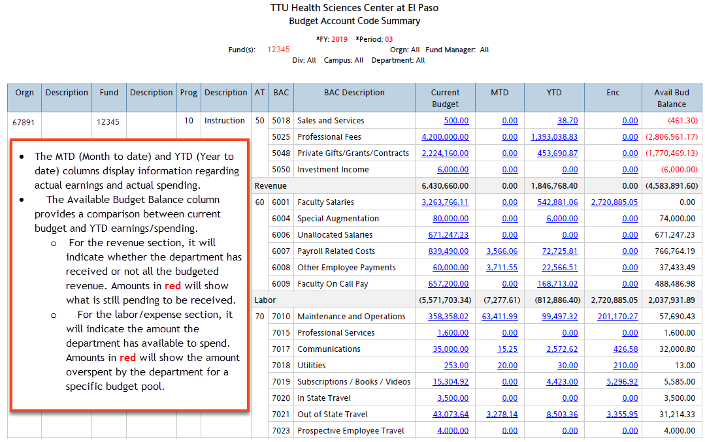

Slide 57
Operating Transactions for Excel
The operating transactions report will display transactions posted to the operating ledger for the following account types:
    50-Revenue
    60-Labor
    70-Expenses
    80-Transfers
The report is helpful for reviewing all transactions posted to your department’s FOAP and should also be utilized to identify transactions that are potentially miscoded.
Besides the FOAP information, the report lists the document number and document reference, document transaction date and description, the encumbrance (if any) associated with the expense, the amount and the vendor name.
The report is available to all users under the Cognos path below:
    HSC El Paso Finance>Transaction Detail

Slide 58
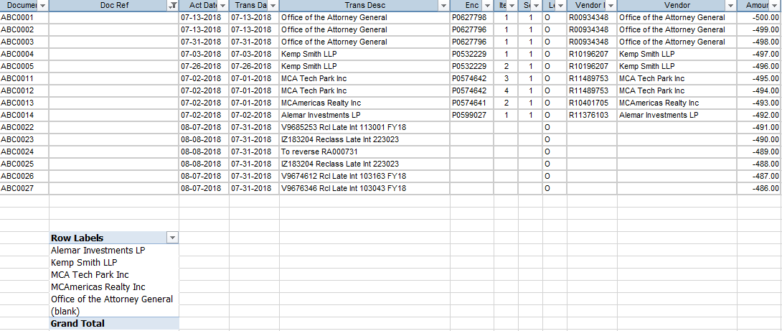
Operating Transactions for Excel
  Use the information available on this report to perform your analysis.
  For example, which vendor are your doing business with? Is the revenue from this vendor properly coded?

Slide 59
Statement of Changes in Fund Balance for Excel
The Statement of Changes in Fund Balance report provides information regarding the cumulative balance of a fund from inception to date as well as operating financial activity throughout the year and an ending balance resulting from the remaining balance after fund’s assets have been used to cover its liabilities.
It allows users to filter by fund, fund manager or department, fund category or fund class.
The report should be helpful to fund managers’ for identifying funds that are operating inefficiently or with a negative fund balance (deficit).
It should also help users determine which funds are no longer needed and submit the request to Accounting Services to terminate the fund.

Slide 60

Statement of Changes in Fund Balance for Excel
The ending balance is a reflection of fund’s beginning balance, +/- year to date activity including operating and non-operating revenues, net expenses and transfers. Before the end of fiscal year, this balance should be positive and enough to cover outstanding encumbrances rolling forward to next fiscal year. Note: The balance reflected under this column will become the beginning balance for the upcoming fiscal year.
Available balance is the ending balance minus encumbrances outstanding.
Fund managers should monitor the ending fund balance for state funds to ensure appropriated funds are fully utilized before the end of the fiscal year.
The report is available to all users under the Cognos path:
- HSC El Paso Finance>Fund Balance

Slide 61
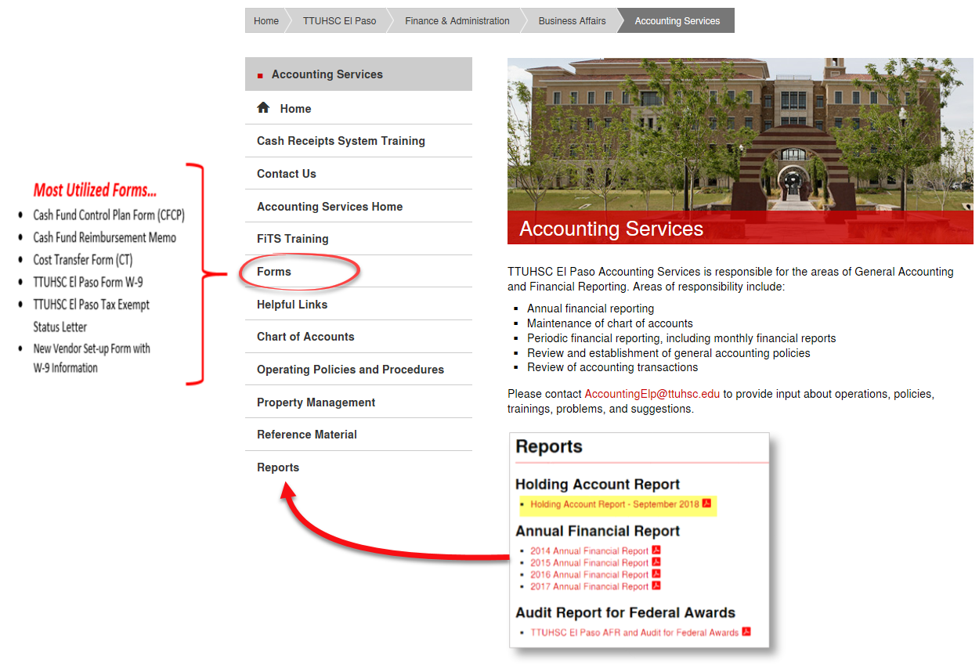
Navigating through our Website…

Slide 63
Finance Systems Management
Quarterly Update

Slide 64
Team App – Auditing Users in TechBuy
Fund Managers, please take some time to review your funds in the TEAM Application and ensure shoppers, requestors, and approvers who are currently assigned to your fund have the appropriate level of access.
You can access Team Application training material in our website via the link below:
http://elpaso.ttuhsc.edu/fiscal/businessaffairs/finsysmgt/TEAM-App.aspx

Slide 65
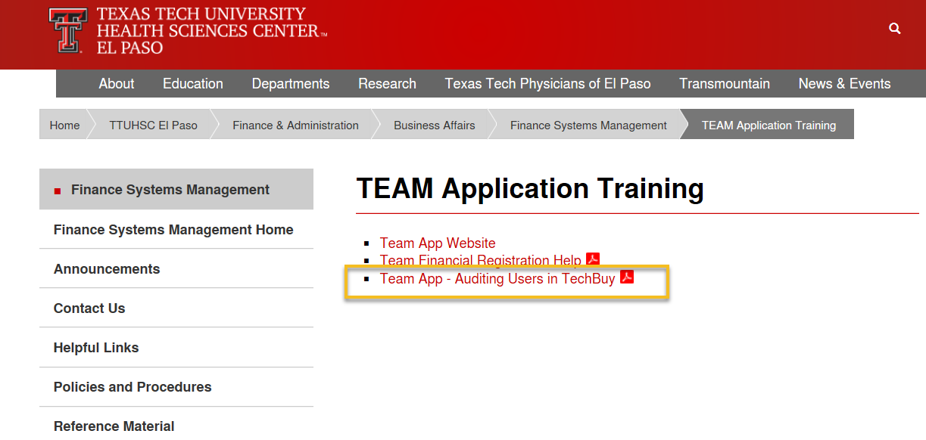
Team App – Auditing Users in TechBuy
If you have any questions, please contact us at FsmElp@ttuhsc.edu.

Slide 66
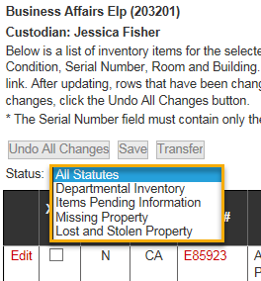
FY19 Property Inventory Reminders
Property custodians are responsible for the
accuracy of their departmental inventory and
should verify their Departmental Inventory
Listing reports.
Property custodian responsibilities:
Inform Property Management of changes in Property Custodian for the department.
Ensure that property tags are affixed to equipment in a timely manner.
Initiate/receive transfers in the Property Inventory System when equipment is moved from one department to another.
Report missing or stolen property to Property Management in a timely manner.
Update building/room location of assets in the Property Inventory System.
Coordinate with Surplus Property Manager for proper removal of equipment that is no longer needed.

Slide 67
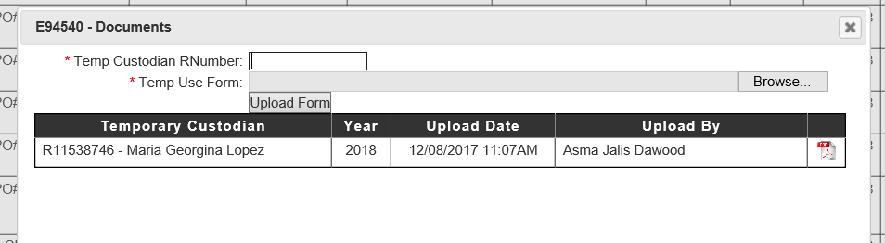
FY19 Property Inventory Reminders
Update serial number of assets in the Property Inventory System.
Make sure all Temporary Use forms have been updated for the current fiscal year (e.g., laptops, tablets, or any property taken outside of campus).
Upload the Temporary Use forms in the Property Inventory System:

Slide 68
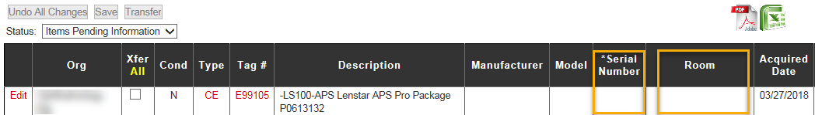
FY19 Property Inventory Reminders
Items Pending Information
Example: Assets with no serial number and/or location
For questions regarding property inventory, email
baelp-asset.accounting@ttuhsc.edu.

Slide 69
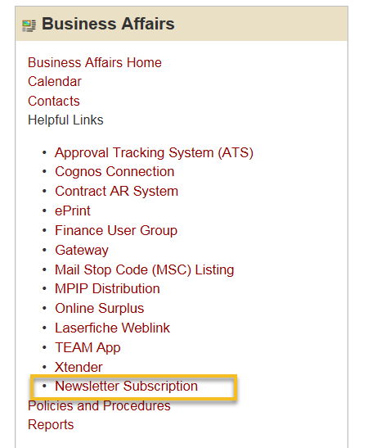
Newsletter Subscription
Sign up!
Provides updates, reminders, and new information about Business Affairs and the services provided by each department.

Slide 71
Thank You for Attending
Presentation will be posted in the portal under the “Business Affairs Announcements” section.

Slide 72
Business Affairs Holiday Event
Business Affairs will be hosting their holiday event on Friday, December 7th and will be closed from 1:30 – 5:00 pm.
Please make any arrangements with each office if necessary.

