Slide 1
Business Affairs
Quarterly Updates

Slide 2
Budget Office
Quarterly Updates

Slide 3
Current Projects:
Enhanced Labor Redistribution System (LRD)
  Moving application to a more uniform platform with upgraded features.
  Position and Salary System (PASS)
  New application that automates the processes for requesting new positions, reclassifications, and salary reviews.

Slide 4
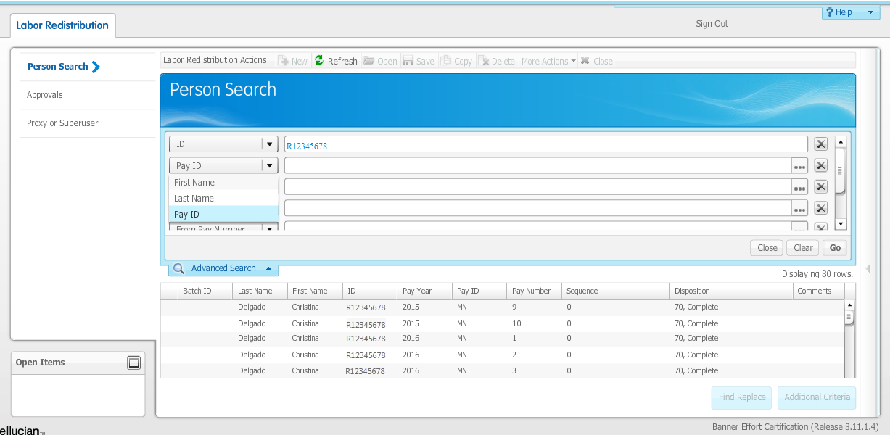

Slide 5
Labor Redistribution (LRD)
Platform will be similar to other finance applications.
Refined search features.
Additional approval routing.
Customized justification/required question section.
Available balance checking.

Slide 6
Position and Salary System (PASS)
Eliminates manual routing/paper forms.
Built-in checks and edits.
Automation/integration to Banner, Salary Planner, Kenexa, and EPM.
Search and tracking of requests accessible to departments.
Centralized housing of HR requests.

Slide 7
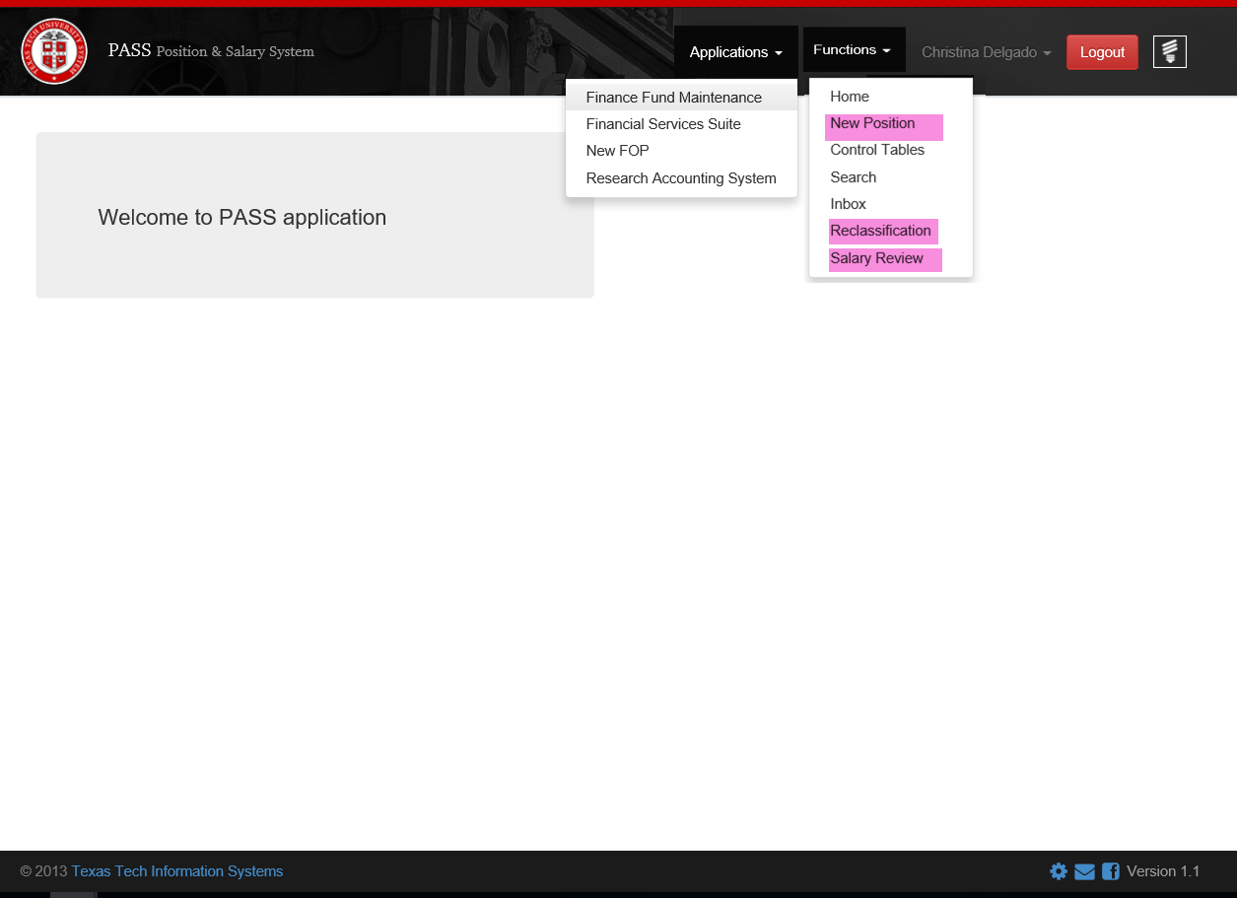
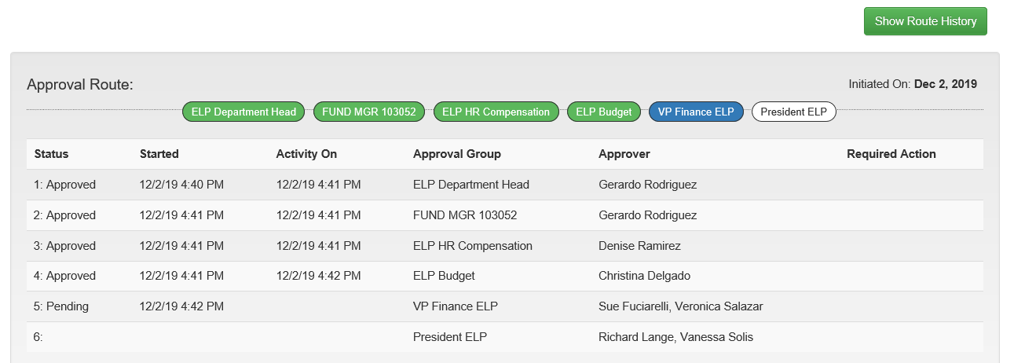

Slide 8


Slide 9
Payment Services
Quarterly Updates

Slide 10

Chrome River

Slide 11
Chrome River
We are in the final stages of the Discovery and Design Phase of the implementation process for Chrome River.
This phase has helped us better understand the needs of our users and how we can better achieve them.
The system is completely configurable which means the end-to-end travel and expense management solution will comply with our operating policies.

Slide 12
Chrome River
We are trying to eliminate paper forms.
Your receipts can be uploaded with your phone camera to eliminate paper.
Chrome River will streamline the approval process.

Slide 13
Reminders
Membership Dues
Use account code 720100
Required documentation
  Completed membership form
  Renewal notice/invoice with the amount due
  Screen print of the organization for the Professional Societies list.
Membership dates must be clearly noted on the forms attached or listed under the product description field of the requisition.
  Pre-paid transactions will be tracked.

Slide 14
Reminders
Vendor Invoices:
Attach vendor invoices through the “Comments” section on the related purchase order.
Add accountspayableelp@ttuhsc.edu as an email recipient.
If the invoice is received via email from the vendor, please forward the email to the Accounts Payable inbox.
DO NOT ADD A COMMENT IN TECHBUY AND SEND A SEPARATE EMAIL TO THE AP INBOX. This creates a potential duplication of payment.
Receipts:
Complete the receipt within 3 days from when goods are received or services provided. Do not wait for Accounts Payable to email you with a request.
Ensure receipts are also created for punch-out orders.
The “receipt date” should be the actual date goods were received or services provided, not the date the receipt is being created.

Slide 15
Travel
If you are mixing business travel with personal days and will be staying extra days, a comparison of flights must be included. Include two itineraries.
-Examples:
-Business travel-Sunday through Tuesday
-Business with personal days-Saturday through Tuesday.
-A comparison of costs will be reviewed, and you will only be reimbursed up to the most cost effective travel dates.
Unused airline tickets should be tracked by the department and should be used on the next business trip.
Car Services
-Use the most cost effective method.
-No black sedans are allowed.
-No XL-Ubers or IL Lyfts, etc.
-Should be used for business purposes only.

Slide 16
Conferences/Trainings
If you have an employee who has registered to attend a training/conference and is unable to attend, every effort should be made to cancel and receive a refund or to find another employee who is able to attend.
Reminder – faculty, residents, and staff may not accept reimbursements for travel, lodging, meals or conference fees for their attendance, only if the individual is presenting his/her own educational material, serving as a panel discussion participant, panel moderator or otherwise actively participates in the conference or meeting (HSCEP OP 52.16 Vendor Interactions)

Slide 17
New Project Purchases
If your department has a new project and will require the institution to purchase a good/service, contact our office for assistance.
The Purchasing team can help you find contracted pricing or identify if an RFP is needed.
If your new purchase requires connectivity to our IT servers, the IT department should also be brought into your project meetings early on.

Slide 18
Event Payments
For event payments, the purchase order must be created with two line items.
Deposit for event.
      Select advance pay to trigger payment.
      Quote or agreement must indicate deposit required.
Remaining balance.
      An invoice must be submitted to Accounts Payable at accountspayableelp@ttuhsc.edu.
      The invoice must be submitted at least 5 business days prior to the check being required.

Slide 20
Accounting Services
Quarterly Updates

Slide 21
Manual Cost Transfers
Manual Cost Transfers are processed to move current fiscal year expenditures between departmental FOAPs (Fund-Organization-Account-Program).
This type of transfer is processed when the original expense is charged under an incorrect account code.
  -For example, a computer keyboard was purchased and expensed under account code 730050 (SM Consumable- office supplies). A manual cost transfer will need to be submitted to move this expense to account code 737700 (OC Computer Equipment Expensed).

Slide 22
Manual Cost Transfers
Cost transfers for a change in fund, org code, program code, or amount should be processed through FiTS.
-Payroll cost transfers are processed through an LRD (Labor Redistribution).
Departments may process cost transfers at any time an error is found or during review of transactions.

Slide 23
HSCEP OP 50.18 Cost Transfers
Timeliness:
  CTs must be requested and processed in the same fiscal year the expenditure was incurred.
  Fund managers should review posted transactions at least on a quarterly basis.
  CTs must be submitted within 90 days after the charge originally posted in the ledger.
  CTs older than 90 days require approval from the Director of Accounting Services.
  CTs received at fiscal year-end must be submitted in accordance with HSCEP OP 50.30.

Slide 24
HSCEP OP 50.18 Cost Transfers
Justification:
  CTs must include a complete/detailed explanation and justification for the transfer.
  Examples of improper justification:
a. Recurring allocations of routine expenses, including procurement card expenses that were not timely allocated before the monthly deadline.
b. Collections of fees for providing goods or services to internal departments.
c. Modifications to revenue classifications.
d. Transfers of revenue or funding.

Slide 25
HSCEP OP 50.18 Cost Transfers
When submitting a cost transfer request, the following criteria must be met:
1) All sections of the cost transfer request form must be completed prior to submission to Accounting Services.
-FOAP, Document ID and description should match information shown on Operating Transaction Cognos report.
-Thorough justification must be provided for each question.
-Approver must be fund manager or approver per TEAM App.
2) A Cognos report showing the original charge and complete FOAP information must be attached to the request.
-Team content > HSC El Paso Finance > Transaction Detail > Operating Transactions
3) Sufficient budget must be available on the fund receiving the charge.
  -Team content > HSC El Paso Finance > Finances Relative to Budget > Budget Account Code Summary
  4) Incomplete cost transfer requests will be rejected by Accounting Services and must be resubmitted through the process defined in HSCEP OP 50.18.

Slide 26
HSCEP OP 50.18 Cost Transfers
CTs do not modify/change purchase orders or encumbrances. If the expenditure being cost transferred resulted as a payment against a PO, the department must review the outstanding balance on the PO to determine if an encumbrance change request needs to be processed for future payments.
CTs for travel expenditures must be submitted separately.
If the CT is related to an expenditure that posted as a result of a charge from an Internal Service Voucher (IVs), the department charged must communicate with the service department of such changes for future IVs.

Slide 27
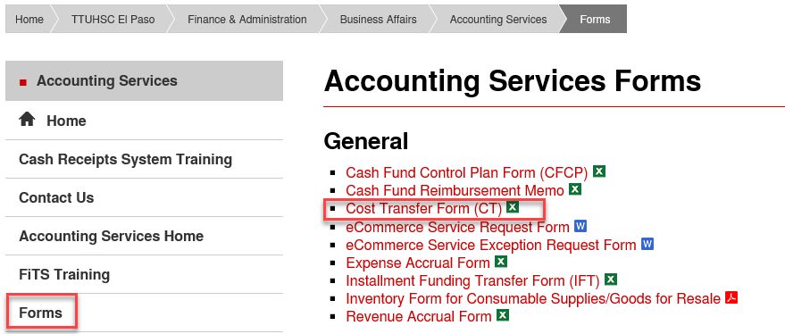
Manual Cost Transfers
The manual cost transfer form can be found in the Accounting Services Home Page under Forms.

Slide 28
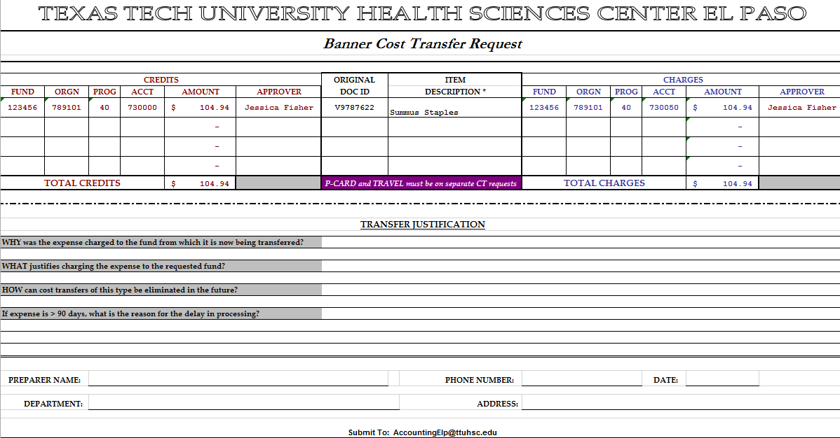
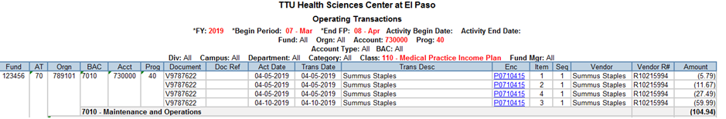
Manual Cost Transfers

Slide 29
Supporting Documentation
Please include a copy of the vendor invoice. If it is a punch out vendor purchase, such as Staples, then a printed copy of the TechBuy invoice should be included. The vendor invoice is required to ensure that the items purchased are charged to the correct account code and that the amounts tie to the CT request.
For Pcard transactions, a copy of the expense report showing that specific charge will be needed, along with a copy of the respective receipts.
For Travel expenditures, documentation pertaining to the travel voucher including copies of the receipts should also be attached.
CT forms should be approved via email or signature on the form by a person listed as an approver in TEAM App.
https://banapps.texastech.edu/team/Report/ProfileReport.aspx
Once all information has been gathered and approved by both fund managers, cost transfer requests should be submitted to accountingelp@ttuhsc.edu.

Slide 30
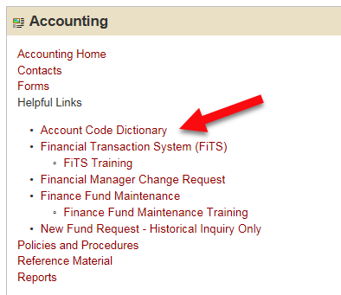
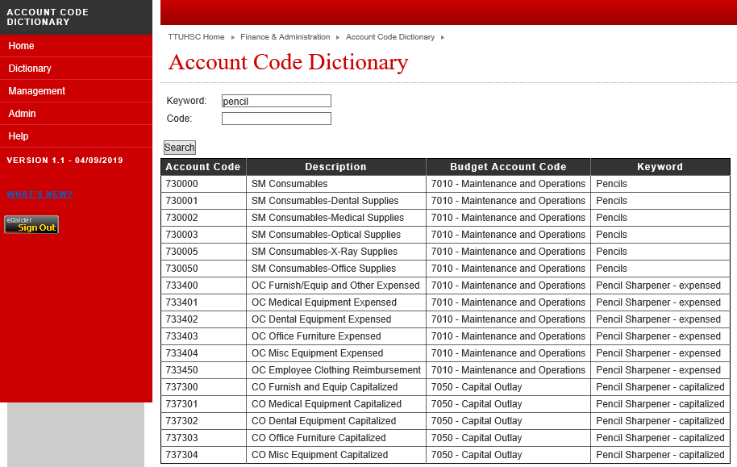
Account Code Dictionary
The Account Code Dictionary allows users to search for the appropriate account code to use by providing keywords or searching by the description of each account code. Users have the option to search either by account code or keyword and the matching results will be displayed.
What’s new?
-“Budget Account Code” column has been added to the search results.

Slide 31
FiTS Enhancements
Improve overall speed of the application for the end user.
Similar format as the New Fund Request module to facilitate ease of use.
Default amount to transaction amount instead of $0.00.
Confirm that there is available budget at all approval levels.
Allow system to check for duplicate transactions.

Slide 32
Announcements
Accounting Services Directory by Fund Type
  -The form is regularly updated to reflect the most recent changes. It is available under the link below:
  http://elpaso.ttuhsc.edu/fiscal/businessaffairs/accounting/_documents/Responsible-Contact-List-by-Fund.pdf

Slide 34
Contracts and Grants Accounting
Quarterly Updates

Slide 35

Have you ever wondered if your award is a gift or a grant?
Grant?
Gift?

Slide 36

What is a gift?
A gift is a voluntary contribution made to the Institution for which the donor receives no direct benefit and requires nothing in exchange beyond a general assurance that the intent of the contribution will be honored.

Slide 37

What is a grant?
A grant is an agreement representing the transfer of money or property from a sponsor in exchange for specific outcomes/services, that either directly benefits the provider or a public purpose and requires some formal financial and/or technical reporting.

Slide 38
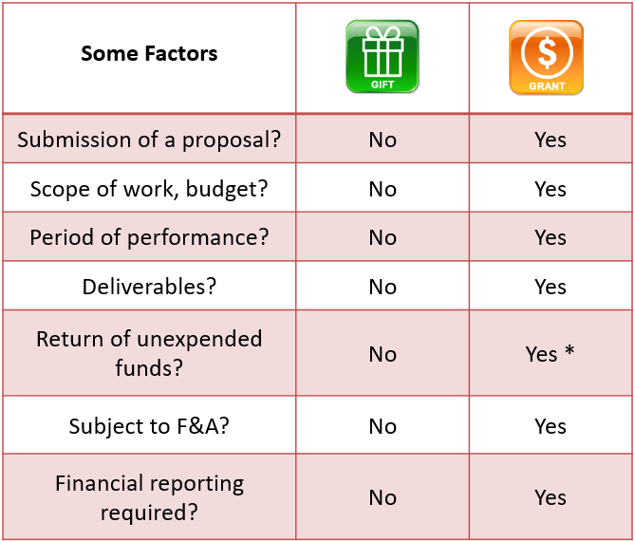

Slide 40
Student Business Services
Quarterly Updates

Slide 41
HSCEP OP 50.07 Cash Collections
Establish rules and guidelines for the handling of cash collections, banknotes, coins, checks, wire transfers.
Each location involved in the regular collection of cash is considered a cash collection point and must appoint a cash collection custodian who is tasked with establishing and maintaining cash handling procedures, safe guarding cash collections and communicating cash handling procedures to supporting staff.
Cash handling procedures must establish guidelines for the handling of cash receipts in person or by mail. The cash collection custodian must regularly review and revise cash handling procedures to accommodate for operational changes.

Slide 42
Specific Guidelines for the Receipt of Cash or Checks in Person or by Mail
Collection of cash or checks in person should be recorded on a point of sale register or terminal when available, and a register receipt provided to the paying customer. If a point-of-sale register or terminal is not available, then pre-numbered receipts (supplied by Accounting Services) should be utilized and a copy of the receipt provided to the paying customer.
Checks received via mail should be recorded on a mail log which will serve as supporting documentation for receipt of payment.
All checks must be immediately endorsed with a restrictive TTUHSC El Paso endorsement stamp. See HSCEP OP 50.10.

Slide 43
Specific Guidelines for the Receipt of Cash or Checks in Person or by Mail
Only one cashier should be allowed access to a cash register or cash drawer during a single shift. If funds are passed from one cashier or custodian to another, transfer of accountability and cash count verification should be documented and signed by both the transferring and receiving cashier or custodian. Two should always be present to witness cash counts.
Cash collected should be counted and reconciled daily by comparing total cash on hand to cash register totals, pre-numbered receipt totals, and mail log totals as applicable. The cash count and reconciliation must be verified by another employee before cash is submitted for deposit.

Slide 44
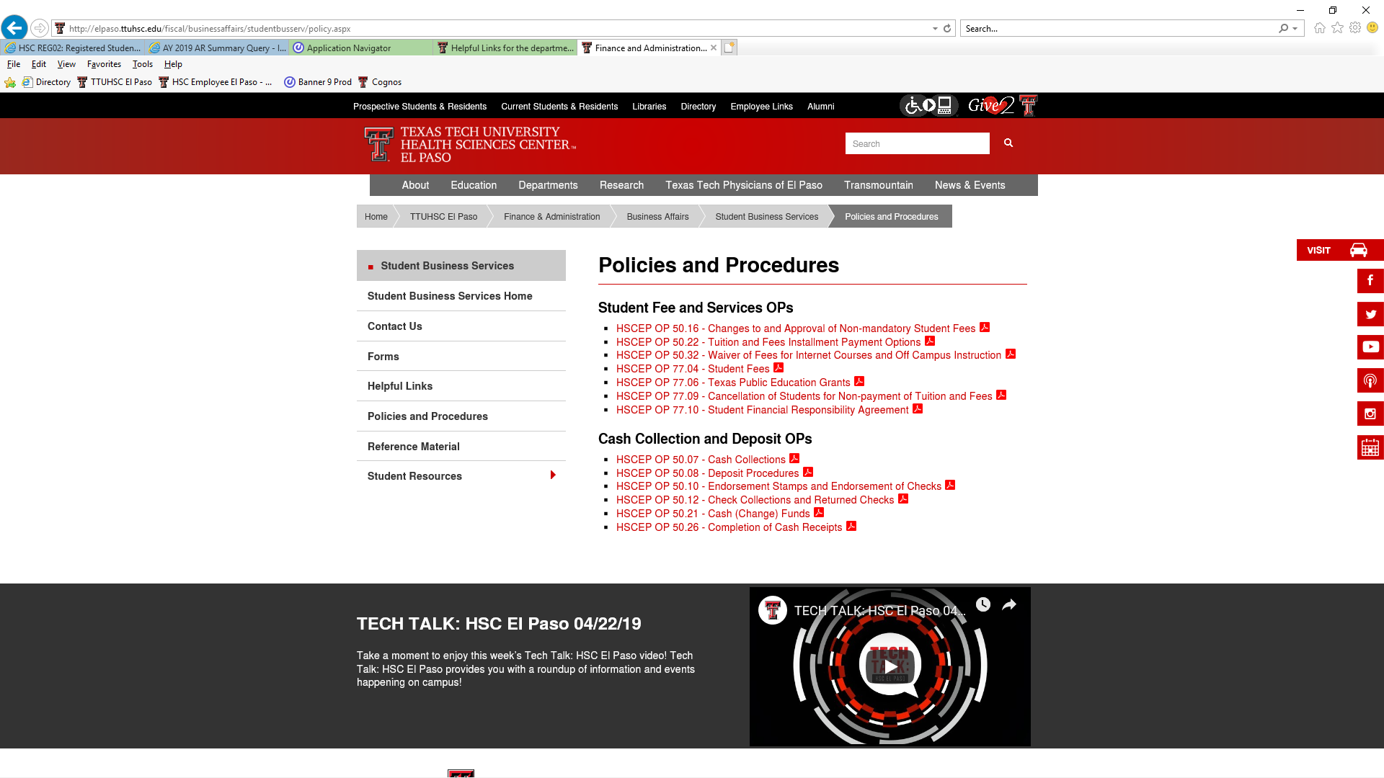
Applicable Operating Policies:
HSCEP OP 50.07 – Cash Collections
HSCEP OP 50.08 – Deposit Procedures
HSCEP OP 50.10 – Endorsement Stamps and Endorsement of Checks
HSCEP OP 50.12 – Check Collections and Returned Checks
HSCEP OP 50.21 – Cash (Change) Funds
HSCEP OP 50.26 – Completion of Cash Receipts
Where to find these operating policies and procedures:

Slide 46
Finance Systems Management
Quarterly Updates

Slide 47
FY20 Property Inventory Reminders
Property custodian responsibilities:
Inform Property Management of changes in Property Custodian for the department.
Ensure that property tags are affixed to equipment in a timely manner.
Initiate/receive transfers in the Property Inventory System when equipment is moved from one department to another.
Report missing or stolen property to Property Management in a timely manner.
Update building/room location of assets in the Property Inventory System.
Coordinate with Surplus Property Manager for proper removal of equipment that is no longer needed.

Slide 48
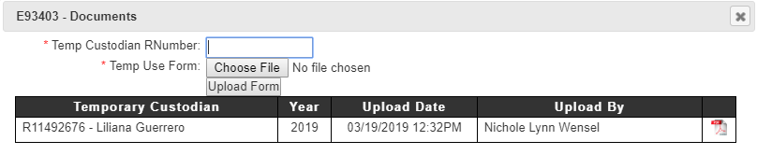
FY20 Property Inventory Reminders
Update serial number of assets in the Property Inventory System.
Make sure all Temporary Use forms have been updated for the current fiscal year (e.g., laptops, tablets, or any property taken outside of campus).
Upload the Temporary Use forms in the Property Inventory System:

Slide 49
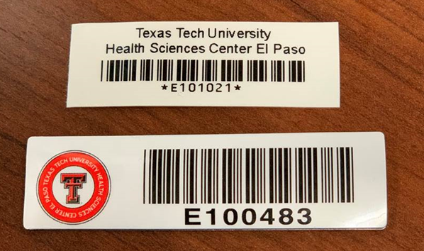
New Property Inventory Tags
New:
Old:
For questions regarding property inventory, email
baelp-asset.accounting@ttuhsc.edu.

Slide 50
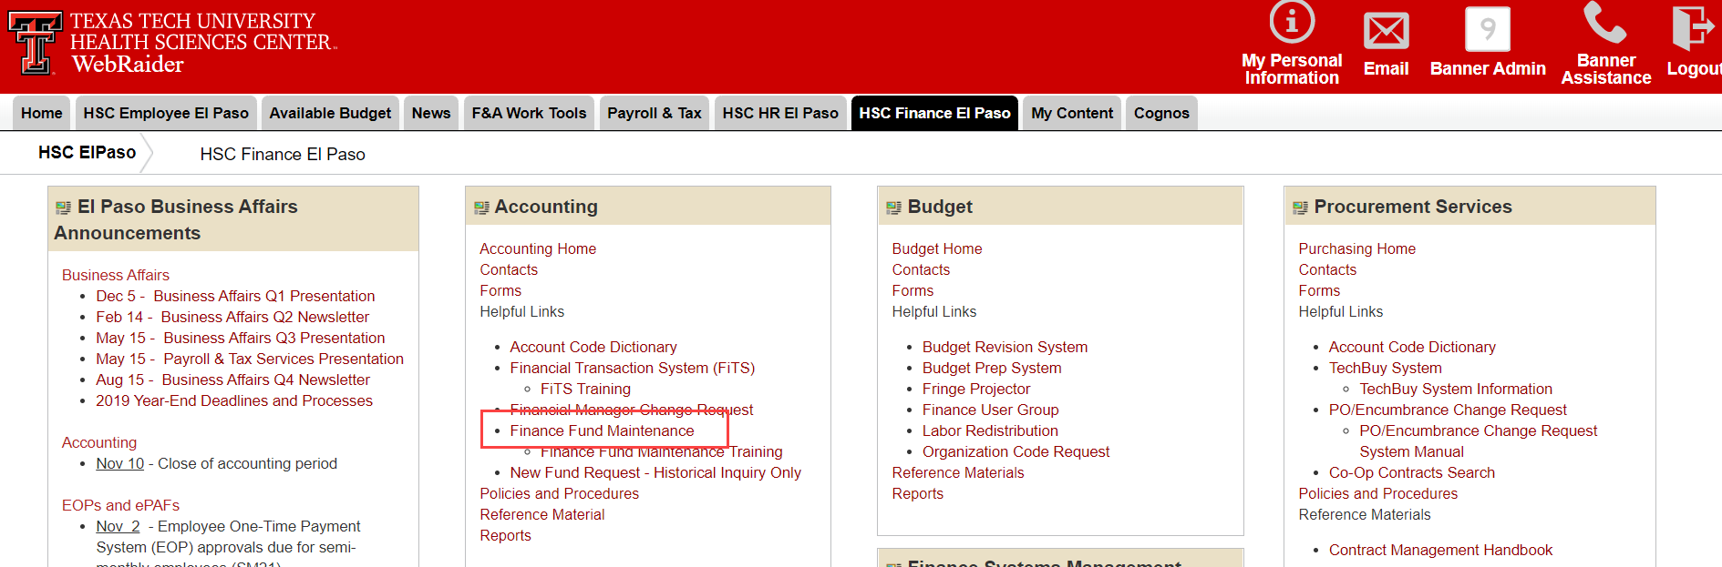
Finance Fund Maintenance System
  Two news systems have been added to the Finance Fund Maintenance System.
  Fund Name Change - The system will allow requests to be submitted for fund name changes.
  Terminate Fund - The system will allow requests to be submitted to terminate funds.
The Finance Fund Maintenance system can be accessed via the portal, under the “Accounting Services” section.

Slide 51
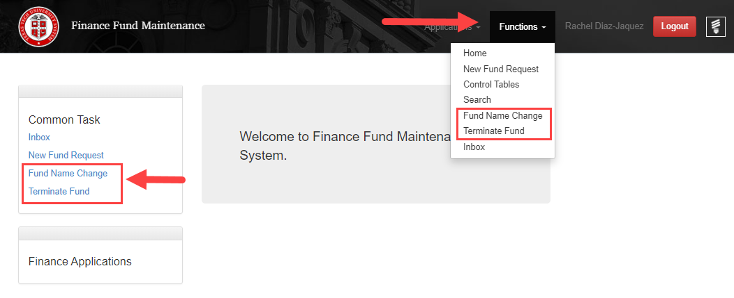
Finance Fund Maintenance System
  You can access the systems by clicking on the “Functions” tab at the top of the page, or by clicking on the link to the left under “Common Task”.
Reference material for the Finance Fund Maintenance system has been updated. Please visit the FSM reference material link below:
https://elpaso.ttuhsc.edu/fiscal/businessaffairs/finsysmgt/NewFundReqTraining.aspx

Slide 53
Thank You for Attending
Presentation will be posted in the portal under the “Business Affairs Announcements” section.

