Slide 2
Office of Research Sponsored Programs

Slide 3
Our Purpose
We assist with the preparation and submission of sponsored program proposal submissions (federal, state, local, private/foundations)
  For today’s presentation, this is our focus.
  We are here to assist with the proposal submission of federal clinical trials
  Friendly reminder that Industry Clinical Trials are handled by our Research Contracts and Agreements unit.
    Email: ELP-Research-Contracts@ttuhsc.edu
If awarded, we assist faculty and research staff with the management of all non-financial post award, to include project closeout.
  Prior Approvals (budget revisions)
  No Cost Extensions
  Non-Financial Report submission

Slide 4
What is a sponsored project?
An externally-funded project or activity in which TTUHSC El Paso enters into a formal written agreement (i.e., a grant, contract, cooperative agreement, etc.) with a sponsor.
Sponsored projects include consortium and subaward (subcontract) agreements in which another entity is the lead applicant.
  Incoming subawards (when another institution is the lead)
  Outgoing subawards (when TTUHSCEP is the lead)

Slide 5

Role of Sponsored Programs in the Office of Research
Assist in proposal preparation and submission
Budget development
Ensure completion of administrative sections of proposals
Provide oversight of grants and contracts
Ensure compliance with sponsor and institution requirements
Streamline administrative burdens (reporting, internal, final)

Slide 6
What do I need to know if I am planning on submitting an application for external funding?
Proposal Submission Policy
  https://ttuhscep.edu/research/osp/_documents/SP_Proposal-Submission-Policy-30-10-5-2-Effective-08-03-2022.pdf
All proposals must be started in Cayuse, the electronic grants management system used by SP
  https://ttuhscep.cayuse424.com/sp/index.cfm
All applications for sponsored programs funding must be submitted through SP

Slide 7
SP Proposal Submission Policy
Applies to all applications for sponsored program funding regardless of sponsor type
The SP proposal submission policy contains a 30, 10, 5 and 2 day deadline (with exceptions)
For private/foundation submissions, we collaborate with Institutional Advancement to submit the proposal. They will be providing more information about their process/services they offer.

Slide 8
Proposal Submission Policy
30-Calendar Day Deadline
All proposals for external funding need to be started and completed in Cayuse by the lead PI/PD at least 30 calendar days prior to the agency deadline (the earlier the better…)
  https://ttuhscep.cayuse424.com/sp/index.cfm
  Cayuse Quick Guides
  https://elpaso.ttuhsc.edu/research/osp/forms/Cayuse-Quick-Guides.aspx
The following elements must be completed in Cayuse
  All sections of the record (except those marked “OSP Only”) must be fully completed
  All participating subawardees must be specified
  The Personnel Worksheet must be uploaded by the PI/PD in the attachment section of the record
    https://elpaso.ttuhsc.edu/research/osp/forms/_documents/Personnel_Worksheet_08-04-2022.pdf
If a sponsor or subawardee is not available in Cayuse, “Sponsor Not Listed” must be selected within the 30-day window. The assigned RA will make sure to add the sponsor to Cayuse.
The assigned RA will be sending the PI a SP timeline via email.

Slide 9
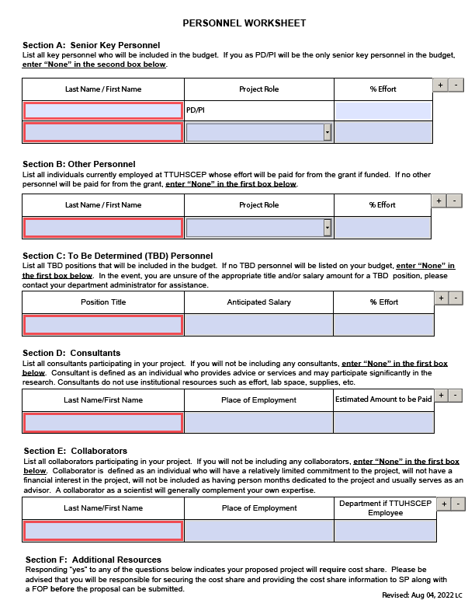
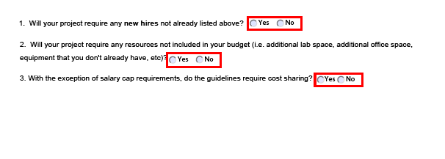
Personnel Worksheet

Slide 10
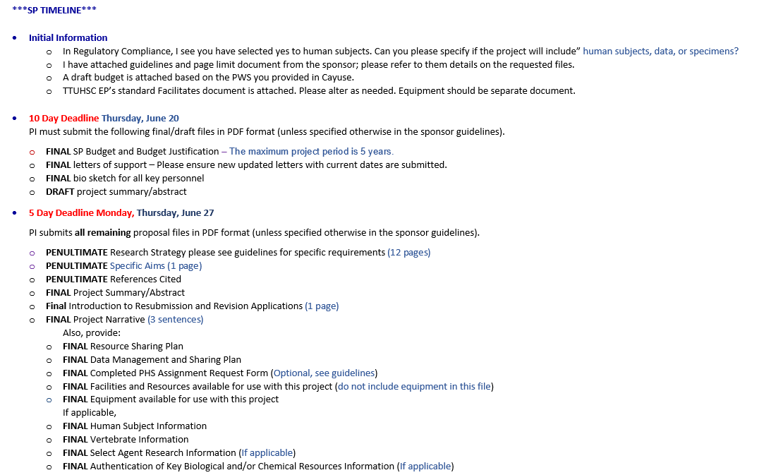
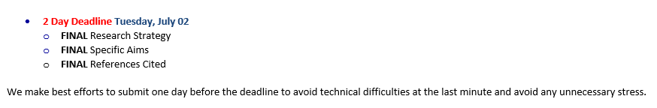
Example of SP Timeline

Slide 11
Proposal Submission Policy
10-Business Day Deadline
PI needs to submit the following files in PDF format (unless otherwise specified by the sponsor guidelines) to SP via email.
  Final Budget
  Final Budget Justification
  All final signed letters of support
  Final Biosketches for all key personnel along with any others that will be included in the proposal
  Draft project summary, specific aims or abstract
Files will be reviewed by SP and uploaded in Cayuse
Proposal will be submitted for routing in Cayuse within 2 business days of the 10 day deadline.
  Department Chairs and required approvers may review and approve the proposal once these files have been uploaded in Cayuse or they may choose to wait until the 5-business day deadline when all final files are uploaded
  Lately, because SP is waiting for files, department chairs may be asked to approve later. Please help us improve this.
  Also, please keep in mind that for private/foundation proposals, only FINAL Approved files by both SP and IA will be uploaded for routing.

Slide 12
Proposal Submission Policy
5-Business Day Deadline
PI submits all remaining final files in PDF format (unless otherwise specified by the sponsor guidelines) to SP via email.
SP will review final files and upload them in Cayuse
If any edits are required, SP will advise the PI of the changes needed
If institutional approvals have not yet been received, SP will send a reminder to the department chair and required approvers asking them to approve the proposal. Our goal is to have the proposal approved no later than 2-business days before the sponsor deadline

Slide 13
Proposal Submission Policy
2-Business Day Deadline
PI submits final project description (specific aims, project narrative and references cited) in PDF format (unless otherwise specified by the sponsor guidelines) to SP via email.
SP will finalize the proposal in Cayuse and ensure all institutional approvals have been received
SP will submit the proposal to the sponsor 1 business day prior to the sponsor deadline or when required provide a transmittal letter authorizing an additional submitter
Note: If the proposal must be mailed, the deadline will be 3-business days instead of 2 and the proposal will be mailed 2 business days prior to the sponsor deadline
Note:The Office of Research and Office Institutional Advancement (for private/foundation), reserve the authority to not approve a proposal for submission.
  Ex: Extremely late submissions that are still pending many files

Slide 14
Proposal Submission Tips
The earlier the better! Please help us help you.
Know the SP Proposal Submission Policy
Read the sponsor guidelines prior to completing the Cayuse record
  Ensure you meet the sponsor’s eligibility requirements
  Ensure your project meets the sponsor’s funding purpose and requirements
  Discuss with your Chair/Dean (effort %, cost share, collaborations)
Unsure or have questions?
  Reach out to SP or check our website for available guides and resources

Slide 15
Our Team
Esmeralda Zazueta
Director
ezazueta@ttuhsc.edu
VACANT
Research Administrator III
Luis22.Garcia@ttuhsc.edu
VACANT
Research Administrator I
@ttuhsc.edu
Leslie Casas
Director
leslie.casas@ttuhsc.edu
Cecy Rodriguez
Research Administrator II
cecy.rodriguez@ttuhsc.edu
Joshua Rayner
Research Administrator II
jrayner@ttuhsc.edu

Slide 16


Slide 17
Office of Institutional Advancement
Services and Resources

Slide 18
Mission Statement
The mission of the Office of Institutional Advancement (IA) is to foster the institutional vision of improving patient care, education and research through stewardship of current and potential donors and engaging public relations.
Vice President for Institutional Advancement
Andrea Tawney, Ph.D.

Slide 19
IA Departments
Marketing & Communications
The Office of Institutional Advancement’s Marketing & Communications team communicates the university’s mission by engaging the internal campus community, as well as the greater external public; creating awareness about the education and health care provided by faculty and physicians; and promoting the research and achievements of the institution’s students, faculty, staff, residents, alumni and physicians.

Slide 20
Marketing & Communications
External communications with community (press releases, news stories, Tech Talk, photos, videos)
Institution website and microsites
All social media (Facebook, Twitter, Instagram, LinkedIn)
Branding of TTUHSC El Paso and TTP of El Paso (on website)
Creative requests (flyers, brochures, referral cards, invitations, banner design, digital ads)
Guidance about vendors and branded material
Visit https://elpaso.ttuhsc.edu/ia for more information and to request support

Slide 21
Marketing & Communications
Creative Requests
http://bit.ly/ttuhscepcreativerequest
*Please note that there is a fee for design work (not for logos)
Logos, Logo Requests, Stationery Templates, & Signature Generator Tool
https://elpaso.ttuhsc.edu/ia/mc/branding/default.aspx
Stationery Templates include conference template, letterhead, business card request form, and PPT template
Physician Referral Cards
http://bit.ly/physicianbioform
Headshots
Schedule with Senior Photographer Tommie Morelos
tommie.morelos@ttuhsc.edu

Slide 22
Marketing & Communications
Please . . . .
Notify IA before speaking with media or if contacted by media
Use correct logos and branded material
Refer to the university correctly as TTUHSC El Paso
Check with IA before using Texas Tech Health El Paso
Allow IA to review branded material before using (posters, videos, etc.)
Inform IA of any newsworthy events such as publications, awards, grants so that we can publicize your achivements
Assistant Vice President: Danielle Urbina Danielle.Urbina@ttuhsc.edu

Slide 23
Development Department
Responsible for:
Annual Giving and Appeals
Employee Giving Campaign
Alumni relations
Major gifts
Planned Giving
Special events, donor events, and president’s office events
Corporate & Foundation Relations
  Grants from private funding sources (sponsored projects vs. philanthropic grants)
  Editing/reviewing assistance for all grants and other items, upon request
  Research on potential grant sources (private funders only)

Slide 24
Development Department
Our Success
Fiscal year 2020 | $3,497,773
Fiscal year 2021 | $12,860,780
Fiscal year 2022 | $9,178,711
Fiscal year 2023 | $29,933,053
Fiscal year 2024 | $8,891,754

Slide 25
Individual / Family Gifts
Major Gifts:
  $25,000 and above
    Outright gift
    Multi-year pledge
    Planned gift
  Annual / Employee Giving
    Gifts under $25,000
    Often given on a monthly or annual basis
  If you have a major gift prospect
    Contact: Craig Holden, Assistant V.P. for Development at craig.holden@ttuhsc.edu
  If you would like to make a recurring donation through employee giving
    Contact: Desma Montellano, Associate Director for Donor Relations & Annual Giving at desma.montellano@ttuhsc.edu

Slide 26
Corporate & Foundation Relations
Responsible for
  Identifying funding opportunities from
    Private Foundations
    Corporations / Corporate Foundations
  Cultivating relationships with private funding organizations
  Preparing requests to private funding organizations
  Assisting Faculty / PIs with private grant submissions
    Research opportunities / RFPs
    Strategic planning / funding approaches
    Structuring / editing requests
    Assisting with interim / final reports
  Processing in-kind gifts with a value over $1,000
    Please notify IA of all in-kind donations, even those below $1,000
  Stewarding private funder relationships
    Helping to maintain long-term partnerships
    Maximizing future funding
Contact: Janine Young, Senior Director, Corporate & Foundation Relations at janine.young@ttuhsc.edu

Slide 27
Corporate & Foundation Relations
Requesting Grant Support
  Faculty member must register project in Cayuse
    At least 30 days before due date
  Any faculty member may reach out to IA for assistance
    Looking for RFPs
    Contacting any private funder
    Structuring a narrative
    Editing a proposal
  IA and OSP will:
    Determine whether or not the project is sponsored
    If it is, project will be managed and submitted by OSP
    If not (if it’s a philanthropic grant), it will be managed and submitted by IA, through TTFI
    For all grant submissions to private funders, IA will review and provide edits/comments
  All private foundation proposals must be approved by IA in Cayuse

Slide 28
Corporate & Foundation Relations
Practice Good Stewardship of Grant Awards
  Faculty member should communicate with OSP and IA on all post-award items including decline notifications
  Faculty should not sign contracts/agreements but forward to OSP or IA
  Faculty should not communicate directly with funders but instead use OSP or IA as a liaison
  Faculty should spend down grant funds within the timeline of the award as part of good stewardship
    Plan ahead to ensure spend down

Slide 29
Development Department
Tips for Identifying Resources in Your Field
IA List of Funding Opportunities
  Emailed twice a month
  Contact Lori Navarrete at lori.navarrete@ttuhsc.edu for more information and to be added to list
Let Us Know What You Are Working On
  What is your timeframe?
  What is the dollar amount needed?
  Send us a one-paragraph description of research project
Research Who the Funders Are
  Sign up for organization listservs & newsletters – many include funding opportunities
  Utilize your professional networks, colleagues and member organizations to identify funders
  A simple Google search of your focus area can result in organizations you were previously unaware of
Talk To Private Funders Before Submitting LOIs and Applications
  Must do this through OSP or IA
  Helps the funder pre-screen, puts you on funder’s radar, provides you information on funding priorities and avoids wasting your time and theirs

Slide 30
Thank You!
Development Team
Craig Holden, Assistant Vice President, Development
Janine Young, Senior Director, Corporate & Foundation Relations
Brianna Huffman, Senior Program Director
Desma Montellano, Associate Director, Donors Relations & Annual Giving
Lori Navarrete, Senior Writer
Christopher Rosenbluth, Senior Writer
Cassara Cravens, Senior Business Assistant
Meriah Rivera, Program Coordinator
Contact us at 215-4850
https://elpaso.ttuhsc.edu/ia/

Slide 31
Questions?
The Office of Institutional Advancement Welcomes You
Visit us at ASB II @ 222 Rick Francis St.

