Slide 1





Pasos Para Prevenir Cancer: Tips for eating out
Notes:
Hello and welcome back to Pasos Para Prevenir Cancer. Once again, my name is Roy and I am a health educator at Texas Tech University Health Science Center. In this class, we will discuss healthier ways to eat out. Sometimes we are not in control of events that lead us to eat out, but that doesn’t mean we have to make unhealthy decisions that can negatively impact our health in the future. We will go over some tips when eating out and make suggestions for some of the more commonly consumed to meals when on the go.

Slide 2
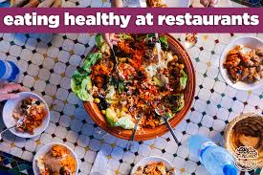

Tips for eating out.
Eating out is okay every once in a while.
Making a few good decisions during your meal is easy.
Sometimes restaurants have special menu options.
But if they don’t here are some easy tips.
Notes:
As I just mentioned, sometimes we can’t control certain events that lead us to dine out or we simply just choose to eat out. We stated before that it is okay to eat out, but it is best to leave it for special occasions only. Now I would like to point out that there is a big difference between eating out at a dine-in restaurant and stopping at a fast food joint for a quick meal. There are many issues with fast food, one being that they normally involve some sort of fried food. The good thing about dine-in restaurants is that many of them offer special menu options that include healthier alternatives. In the next few slides, we will provide you with some tips for eating healthier when healthy options are not at your fingertips.

Slide 3
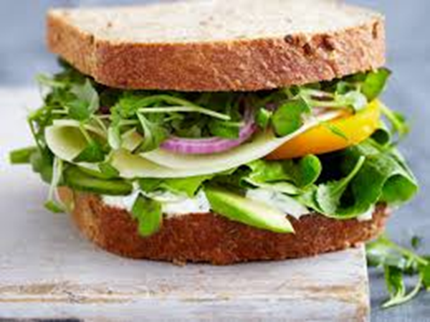
Sandwiches.
Order sandwiches without mayonnaise or other high calorie sauces.
Order small plain burgers – stay away from the ‘deluxe’.
Order sandwiches with lean meat- stay away from tuna or chicken salad.
Pick grilled over fried.
Notes:
One of the most popular choices of on-the-go Americans and a staple of fast food is the sandwich. They are normally viewed as a healthier alternative to hamburgers and hotdogs, but they too can be very unhealthy. It is important that we order sandwiches without mayonnaise or other high calorie sauces. Mayonnaise is made up of mostly fat and is therefore very calorie dense. The same thing can be said about tuna sandwiches. Many recipes call for an addition of heavy mayonnaise in tuna sandwiches, which means we should stay clear of this food. When we do order sandwiches, it is best to use fresh lean meats as opposed to preserved cold cuts that have been loaded with sodium and salt for preservation. Hamburgers are also a type of sandwich that people love to shop for. While it is okay to have a sandwich once in a while, it is still important that we maintain an adequate portion control; meaning we have to stay away from deluxe or larger sized meals. When possible we have to select grilled meats over fried meats due to the high caloric count in fried foods. Another healthy option to consider when selecting a sandwich is to select the best type of bread to consume. As we mentioned in the Go, Slow, or Whoa foods portion of the course, whole grain and whole wheat breads are a better option over white bread or other flavored breads. This will help you acquire the recommended daily intake for fiber. To make up for the lost flavor form condiments like Mayonnaise, it is best to fill your sandwich with vegetables such as tomatoes, fresh greens, red onions, and peppers. While sandwiches are normally viewed as take-out food, our next slide will include foods that can be taken out or dined in.

Slide 4
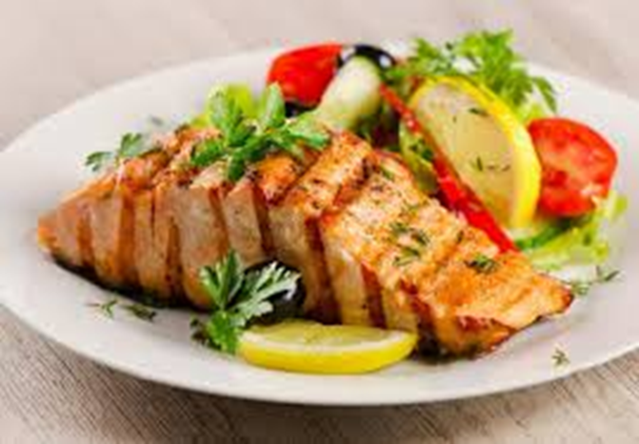
Main Dishes.
Choose tacos made with corn tortillas and lean meat like chicken or beef.
Ask for low fat substitutes when available.
Baked over fried.
Load up on veggies.
Notes:
As we all know, the main dish in an entrée is usually the biggest portion, however that doesn’t mean that it has to be the unhealthiest one too! We already discussed the difference between corn and flour tortillas, so it is not surprise that we highly recommend the use or corn tortillas and lean meat like chicken or 95/5 ground beef when you are making dishes the require the use of meat as a filler. Popular dishes include enchiladas, tacos, gorditas, chicken, and steak. One thing we continue to mention is that it is okay to have that type of main dish, just select the better products. A great example is selecting grilled, broiled, or baked meats over fried or baked meats. For those of you who really love flavor, it is also important to eliminate the use of cooking in marinades with added fat, sugar, or salt. When eating out, try asking for meats that are made in healthy olive oils instead. Cooking chicken with the skin on adds no nutritional value, but does add fat and calories (especially when the skin is fried in oil). Therefore, it is essential that you remove the skin from chicken to make your meal more nutritious. There are three things going on in this picture that add nutritional value to this meal. First, the skin of the chicken was removed and second it was noticeably grilled. The third is even more evident. This plate has been filled with colorful greens, tomatoes, and lemon. The key contributor here is the lemony flavor this side salad will have, as opposed to a processed flavor from a fatty dressing. In the next slide we will discuss other ways to make side dishes more enjoyable, and nutritiously sound.

Slide 5
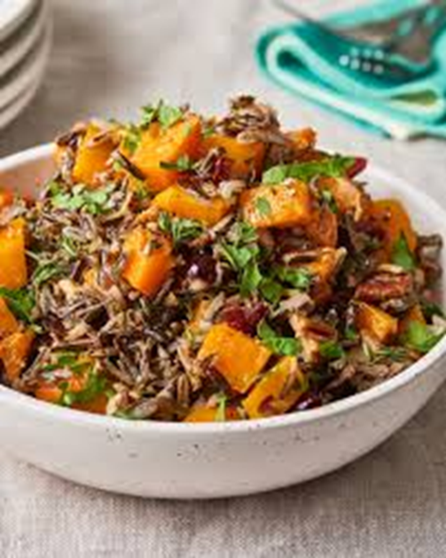
Side Dishes.
Share the order of fries.
Go salt free.
Asked for baked or steamed.
Use low fat salad dressing. (bring your own if you need to)
Substitute with veggies or a salad.
Notes:
One of the main things when eating out is to not ignore the smaller sized side dishes that we consume in comparison to our main entrees. Just because they are smaller, doesn’t mean they are not harmful. In fact, it can be quite the opposite. Take French fries, which are labeled as a Whoa food, for instance. They are probably the most common side item that is consumed in both fast food and dine in restaurants, yet, the labeling as a Whoa food tells us they should only be consumed once in a while or as little as possible. Imagine getting a skinless, grilled chicken sandwich, with dark green leafy vegetables and tomatoes and then pairing it with French fries. While the fries seem to counter the healthiness of the sandwich, they too can be consumed in a healthier manner. One way to do this is by not asking for a large portion and when available, share the order of fires with someone. This can also be done in dine-in restaurants with other side dishes. Another thing we can do is skip the fried version of this vegetable and have it as a baked or steam, but as always stay away from added salt. In substituting fries or other unhealthy side dish, you can always request a salad or steamed vegetables. As we stated in the previous slide, stay away from condiments loaded with fat by selecting low fat salad dressing or simply get a plain one and bring your own healthier version. Another calorie loaded item that is usually consumed when eating out is sugary beverages. Next we will discuss ways to improve our dining out experience by selecting healthier drinks to complement our meals.

Slide 6

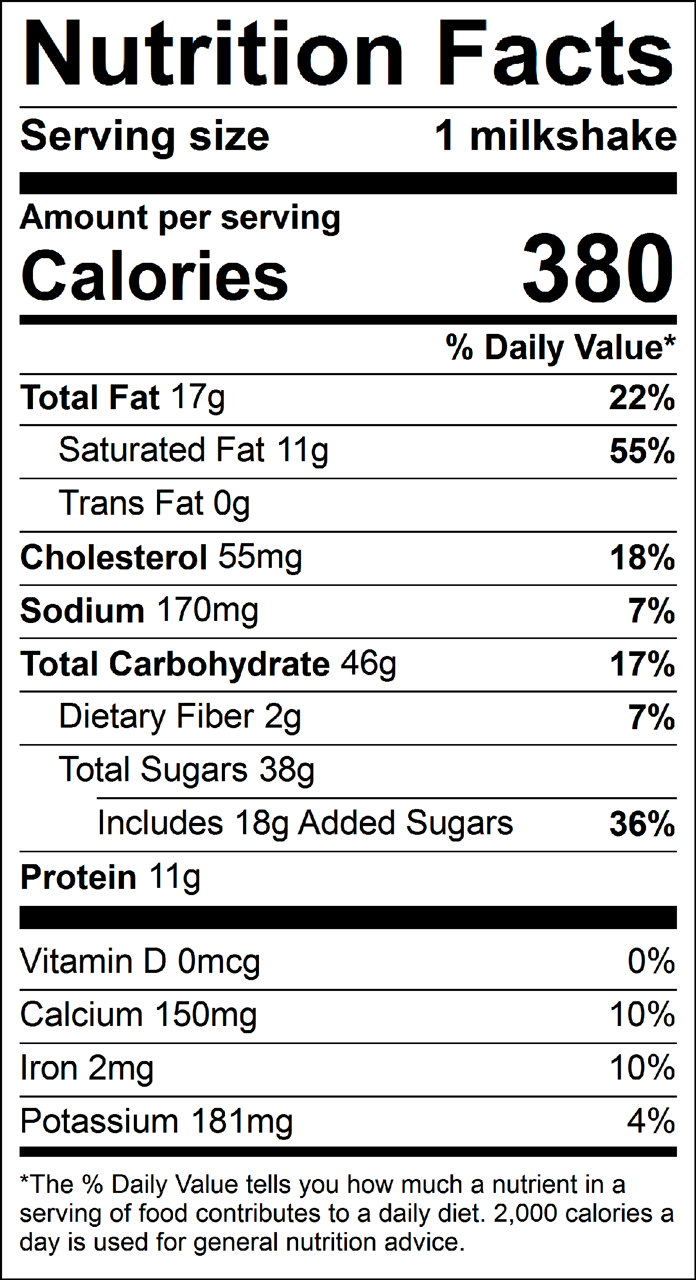
Beverages.
Go with water.
Ice tea.
Light cola.
Skip the shake or order a small.
Notes:
We have already discussed that water is the best beverage that we can consume, but it is not the usual drink of choice when people are dining out. We tend to select products loaded with sugar and high fructose corn syrup like sodas, sweet teas, and unhealthy fruit flavored juices. Some alternatives to consider besides water, are unsweetened ice teas or light colas. As you can see from the picture above, water and ice tea can be garnished with limes and lemons for added flavor. Milkshakes can split a fine line between serving as a beverage or a dessert. The picture on the lower right shows the nutrition fact label for a common milkshake. As you can see from the label it is loaded with over 55% of the daily recommendation for saturated fat and contains 36% of the daily recommended amount of sugar. Worst of all, it contains almost 20% of the daily recommended calorie intake; based on a 2,000 calorie diet. Since milkshakes fall in the category of a Whoa food, it is okay to have them on occasion, but it is important that you only consume them in small amounts. Now we can move into the task of making our desserts better as well.

Slide 7
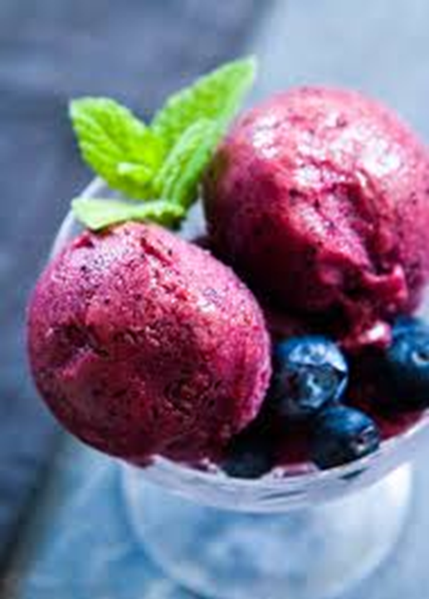
Desserts.
Order fruit or a sorbet.
Go Small.
Share with the table
Notes:
To complete a well-rounded four course meal we can’t forget about everyone’s favorite portion, dessert! When possible, the best option is to consume fresh fruit as a dessert. We understand that they are not always an option though. In times like these a sorbet would suffice. Sorbet are made from water and fruit puree or juice and they do not contain milk, cream, or eggs. When desserts are a bit more unhealthy it is best to consume them in small or amounts, or if possible share them with the table. This way everyone gets to eliminate the craving for something sweet, but you also ensure it occurs in small amounts.

Slide 8
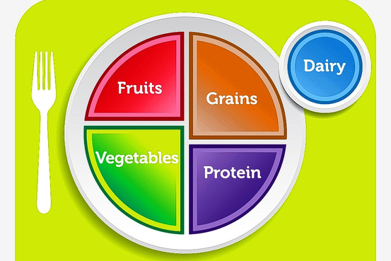
Summary
Tips for eating out
Sandwich variations
Main dishes
Side dishes
Beverages
Desserts
Notes:
In summary, today we discussed way to make eating away from home healthier. We provided you with tips on how to make better decisions when deciding to eat out such as only eating out once in a while and selecting dining in restaurants over fast food places. We provided you with tips on how to select healthier sandwiches when you are on the go and reminded you of ways to improve the selection of main and side dishes when you decide to dine in. We also went over the importance of beverage selection and ways to enjoy and improve the consumption of desserts to compliment a meal. This presentation concludes our nutrition portion of the program. However, we know that living a healthy lifestyle also means that we need to include physical activity into our daily routines. Therefore, our next class will focus on physical activity and ways to help you include it into your daily routines.

