Slide 1




Pasos Para Prevenir Cáncer
Notes:
Hello and Welcome back to Pasos Para Prevenir Cancer! Once again, my name is Roy and this week we will go over healthier ways to keep eating our favorite foods. The last two classes have centered on Choose MyPlate and Food Nutrition labels; so this week we will use that knowledge learned to help you create better meals that you already enjoy. This class may serve as a little review on some topics, but I ensure you, we will also share more information on how to eat healthier. The first thing we will do is go over one of our most popular Mexican dishes.

Slide 2
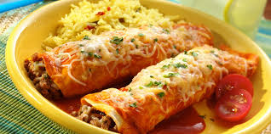
We all love our ethnic favorites!
Beef Enchiladas:
Amount Per 1 enchilada (192 g)
Calories 323
% Daily Value*
Total Fat 18 g | 27%
Saturated fat 9 g | 45%
Polyunsaturated fat 1.4 g
Monounsaturated fat 6 g
Cholesterol 40 mg | 13%
Sodium 1,319 mg | 54%
Potassium 574 mg | 16%
Total Carbohydrate 30 g | 10%
Protein 12 g | 24%
Vitamin A | 22% | Vitamin C | 2%
Calcium | 22% | Iron | 17%
Vitamin D | 0% | Vitamin B-6 | 15%
Cobalamin | 16% | Magnesium | 20%
Notes:
Last week we spoke about the nutritional food label for tortillas and lean ground beef. I mentioned that both products were essential for making dishes like enchiladas, tacos, and many other Mexican foods. The week before, we used Choose MyPlate to provide you information on cheeses to eat and the importance of using herbs and spices as a flavor enhancer. As you can see from this picture, all those ingredients have been used to make this beef enchilada. The first thing we need to be made aware of is that this single enchilada equates to one serving. If you remember my discussion about how many tacos or enchiladas are usually consumed in a meal, it is three or more. In a real world setting, it is customary to consume these enchiladas with a side or Mexican rice and beans. However, we will only use the enchilada in this discussion. Now that we understand how to read a nutritional food label, we can easily see the high risk contents in this food. For instance, it contains 18 grams of fat, or 27 percent of the percentage daily value for fat. The worst part is that it also contains 9 grams of saturated fat or almost half of the percentage daily value that is recommended by the USDA. If you recall, saturated fat should consist of 10 percent or less of the total fat intake. Sodium was another essential topic of discussion last week. If you recall once again, one of the many goals of Choose MyPlate was to reduce the intake of sodium to less than 1500 mg per day, because it has been linked to high blood pressure and many other chronic conditions. Once again, this is only one enchilada, three enchilada would surpass the recommended guidance. A beef enchilada does offer other good nutrients though, such a 16% of the recommended daily intake of Sodium, 10 percent for carbohydrates, and 24 percent of the recommended daily intake of protein. It also offers some of the many mineral and vitamins that are essential in food like Vitamins A, B, and C, Calcium, Iron, Cobalamin, and Magnesium. I understand the concern from the high amounts of saturated fat and sodium, but on the next few slide we will provide you with tips on how to continue to enjoy your favorite meals, including those that provide a cultural or ethnic significance.

Slide 3
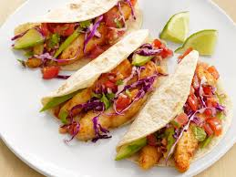
You do not need to say goodbye completely to the food that you love!
Make better decisions.
Swap out less healthy for better ingredients.
Eat in moderation.
Portion control.
Notes:
I said in the last slide, you do not have to say goodbye to your favorite foods simply because they do not meet the recommended guidelines from the USDA or other organizations. However, it does require some minor modifications, both in how we prepare our food and our lifestyle choices. The first thing you have to do is make better decisions on the ingredients you select to make your food. You also have to swap out less healthy ingredients, for healthier ingredients. A great example of this was described last week when we discussed sweet potatoes and white potatoes. Two minor lifestyle modifications that need to be followed are eating in moderation and practicing portion control. We will break these steps down further in the next few slides.

Slide 4
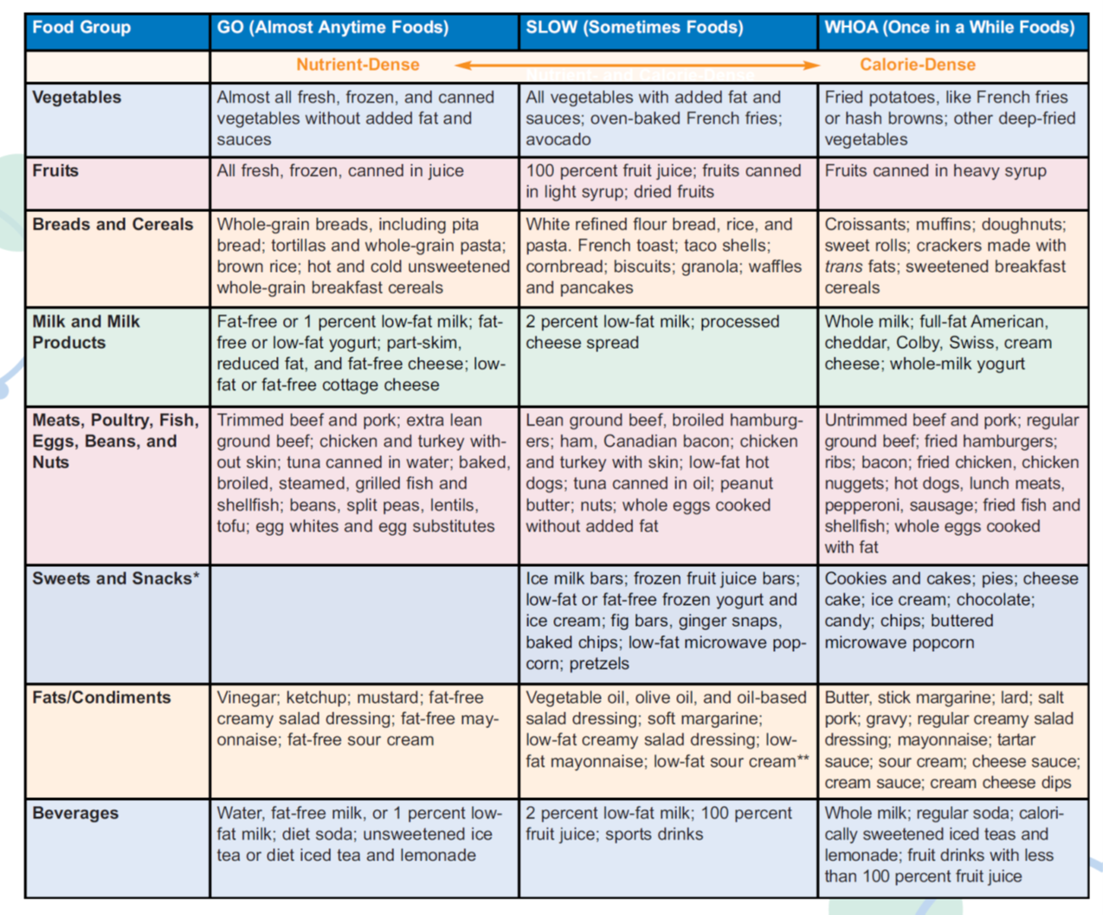
Make better decisions.
Notes:
In this slide we will dig deeper into different types of foods that fall in the same food group. The groups we will focus on are vegetables, fruits, breads and cereals, Dairy Products, Protein products, sweets and snacks, fats and condiments, and lastly we will discuss beverages. The categories that we will discuss are Go foods, which are those that we can consume anytime, slow foods, which are those we can consume sometimes, and Whoa foods, which are those that we should only consume once in a while. The manner in which we prepare our foods goes a long way in determining how healthy they can be. The best way to consume vegetables all the time is if they are fresh, frozen, or canned without added fats or sauces. Some variations like oven-baked French fries and vegetables with added fat and sauces can be eaten sometimes. The foods we real want limit though are fried potatoes like French fries and hash browns, and other forms of deep fried vegetables. We normally assume that all fruits are good for us to eat, but even fruits can be separated from those that can always be consumed to those that should only be consumed sometimes. Like vegetables, fruits that are fresh, frozen, or canned are great to eat all the time. Fruits that should only be consumed sometimes are 100% fruit juices, fruits canned in light syrup, or dried fruits. Fruits canned in heavy syrup should be consumed only once in a while. Brown rice, whole grain breads and cereal can be consumed all the time, but we must limit the use of foods like refined flour bread, rice, pasta, French toast, taco shells, cornbread waffles, and granola. Snack style breads like croissants, muffins, doughnuts, sweet rolls, crackers, and sweetened cereals should be consumed once in a while. Milk and milk products can also be separated based on quality. We should focus on using products that are labeled 1 percent low-fat, fat-free, or low fat when it comes to all things dairy. Protein foods should be selected very carefully. You can always eat foods like trimmed beef and pork, extra lean ground beef, chicken and turkey without the skin, tuna in water, shellfish, egg whites and egg substitutes. Great sources of protein which can be consumed all the time and are not animal products are beans, split peas, lentils and tofu. Some less healthy protein options are lean ground beef, broiled hamburgers, ham, Canadian bacon, chicken and turkey with skin, low-fat hotdogs, tuna canned in oil, nuts, and whole eggs cooked without added fat. Those that should be eaten once in a while are untrimmed meats, regular ground beef, anything fried, chicken nuggets, lunch meats, and whole eggs cooked with fat. Sweets and snacks are items that should not be consumed regularly. It is okay to eat things like ice bars, frozen fruit juice bars, low fat or fat free frozen yogurt and ice cream, fig bars, and low-fat microwave popcorn. Items like cookies, cakes, pies, cheese cake, ice cream, chocolate, candy, chips, and buttered microwave popcorn should only be eaten once in a while. Fats and condiments can make a healthy meal, unhealthy. Let’s try to use ingredients like vinegar, ketchup, mustard, and any fat-free condiment almost all the time. Vegetable oils, oil-based salad dressings, and low-fat condiments should only be used sometimes. Items like butter, lard, stick margarine, gravies, tartar sauce, cream cheese, and cheese dips should only be consumed once in a while. As we have already mentioned, water is the healthier thing you can drink. Other option that can be consumed all the time are fat-free or low-fat milk, unsweetened teas, diet ice tea, and lemonade. Drinks that should only be consumed once in a while are whole milk, regular soda, sweetened ice teas and sugary lemonades, and juices that are not 100% fruit juice. Next we will discuss substitutes for unhealthy ingredients in common recipes.

Slide 5
Healthier swaps!
Less fat.
Less sugar.
Less sodium.
Notes:
When cooking and baking it is essential that we swap out unhealthy ingredients for healthier ones. The goal is to always use less fat, sugar, and sodium. For instance, for recipes that ask for milk, we can substitute whole milk with fat-free or low-fat milk. When a recipe calls for cream we can use evaporated fat-free milk or we can instead mix equal amounts of low fat milk and fat free evaporated milk. For ingredients that require sour cream or mayonnaise, we can substitute those items with their fat-free or low-fat versions. Recipes that call for 1 cup of butter can be made healthier if they use 1 cup of tub margarine and 2/3 cup of vegetable oil instead. Oil used for baking can be alternated with equal amounts of applesauce or prune puree and oil for sautéing could be substituted with water, nonstick cooking spray or low-sodium broth. Whole eggs can be substituted with ¼ cup egg substitute or 2 egg whites and eggs needed for thickening can be replaced with 1 tablespoon of flour. Ground beef is an essential ingredient in Mexican cuisine which can be made healthier when we use meats which contain 10% or less fat. We understand that sometimes we get a craving for dessert, on the next slide we will discuss ways to enjoy them, without placing a higher risk in health.

Slide 6

Eat in moderation!
Share a dessert.
Ask for a smaller slice.
Treats on special occasions.
Notes:
When eating desserts it is important that we consume them in moderation. Some tips for accomplishing this is to share a dessert with others when available, to ask for or treat yourself to smaller slices, and most importantly to try to save them for special occasions. Just like the less healthy ingredients that we listed earlier, it is important that these types of foods are consumed only once in a while. Next we will go over another tip that will aid you in limiting the consumption of unhealthy foods.

Slide 7
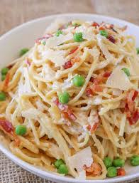
Portion Control!
Un-super size.
Know how many calories are in one serving.
Know how many calories are in front of you.
Save half for later.
Notes:
Another great way to ensure that you are eating healthy is by knowing how much you should eat in a day. Last week we discussed that nutrition information on the food nutrition label is based on a 2,000 calorie diet. The reason behind this number is that 2,000 calories are the amount of total calories per day that a moderately active adult female, one who weighs approximately 132 pounds, would need to maintain her weight. Of course, people with different weights will vary, so speaking to a medical professional would come useful in this matter. Once we know our caloric intake goals, we can make sure to limit the portion of meals that we consume. The picture above shows a huge bowl of pasta with some vegetable mixings. Let’s assume that this one meal contains 800 calories in total. We can split that count in half by simply eating half of it for one meal, then finishing it off the next meal or in another day. Earlier we mentioned that you can share desserts when available; the same can be said about a super-sized meal. This would ensure that you don’t surpassed the 2000 calorie limit, or the limit that you have found to be needed for your body type and activity level.

Slide 8

Eating better is making better choices!
The decision is easy.
You do not need to give up what you love.
Making swaps can help you eat better.
Notes:
In the end the choice to eat healthier is a decision that will impact your life forever. The decision to eat healthier can be made rather easy, especially now that you have the knowledge to start changing unhealthy behaviors. As we stated throughout this presentation, you do not need to give up the meals that you enjoy. You simply have to swap out unhealthy ingredients for heathier ones when you make your favorite meals. I challenge you to switch your WHOA foods, or those that should be halted more often for Go foods, which can be consumed anytime. Practice the recipe swaps that we lectured you on and eat in moderation when possible. Practice sharing meals or saving them for later when possible, and most importantly, do not over eat. Practice different methods of portion control to determine which methods suits you best.

Slide 9


In Summary
Ethnic Favorites
Make better decisions.
Swap out less healthy for better ingredients.
Eat in moderation.
Portion control.
Notes:
Thank you very much for taking part in this week’s class. Today we discussed ways to keep eating our favorite meals. We started off by dissecting the ingredients in one of the most popular Mexican dishes in El Paso, the enchilada. We can continue to eat the foods we enjoy by making better decisions on the ingredients they contain and how they are prepared. We learned how to swap out unhealthy foods for healthier alternatives. We also discussed the importance of eating in moderation and controlling the portions that we consume. It is imperative that we do not over eat, because calories will add up quickly. In the next class we will continue to educate you on common ingredients that are used in popular dishes. I hope you enjoyed this class and please continue to follow us on Facebook and check in regularly to view our newest content. Thank you very much and have a great day.

