Slide 1




Pasos Para Prevenir Cancer:
Notes:
Hello and welcome back to Pasos Para Prevenir Cancer. Once again, my name is Roy and I am a health educator at Texas Tech University Health Science Center. Today, we will be discussing different strategies to eating healthy. However, before we start, let’s recall some things we learned from our last lesson. We introduced you all to Choose MyPlate, which follows the current Dietary Guidelines furnished through the U.S Department of Agriculture and Health and Human Services. The current guidelines recommend that we choose a healthy eating pattern at an appropriate calorie level, that we focus on variety, nutrient density, and portion control. We were also informed to limit calories from added sugars and saturated fats, and reduce sodium intake. Before we go into the strategies that we can follow to eat healthier meals, we will reflect on some of the common practices that play a role in unhealthy eating.

Slide 2

Busy times.
How many of us do one or all of these on regular basis?
Skip breakfast and lunch, eat one big meal in the evening.
Eat out several times per week.
Buy boxed, instant, or already prepared foods.
Buy food from vending machines.
Notes:
It is customary that before we can fix a problem, we must first identify that there is a problem. One of the key issues in practicing bad behaviors is assuming that we are too busy to make better choices. Let’s reflect on some bad choices that people make every day, and please take the time to think of your own bad practices while we move along. A common unhealthy eating practice that is done by people is skipping meals because they believe that it allows them to indulge in eat more at a later time. For instance, during the holidays people assume that they can skip breakfast and lunch so that they can have more holiday dinner without exceeding their calorie limit for the day. What really happens is that people cannot function at 100 percent when they do this. Their blood sugar drops which causes people to feel irritable, confused, and fatigued. Some people skip meals because they assume they will lose weight. This practice actually causes the metabolism to slow down which makes losing weight harder. When the body does not get the nutrients that it desires, it can go into starvation mode. This causes a person to eat excessively when they finally do get to eat. Eating out several times per week is also a cause for concern. For starters, people are more likely to overeat when dining out. This phenomenon occurs because people tend to get appetizers, desserts, and drink sodas or other soft drinks when dinning out. People who are busy also think that buying boxed meals, instant, or already prepared foods, or food from vending machines is a solution for busy schedules. The next few slides we will cover ways to eating healthier and introduce you to methods that will save you adequate time for meal preparation.

Slide 3
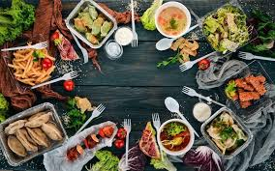
Strategies to eating healthy when time is tight.
Plan your meals.
Use a shopping list.
Share meal prep tasks.
Cook in advance.
Cook simply.
Use herb and spices.
Keep healthy snacks on-hand.
Notes:
Living in a fast paced society where people have to work, go to school, drop off and pick up kids, take them to practice, go to appointments, do chores, and send emails and texts messages, can makes us feel as if we need more time in the day to get everything that we need to do, done. Unfortunately that is not going to happen. Which is why people resort to bad choices when it comes to eating and physical activity. In this class we will show you ways to make healthier choices by allowing you to have more options. Some strategies that can be used for healthy eating are to plan your meals, use a shopping list when you shop, share meal preparation tasks, cook in advance, cook simply, use herbs and spices, and keep healthy snacks on hand. In the next few slides we will break down these categories and present you with great options for eating healthy.

Slide 4
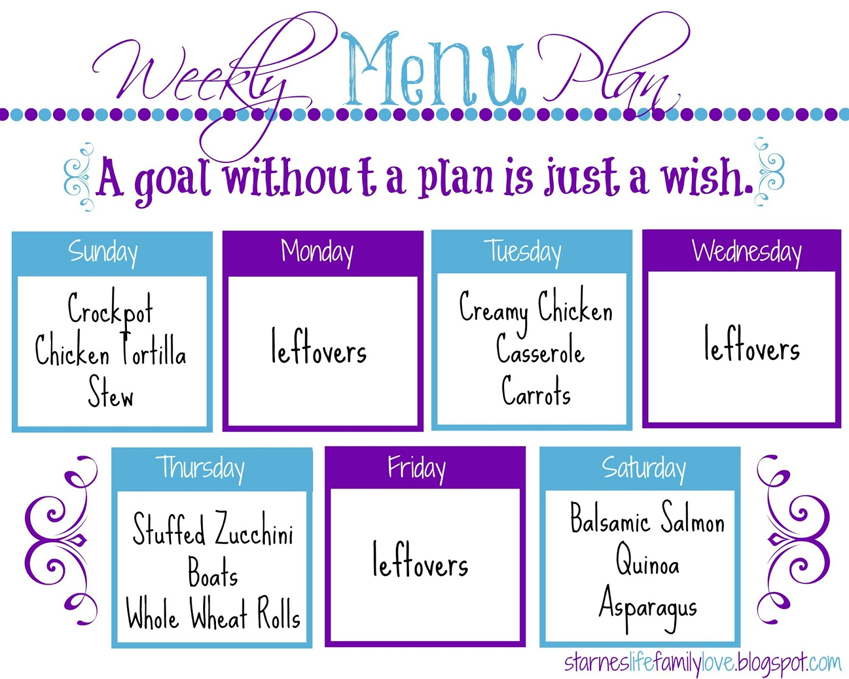
Plan your meals.
Notes:
One of the best ways to save or make time for eating a home cooked meal is by planning meals in advice. One of the key benefits to meal planning is that you are in control of how much you’ll actually eat. This topic was partially covered in an earlier slide about how much food is consumed when we eat out. Planning meals also ensures that you have food readily available for when you do get hungry. Remember what I stated earlier about what happens to the body when it goes into starvation mode, blood sugar drops, as does our metabolism. Another benefit about meal prepping is that it saves time and it saves a lot of money. Provided on this slide is a great example of how a weekly menu plan can look. As you can see this schedule is based on a cook and eat one day and have left-overs the following day. This example makes perfect use of crockpot. Crockpots are essential cooking tools because they allow you to make meals slow and practically unattended. Therefore, you can prepare dinner in the morning before you even start your daily tasks. In this example we have a crockpot chicken tortilla stew that is made on Sunday and can be consumed on Monday as leftovers. A creamy chicken casserole and carrots can be made on Tuesday and consumed on Wednesday as leftovers. Thursday will brings us some stuffed zucchini boats with whole wheat rolls that can be eaten as leftovers the following day. On Saturday we can spoil ourselves with some Balsamic Salmon, Quinoa, and Asparagus, which leads to leftovers to kick off the new week on Sunday. Eating left overs allows us to stop wasting food, which coincidentally also ties in with saving money. This topic will be better explained on the next slide.

Slide 5
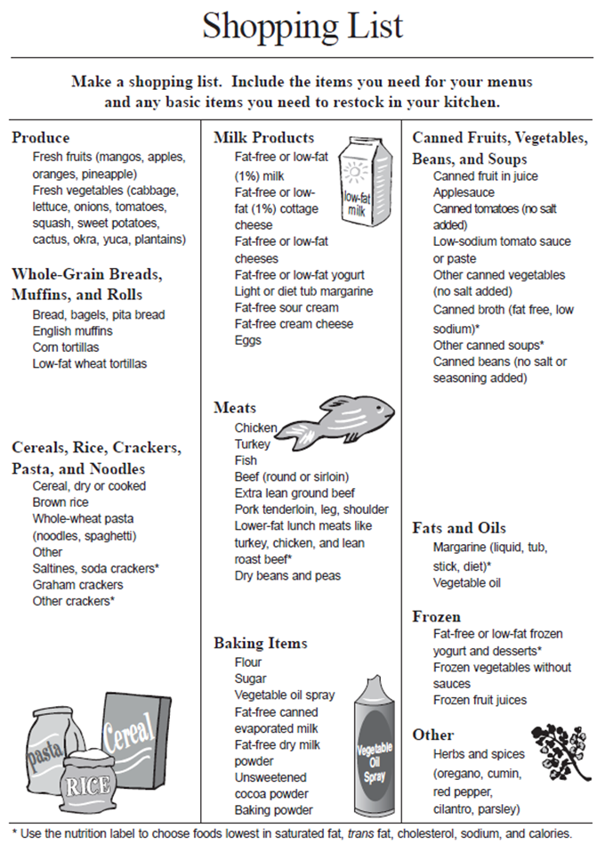
Use a shopping list.
Benefits of shopping lists:
  Saves time.
  Saves money.
  Helps with meal planning.
  Can contribute to weight loss.
  Reduces food waste.
Notes:
We mentioned saving money on the last slide, one of the key aspects of a shopping list is that it saves people money and time. A shopping list gives you guidelines for what to buy based on meals that you have planned. Therefore you won’t be making any additional expenses by purchasing things that are not needed or on the list. A good routine to practice is making a list as you survey the amount and types of food you currently have on store. This can be accomplished by inventorying your refrigerator, cabinets, and pantry as you make your list. A good grocery list also saves you time at the grocery store because it gives you the ability to eliminate unnecessary wandering through the aisles. Another key purpose about shopping lists is that they can contribute to weight loss. This is made possible by shopping for healthier items for foods you will make today and in the future. A prime example is make a shopping list for the weekly planner we made on the previous slide and sticking to those products. The trick is to not make purchases that are not on the list. Most unhealthy decisions are made impulsively, therefore, sticking to your list is essential in preventing you from making last-minute unhealthy food choices. This slide provides us with the shopping template to follow that incorporates some of the items that we mentioned in our last class. One recommendation is to plan your meals and make your list according to the guidelines and sections from Choose MyPlate. This could also be used as an excellent opportunity to teach your loved ones about Choose Myplate and how to shop accordingly. The next slide will go over another key way that family members can help in healthy living.

Slide 6
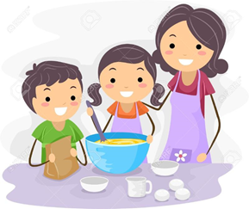
Share meal preparation tasks.
Teach you family how to shop for groceries.
Include your spouse and children in preparing meal and cleaning up.
Clean as you cook.
Share cooking duties with other family members.
Notes:
According to the “Your heart, your life “curriculum we should teach our family members to shop for groceries. Another way we can lead a healthier life is by also including our family members in meal preparation and clean up. This can lead to the sharing of cooking duties with other family members in the future. It is best to conduct clean up while you are cooking so that it can save time later. Next we will discuss ways to prepare food in advance as a way to eat healthier.

Slide 7
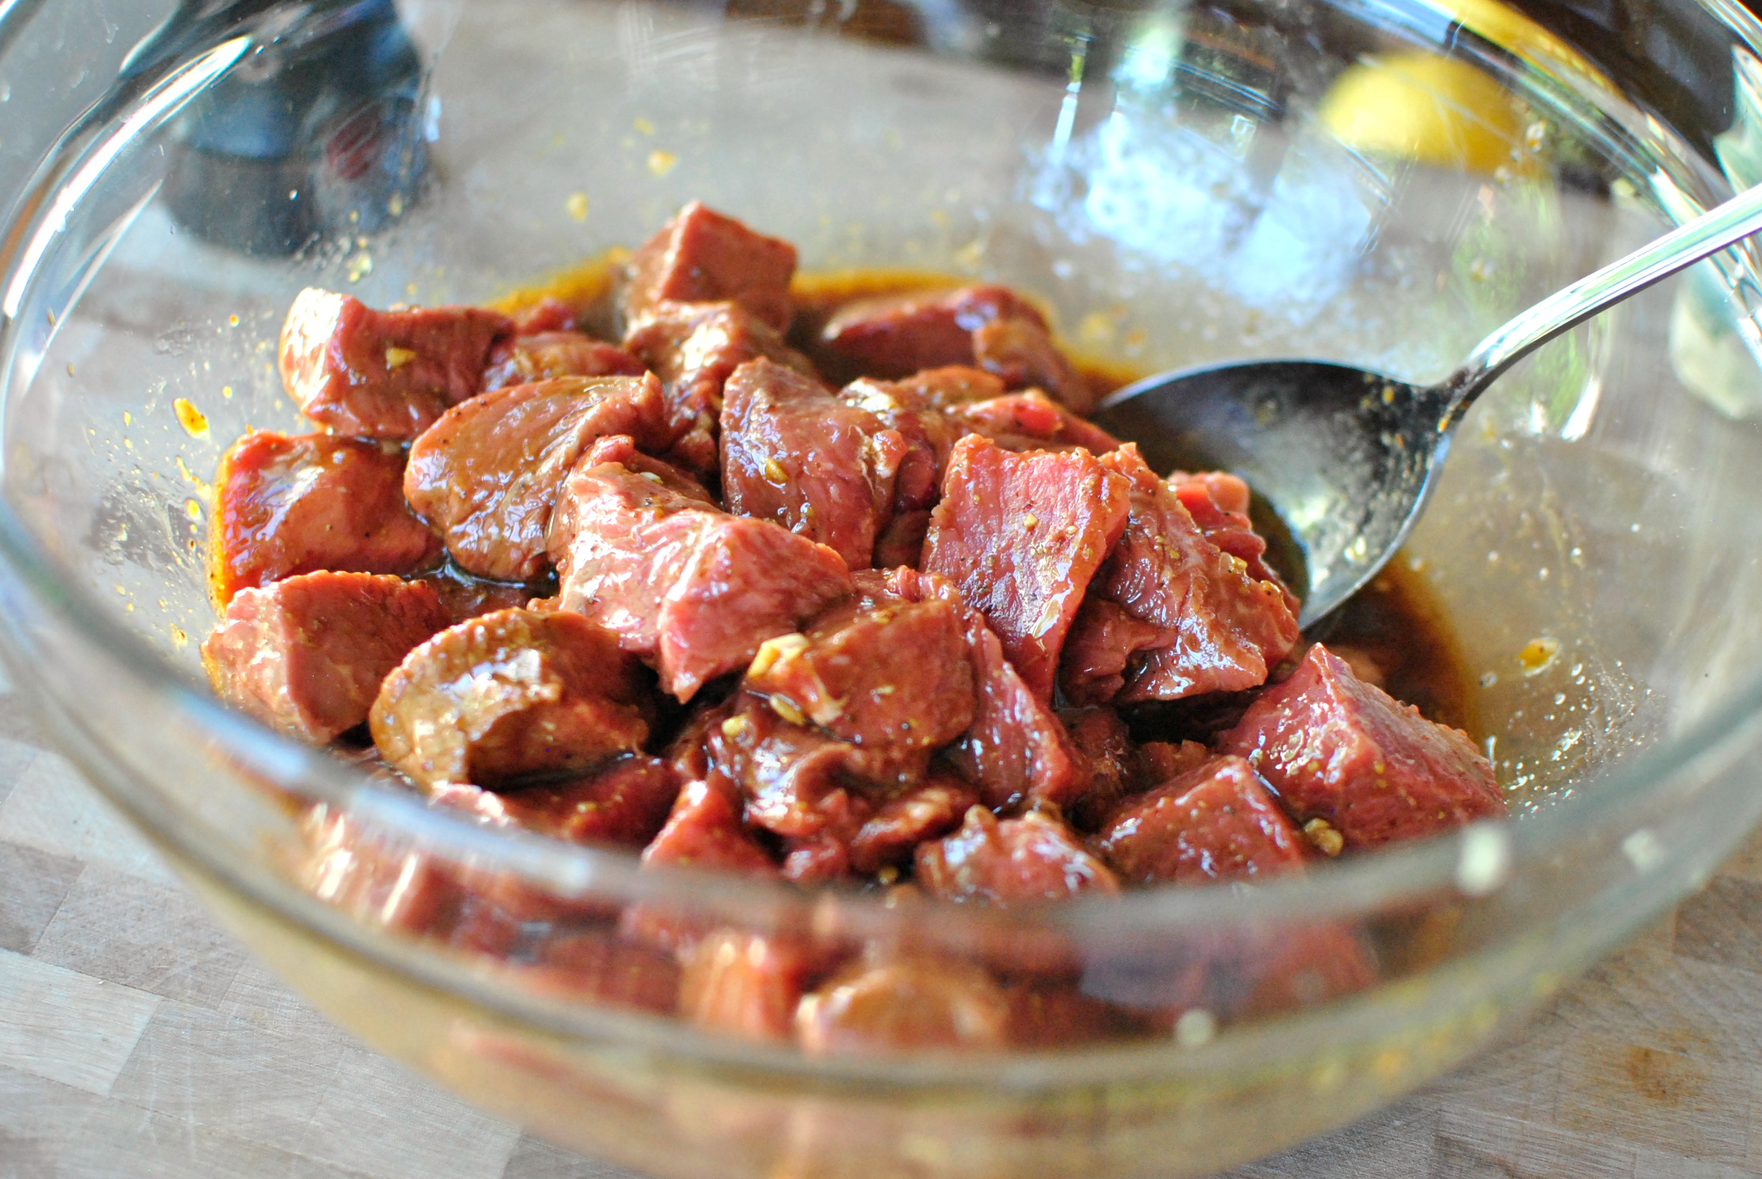
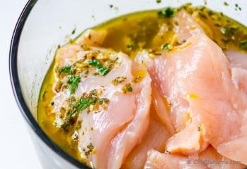
Cook in advance.
Prepare some foods in advance.
  Marinate meats or chickens the day before.
Pack your lunch the night before.
Prepare meals in a slow cooker.
Notes:
With the thought of food preparation in mind, it is important that we take time to prepare foods in advance. This doesn’t mean that we have to fully cook all of our meals and have them ready hours in advance, what it does means is that we can take steps to use our time efficiently. For instance, we can marinate meats or chicken the day before we are scheduled to make them. This way, we do not leave a chance for something to ruin our scheduled timeline. For instance, a missed alarm would give someone the notion that they will not have time to marinate their meats, and would otherwise lead to them having to eat out or buy fast food. Marinating it the night before, prevents issues like this from happening. The concept of using a slow cooker can also be used here. Things like soups, beans, and brisket can be put on the crockpot in the morning and consumed later in the day. The slow cooking gives you the necessary time to carry on with other tasks throughout the day. Those who pack food for lunch can save time in the morning by packing their lunch at night. Next we will discuss ways that make it easier for other family members to help in meal preparation tasks.

Slide 8
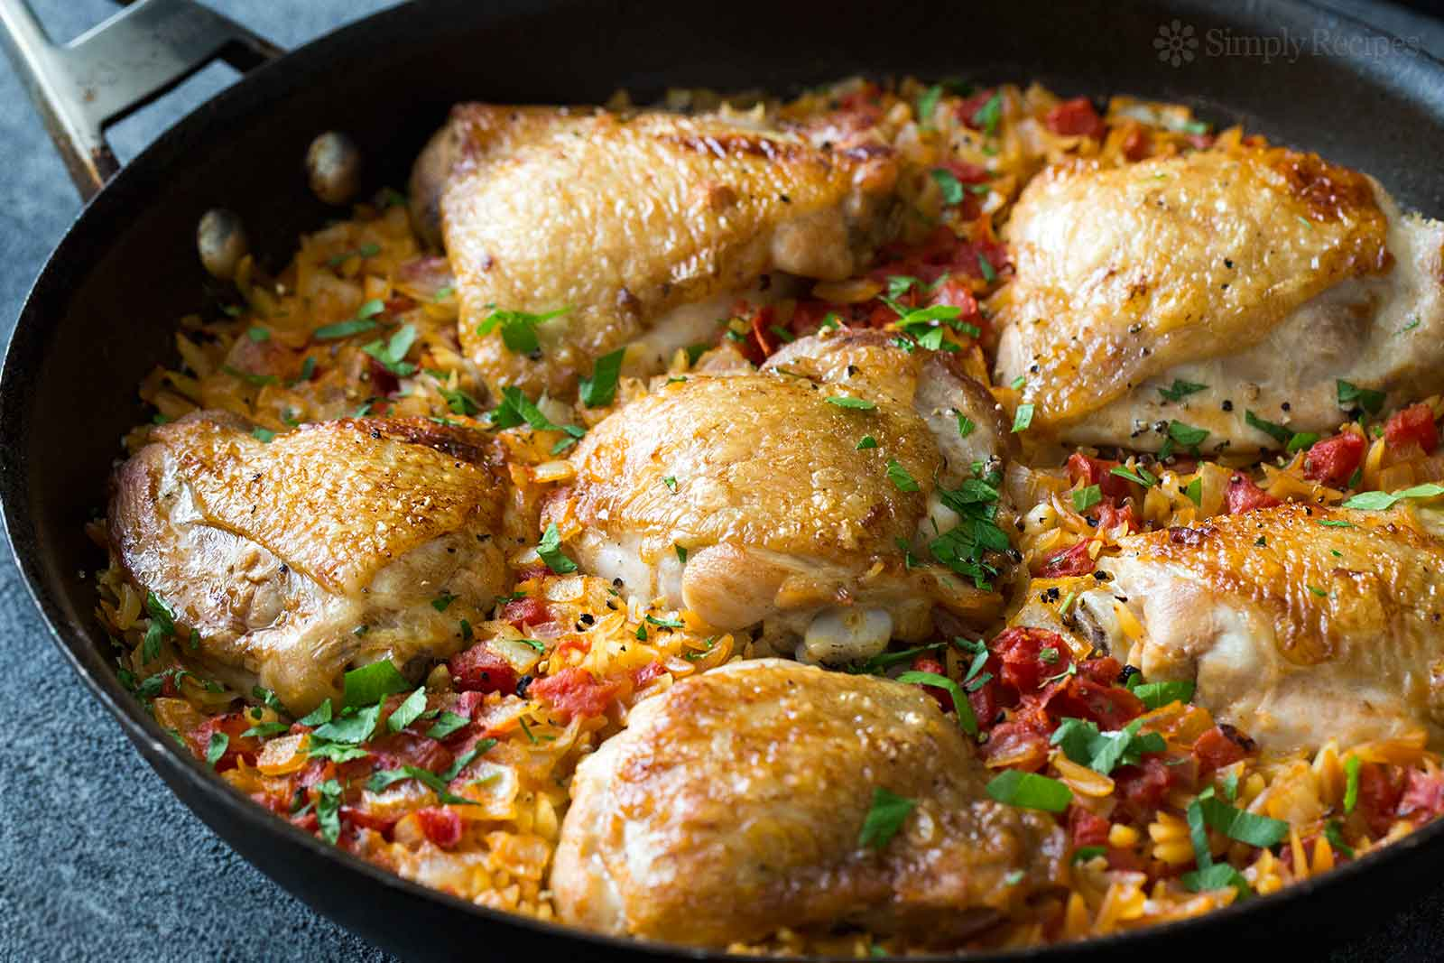
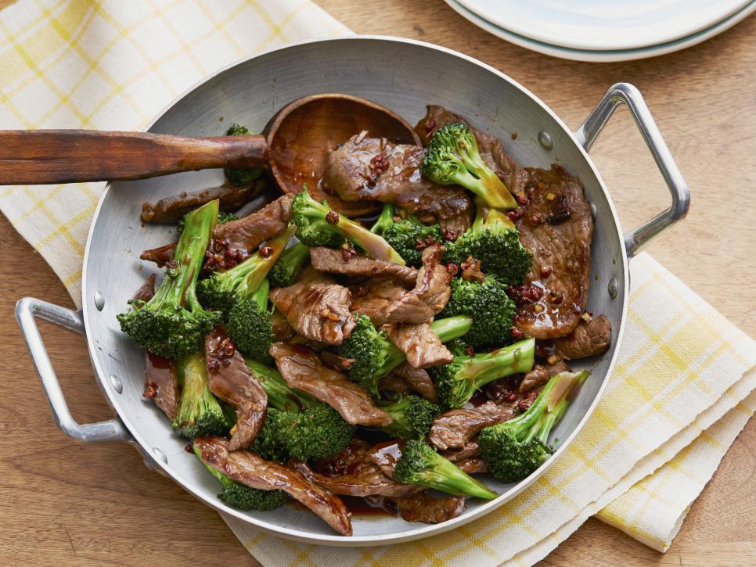
Cook simply.
Steam vegetables.
Frozen vegetables.
Broil, grill, bake or roast meats.
One pot meals.
Notes:
We have discussed ways to improve the time that it takes to prepare food and ways to make it more accessible, but we understand that some people just don’t prepare early. Therefore, it is essential to inform you on ways to make cooking simple. Cooking simple is something that benefits the entire family because it helps reduce preparation and clean up time. It also makes cooking easier, especially for children who are allowed to cook. If you recall, during our Choose MyPlate class we informed you that eating frozen vegetables is just as beneficial as eating raw veggies. I understand that sometimes when we think about frozen style foods, especially vegetables, we automatically think about a frozen bag with food inside that can be heated up in the microwave. Well, this isn’t necessarily the case. One quick and healthy way to make vegetables, whether frozen or raw, is by steaming them. Cooking meats does not have to be a daunting task. They can be broiled, grilled, baked, or roasted. This makes eating meat a healthier because you do not have to add any extra cooking oils. Another great thing about both vegetables and meats, is they can be combined in the same dish to save preparation and clean up time. One pot meals are easy to make, delicious, and nutritious. Next we will discuss healthy ways to add flavor to meals.

Slide 9
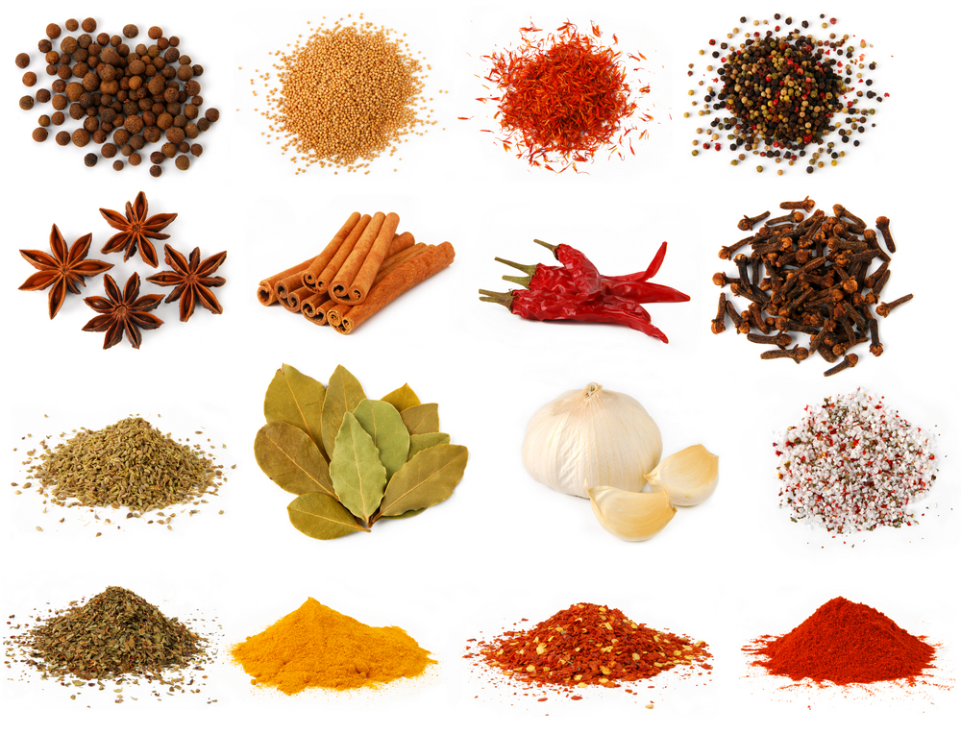
Use Herbs and Spices.
Chop fresh herbs and place in ice cube trays with water and freeze.
Store the frozen ice cubes in plastic bags in freezer.
Grow cilantro, basil, or thyme on a sunny window still.
Keep dried herbs on hand.
One teaspoon of dried herbs is equal to 3 teaspoons of fresh herbs.
Notes:
Herbs and spices are a great way to add flavor, color, and fragrance to dishes without adding extra fat, sugar, or salt. I’ll take you back to one of the key recommendations provided by Choose MyPlate, reduce or eliminate foods with added fats or sugars and reduce salt or sodium as it is usually expressed. Herbs, like parsley, sage, rosemary, basil, thyme, and dill, are leaves and can be used fresh or dried. Spices come from the bark, root, or other parts of tropical plants and trees, and are typically used dried or ground. Some of the most effective ingredients which can be used as a supplement for the taste of salt are black pepper, garlic powder, curry powder, cumin, dill, basil, ginger, coriander, and onion. Some great ways to make herbs and spices more accessible is to chop fresh herbs and place them into ice cube trays with water and freeze them. The stored frozen ice cubes can be saved in plastic bags in the freezer. Dried herbs and spices can be kept on hand. A great note to know is that one teaspoon of dried herbs is equal to 3 teaspoons of fresh herbs. Later in the program we will discuss physical activity and the benefits of having a garden outside, but it is good to know that we can grow herbs and spices like cilantro, basil, or thyme on a sunny window still. Next we will talk about healthy snacks and how to incorporate them into daily living.

Slide 10
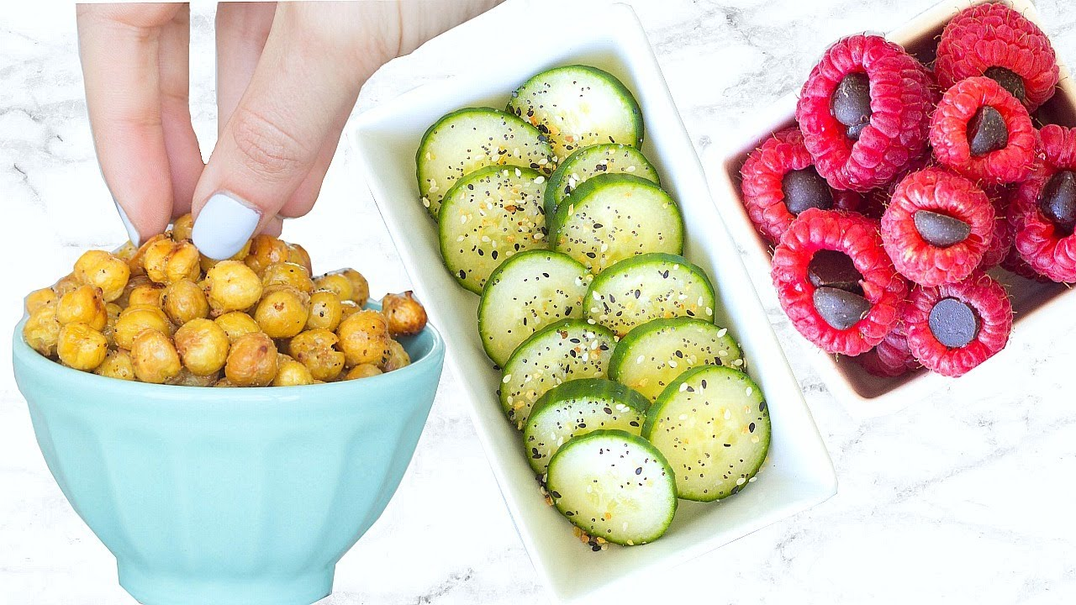
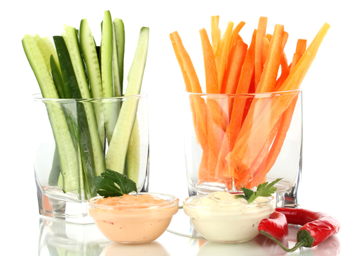
Keep quick snacks on hand.
Dry cereal.
Yogurt
Cheese
Baked corn tortillas chips.
Fresh fruits and veggie!
Notes:
We all get hungry and there is nothing wrong with having a snack to fill our stomachs before we eat a larger meal. Snacks have gotten a bad rap because we often think about unhealthy items like cookies, cakes, ice cream, and candy bars when we think about snacks. Instead, we could supplement those items for healthier things like dry cereal, yogurt, cheese, baked corn tortilla chips, or fresh fruit and vegetables. Most families already have these items; however, location becomes a huge determining after if they are selected over unhealthier items. It is important to keep these healthier items in places that are accessible to the entire family. Keep dry cereal somewhere that kids can reach. If they can reach a piece of cake faster than they can some cereal, they will always target the cereal. Same thing applies for the other items. A key idea for fruits and vegetables is to keep them on the kitchen island or most passed by counter top, this way, family members will always reach for those two items when they get a craving or need a snack to hold them over till their next meal. Now that we have learned several strategies for eating healthier, we will put our knowledge to the test on the next slide.

Slide 11

Rosa’s Dilemma
Single mother.
Her daughter is 12 years old.
She works Monday through Friday from 8-5pm.
She is also taking online clases to complete her masters degree.
Rosa finds it difficult to make time to cook healthy meals during the week.
She brings home fast food most evenings because she just doesn’t have time.
What can Rosa do?
Notes:
Here we have a scenario called Rosa’s Dilemma. In the story, she is a single mother, her daughter is 12 years old and she works Monday through Friday from 8-5pm. She is also taking online classes to complete her Master’s degree. Therefore, she finds it hard to make time to cook healthy meals during the week. This leads to her brining fast food most of the evenings because she just doesn’t have time. What are some things Rosa can do to make healthier meals on her busy schedule? If we stop to think about her situation, the first thing that comes to mind is that she has a 12 year old daughter who may have the ability to cook. It also seems that she is quite busy, so her time is precious. Here are a few ideas that come to mind for her to provide healthier meal options for her and her daughter. First, she can use an example of our weekly food menu to plan her meals at home. For instance she can incorporate our use of a crockpot. As we mentioned earlier, the benefit of using a crockpot is that you can set it on a timer and continue doing the tasks that are needed throughout the day. On Monday, she will not have to pick up fast food because they can eat leftovers that day. This can continue for the rest of the week if she desired it. Let’s assume she wants to eat some steak and vegetables on Tuesday. She can marinate her steak Monday night after class and chop up her vegetables and seal them in a bowl. Or better yet, she can teach or have her daughter do it, while Rosa is working on her schools assignments for the day. This way, on Tuesday, she can create a one-pot meal that incorporates both steak and vegetables. Normally when people stop at fast food joints, they tend to purchase a meal that includes a sugary drink. This can be easily replaced at home with water. So let’s see how these ideas changed how Rosa and her daughter eat every day.

Slide 12
Rosa’s Success Story
She started to plan her meals in advance before she went shopping.
She pre-cooked common ingredients to save on prep time.
She cut down on her visits to fast food restaurants.
She made better decisions when she ate out in restaurants.
She started to drink water at all meals instead of flavored drinks or colas.
If she can do it so can you!
Notes:
As we can see, now that Rosa plans her meals, she has replaced her trip to the fast food joint for a trip to the grocery store instead. Planning her meals and making a shopping list based on those meals means that she can go in and out of the grocery store in no time. She will not be wandering around the aisles looking for ideas or adding random, unnecessary items to her cart. Preparing her meals the day before she makes it has saved her a ton of time and allows her the opportunity to eat at home. Drinking water has also allowed her to consume less sugar; and thus she didn’t add extra calories to her daily diet. If she can do it, so can you!

Slide 13


Summary
Are we really too busy?
Healthy eating strategies
Rosa’s Solution
Notes:
In this class we learned several ways to eat healthier; even when we think we do not have time. Sometimes, being too busy is a choice that we make and can just as easily eliminate it. There is no need for us to place ourselves and our family in high risk situations for obesity by doing things like skipping meals or eating out every day. Small changes in our lifestyle like planning our meals, using a shopping list, and cooking in advance can add time in our busy days, and money when done properly. Remember how easy it was for Rosa to make the transition from unhealthy food to healthier food without much effort. I hope you are able to practice some of the ideas that we informed you about today and that it leads to you living a healthier life. As always, for any questions, comments, or concerns; please email us at the provided email address or simply message us on Messenger or leave a comment on the bottom of the page. Thank you for time and see you all next week.

