Slide 1






Common Barriers to Regular Physical Activity
Notes:
So now we get to the scariest class of all- Physical Activity. Like the words diet and nutrition, physical fitness, exercise, or activity are a set of words that strikes fear in people’s minds because we know that we do not incorporate it into our daily lives as much as we should be doing it. The beauty of this class is that we are going to discuss some of the common barriers that keep people away from regular physical activity and provide guidance on how to incorporate physical activity into your daily routine. Studies have indicated that maintaining a healthy diet and conducting routine physical activity will reduce rates of disease and death from chronic illness. They have also demonstrated that physical inactivity poses almost the same amount of risk for high blood pressure and high cholesterol as smoking does. In the upcoming slides, we will show you ways to incorporate physical activity into your daily regime in promotion of a healthier lifestyle.

Slide 2


Common barriers to physical fitness
Busy lifestyles
Misinformation
Time.
Overwhelmed.
Benefits of physical fitness
Notes:
Like the barriers of nutrition, we live in a society where everyone works, goes to school, has kids, and many other reasons. Other reasons why people do not participate in regular physical activity are because they are misinformed about physical activity, they assume they do not have efficient time to conduct physical activities, or they are simply overwhelmed. One thing I would definitely like to share is that physical activity is not just physical fitness. In this class we will show people the benefits of simply moving around. First and foremost, when it comes to physical activity, it is always important to consult with your physician to ensure that you can conduct the activity safely. Some of the benefits of being more active are that it can help lower a person’s blood pressure, boost levels of good cholesterol, keep weight under control, and it can also prevent bone loss. Two of the more underappreciated benefits of physical activity are that it can reduce feelings of stress and improve sleep quality. As we mentioned in one of our earlier classes, two of the many risks of obesity are stress and lack of sleep. A lot of misinformation that occurs in the physical activity realm occurs because people do not ask questions or because they do not know how to manage their time. People who suffer from chronic conditions like heart disease or diabetes can still conduct physical activity, however, they should seek advice from their medical provider first. In the upcoming slides we will go over easy ways to incorporate physical activity into your daily routines.

Slide 3


Easy solutions to physical fitness
Educate yourself and find an activity you love
Take advantage of the time you do have
Use the resources around you
Use technology to assist you
Find a partner to assist you in your journey
Notes:
There are many solutions that we can act on to eliminate the barriers to physical activity that stand in our way. The first and most important thing to do is to educate yourself on your ability to conduct physical fitness. For instance, seeking guidance from your physician on your ability to perform individual drills, movements, and exercises is essential for setting future health-related goals. Once you are aware of the safety mechanism that you must adhere to, you can start by locating areas in your day where you can implement physical activity. For instance, if you have a desk job, use your breaks to take 5 to 10-minute walks. Also, use the stairs when possible. It is estimated that 1 minute of climbing stairs burns up to 10 calories while taking an elevator burns zero. Another thing that we can do is when we go to the grocery store or the mall, instead of having to find the nearest parking, we can park a bit further to get some steps in for the day. Talking about steps, pedometers like Fitbits, Garmins, Iwatch and many Apps on a smartphone can be used to keep track of daily steps taken. Some of technologies, like Fitbit, provide settings where you can compete with others to boost step rates. Lastly, and probably one of the most important keys to implementing a new lifestyle intervention is to find a partner to share your new journey with. Setting goals with a friend may assist you in keeping those goals and you can use each other as motivation. Sometimes it is hard to see your progress, but having someone share their view on how far you have progressed may also add motivation. So how do we start incorporating physical activity? Well, we first have to understand what physical activity truly is. On the next slides we will discuss the recommendations for physical activity as set forth by the American Heart Association.

Slide 4
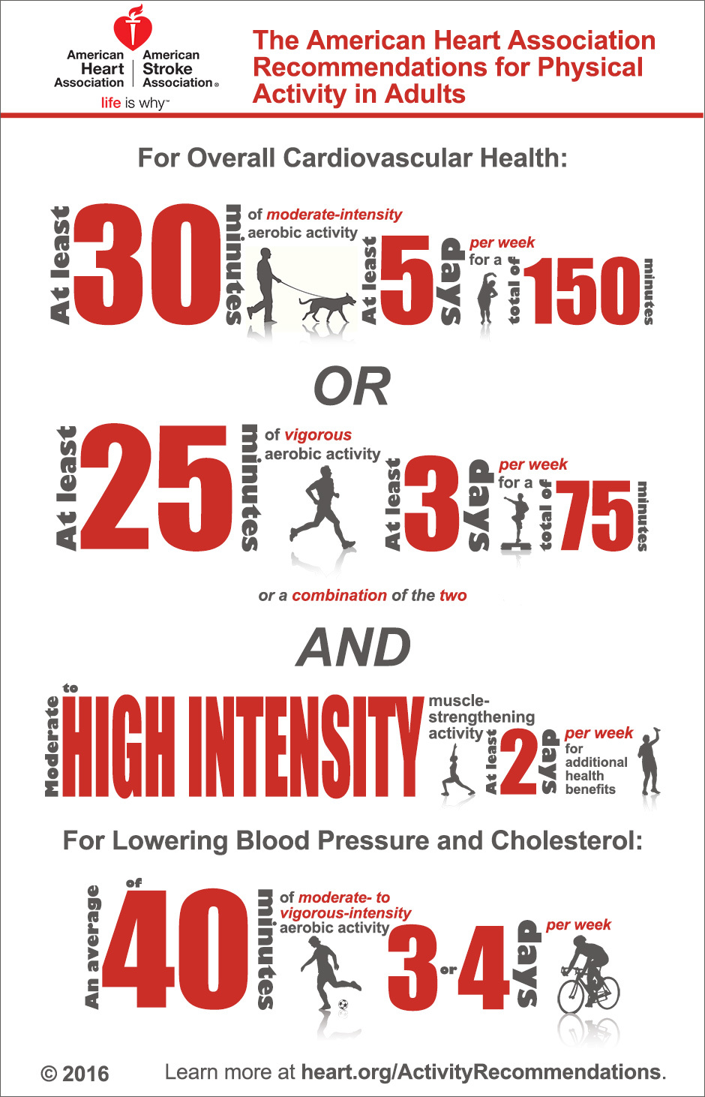
Know the recommendations
30 minutes of moderate 5 days a week.
Or
25 minutes of vigorous 3 days a week.
Notes:
In order to understand the benefits of conducting physical activity it is important that we first learn what the recommendations for physical activity are. The Office of Disease Prevention and Health Promotion published the Physical Activity Guidelines for Americans using current scientific evidence that supports the connections between physical activity, overall health and well-being, disease prevention and quality of life. The following slide shows these recommendations courtesy of the American Heart Association. The first thing to go over are the intensity levels since most of us are very familiar with the application of time. The levels we will discuss are sedentary, moderate, and vigorous intensity. Sedentary refers to a moment when we are not doing anything or inactive. An example is when we sit down to watch television or just stand around to relax. Moderate-intensity activities are those that get your heart beating faster and will cause you to breathe harder, but you will still be able to hold a conversation. Vigorous activities are those which will require a higher amount of physical effort to do, will cause you to sweat, and you won’t be able to talk much without getting out of breath. The AHA recommendations for improving overall cardiovascular health are that we do at least 30 minutes of moderate physical activity 5 days a week for a total of 150 minutes or we should do at least 25 minutes of vigorous physical activity 3 days a week for a total of 75 minutes. In the next slide we will continue to speak on what makes activities moderate or vigorous.

Slide 5
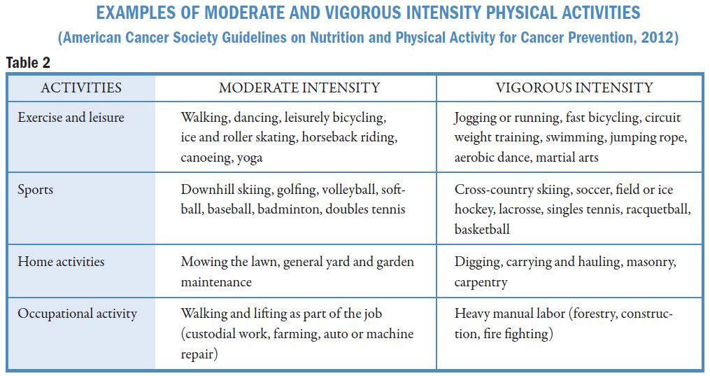
What is moderate or vigorous activity?
Notes:
So far we have learned that physical activity is anything that moves your body and burns calories such as walking, dancing, bicycling, climbing stairs, and stretching. We also discussed the recommendation to conduct 150 minutes of moderate-intensity activity or 75 minutes per week of vigorous activity. However, the best thing to do is to conduct both variations of activity throughout the week. The goal is to add intensity and muscle, and simply feel better. So what are some examples of moderate-intensity activities? We will use examples of four different activities to separate moderate-intensity from vigorous-intensity activities. Those categories are exercise and leisure, sports, home activities, and occupational activities. As we all know, exercise and leisure activities are great ways to get the body moving. Examples of moderate-intensity exercises include walking, dancing, leisurely bicycling, ice and roller skating, horseback riding, canoeing, and yoga. Vigorous-intensity activity examples include jogging or running, fast bicycling, circuit weight training, swimming, jumping rope, aerobic dance, and marital arts. As we all know, not all sports require people to push their bodies to their cardiorespiratory limit. Some of them allow you to enjoy a good conversation, while being active. For instance, downhill skiing, golfing, volleyball, softball, and badminton are labeled as moderate intensity exercise. Some more vigorous sports include cross country skiing, soccer, hockey, lacrosse, racquetball, and basketball. Moving around the house and at work is also essential in building a healthier lifestyle. Some moderate-intensity activities that can be done at home and at work include mowing the lawn, general yard work, garden maintenance, custodial work, farming, and auto or machine repairs. Vigorous activities that can be done at home and at your work are digging holes, carrying and hauling things, masonry, carpentry, and heavy manual labor like forestry, construction, and firefighting. In the next slide we will explain the importance of strength training as a form of physical activity.

Slide 6
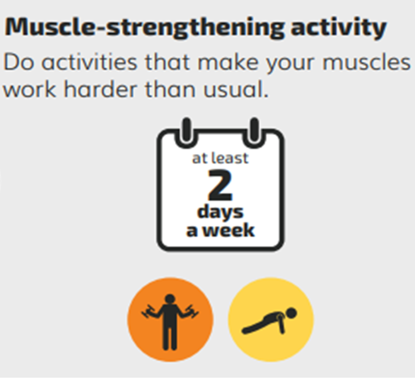
What is strength training?
Notes:
As we mentioned earlier, the American Heart Association recommends that we conduct moderate-to-high-intensity strength training activities at least twice per week. This does not mean that we have to go out and perform like bodybuilders, doing simple weight-bearing exercises using free weights, machines, bands, or our own body weight as resistance is all we need. The good thing is that we do not have to separate our moderate and vigorous aerobic activities, from our moderate to vigorous strength training activities, we can actually combine them. Two important functions that stronger muscles serve are that they allow you to perform everyday activities and protect you from injury and they help you burn more calories, even as you rest, by boosting your metabolic rate. Some common weight bearing exercises that we can do are air squats, push-up, forward and rear lunges, and calf raises. The more common strength training exercises that are done with both free weights and machines are the bench press, deadlifts, and the back squat. In the next slide, we will show you a clip of how easy it is to conduct physical activity while you are at home.

Slide 7

How to start doing more physical activity

Slide 8
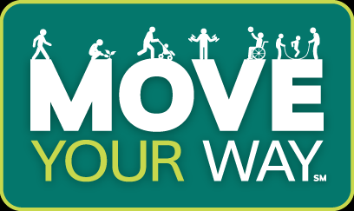
Make time for physical activity.
Notes:
As you can see from the video, the decision to start moving and exercising is 100% ours. In this scenario, a family was stuck indoors with nothing to do until the mother decided it was time to get off the couch and get their bodies moving. Instead of playing on her phone, she turned up the music and got her kids dancing in the living room. If you recall from an earlier slide, dancing is classified as an exercise or leisure activity with moderate intensity. In the second sequence the mother challenge her daughter to some body weight push-up, forward lunges, and jumping jacks during a commercial break. The final sequence showed how a parent could implement physical activity opportunities for their children while they are busy around the house. This video demonstrates how opportunities to conduct physical activity are all around us, we just need to make the time and take action. There are also opportunities as work and when we are on the goal to implement physical activity. For example, when you get to work or the grocery store, try not to park so close to the entrance. This way, you can eventually reach the 10,000 steps per day that is recommended by the American Heart Association. Another tip for getting more steps is to take the stairs when you have to travel to different floors. We already mentioned that you can burn 10 calories per minute by walking upstairs over using the elevator. Like calories, those steps will eventually add up throughout the day. So how do you start moving more? Well, our next slide will present you with a clip that will show you how to motivate yourself to move more!

Slide 9
Getting motivated!

Slide 10

Set achieveable goals!
SMART Goals
Being a marathon runner is not for everyone.
Find something you like to do.
0 to 60 is not sustainable.
Start small and work your way up.
Set a time frame that will grant you success.
Notes:
Any time we decide to make a lifestyle modification, such as eating healthier or conducting more physical activity, it is important that we set SMART and achievable goals. In this instance, SMART stands for specific, measurable, attainable, realistic, and time-bound. The goals that you make have to be specific because you have to set a target goal. For instance, mentioning that you are starting a new fitness regimen because you want to lose weight is not the same as saying you are starting a new fitness regimen with the goal of losing 10 pounds in 5 months. The latter is more specific. Setting measurable goals is also important. Saying you simply want to get healthier is not measureable. Losing 10 pounds in 5 months is easily measured as long as you have access to a scale and a calendar. Your goal also has to be attainable. Losing 10 pounds in one week is not attainable, neither is going from being extremely sedentary to becoming a marathon runner overnight. If the goal is to lose 10 pounds and eventually run a marathon, then a more attainable goal would be to lose 2-3 pounds a month and to be able to run 2-4 miles by the end of the first month and slowly work my way up to my goal. We also have to be realistic when we make our goals. Let say you do not have the time to train for a marathon, a better goal could be to train for a 5K or a 10K run instead. Time can be used in many ways, but one important thing to do when making goals is to set a realistic time frame to achieve your goals. This will serve as a motivational tool, however, you have to make sure that your timeframe is reasonable. You don’t want to give yourself too much or too little time to accomplish your goal. Overall, using the acronym SMART will help set achievable goals and provide you with the time frame to accomplish them.

Slide 11




Successful Lifestyle Interventions!
Notes:
So now we come to the conclusion of this educational presentation brought to you by Pasos Para Prevenir Cancer courtesy of Texas Tech University Health Science Center and made possible by the Cancer Prevention Research Institute of Texas. In this final presentation we discussed barriers and solutions associated with the implementation of physical activity into our daily routines. We listed some common misconception that lead to sedentary lifestyles and countered them with education on how to take advantage of the time, resources, and breaks in life that you do have. We discussed the recommendations associated with moderate-intensity and vigorous-intensity and guided you on different activities in each category. We also introduced you to the benefits of strength training and provided you with some motivational tips to inspire your future changes. We learned to use the acronym SMART to ensure that our goals are not just inspiring, but also achievable. I hope you enjoyed the past few weeks with us and I hope you have implemented as many changes as possible into your daily routine. I challenge you to follow the guidelines set forth by Choose MyPlate and I hope you find adequate time throughout your day to find or make the time to MOVE!

