Slide 1


Presentation of Health Insurance & Vision Insurance
For
The Resident’s of:
Presented by

Slide 2
CONTACT INFORMATION
Monica Loya, Account Manager
The Scioli Group
4412 74th Street Suite A-100
Lubbock, TX 79424
877.211.1975 (toll-free)
806.741.1050
806.741.1160 (fax)
monica@scioligroup.com
As your Account Manager, Monica will give you the individual attention you need and deserve.
Please contact Monica if you have any issues or questions in regards to your medical or vision insurance benefits. Some examples of contacting Monica include:
Lost / Stolen ID Cards
Benefit Inquires
Claims Inquiries
  It is very helpful to send Monica a copy of the Explanation of Benefits as well as copies of any bills received from providers
Network Provider Information
Other key contacts:
Bre Kittley
877.211.1975 (toll-free)
806.741.1050
806.741.1160 (fax)
bre@scioligroup.com
To access online enrollment and view benefit documents, go to www.employeenavigator.com
Blue Cross Blue Shield of Texas (Medical Benefits)
800.521.2227
Avesis (Vision Benefits)
800.828.9341

Slide 3
CRITICAL INFORMATION FOR ORIENTATION
Benefits go into effect July 1st of each plan year.
TTUHSC El Paso will pay 100% of the Resident’s Monthly Premium & 100% of the Dependent’s Monthly Premium.
Dependents are:
  Spouse
  Children – Birth, Adopted, Step
You may NOT cover your parents, grandparents, aunts, uncles, cousins, etc.
If you become married while covered under these benefit plans, you ONLY have 30 DAYS from the date of marriage to add your spouse to the plans. It is YOUR responsibility to inform Brenda Taylor or Diana Villarreal in the Human Resources Department, of your new dependent. If you do not have them added within the 30 Day Time Period then your spouse will NOT have coverage until open enrollment.
If you have a child (birth, adoption, step) you ONLY have 30 DAYS from the date of birth, adoption or marriage for stepchildren to add your child(ren) to the plans. It is YOUR responsibility to inform Brenda Taylor or Diana Villarreal in the Human Resources Department, of your new dependent. If you do not have them added within the 30 Day Time Period then your Child(ren) will NOT have coverage until open enrollment.
YOU MUST BRING THE FOLLOWING TO ORIENTATION TO COMPLETE YOUR ENROLLMENT
  Your Social Security Number
    If you do not have a social security number then you will need a VISA (J1 or J2) or Proof of Citizenship
  Your Eligible Dependents Social Security Number
    If they do not have a social security number then provide a VISA (J1 or J2) or Proof of Citizenship
  Your Date of Birth
  Your Eligible Dependents Dates of Birth
  Insurance Card for current insurance whether you are keeping the other insurance or not
  Your Mailing Address
  Marriage Certificate Copy - if the last names are different

Slide 4
Question & Answers
How much does it cost me to have health insurance benefits and vision benefits?
$0 (The institution pays 100% of the monthly premiums)
How much does it cost me to have health insurance benefits and vision benefits for my eligible dependents?
$0 (The institution pays 100% of the monthly premiums)
Who can I select coverage for?
Yourself, your legal spouse and your child(ren). Eligible children include birth, adopted or step.
My mom lives with me can I add her?
NO
I am getting married soon, when can I add my spouse?
Within 30 days from the date you get married. Contact Human Resources.
I and my spouse are going to have a baby, when can I add the baby?
Within 30 days from the date of birth or adoption. Contact Human Resources.
Where do I find a list of the BCBS of Texas Providers?
www.bcbstx.com
Where do I find a list of Avesis (Vision) Providers?
www.avesis.com
Who do I contact if I have questions about an explanation of benefits I received after seeing a provider?
A. Monica Loya with The Scioli Group (see contact sheet)

Slide 5
The following pages contain information about
your health benefits with BCBS.
Health Benefits

Slide 6
The following are some definitions that will be helpful to you.
Deductible: The amount of covered expenses that the insured must pay before a plan or insurance contract starts to reimburse for eligible expenses.
Co-payment: A small charge paid at the time a medical service is received. It does not accumulate towards a plan's deductible or out-of-pocket maximum.
Out-of-Pocket Maximum: The maximum amount that an insured is required to pay under a plan or insurance contract.
Out-of-Pocket Expenses: Those health care costs that must be borne by the insured.

Slide 7

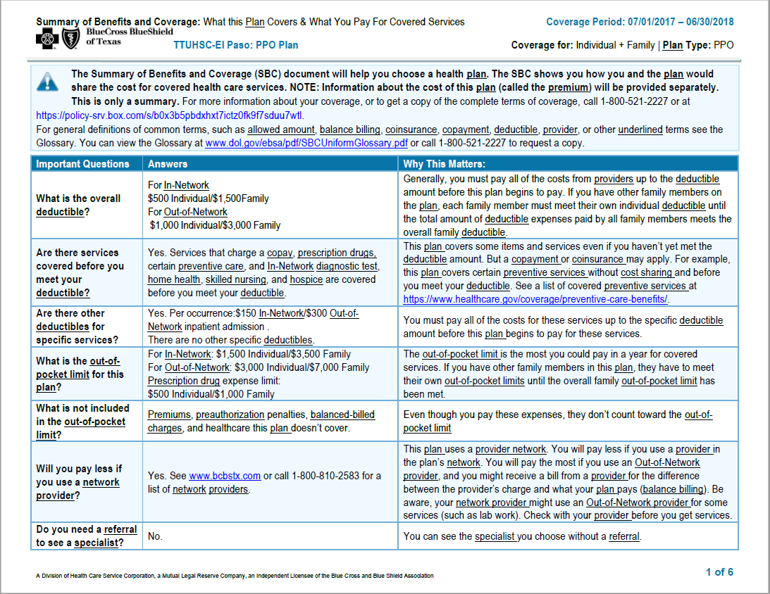

Slide 8
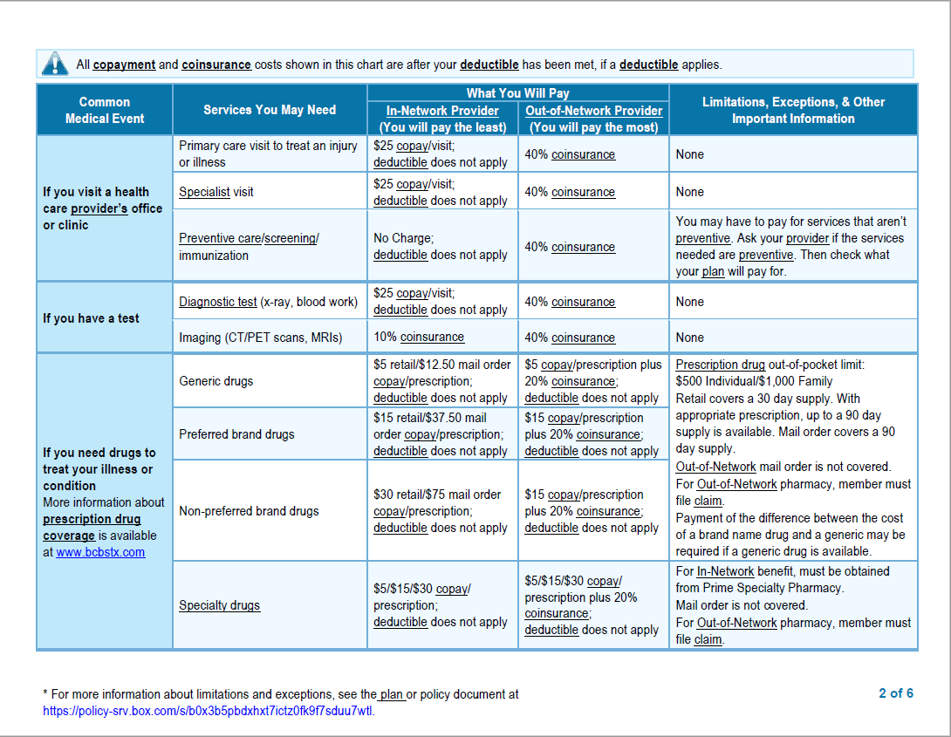

Slide 9
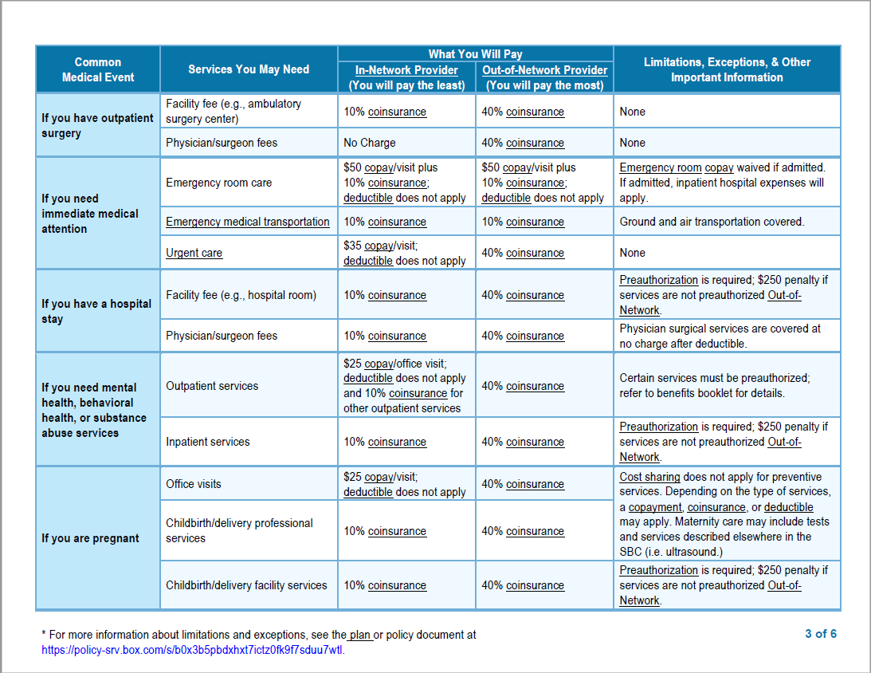

Slide 10
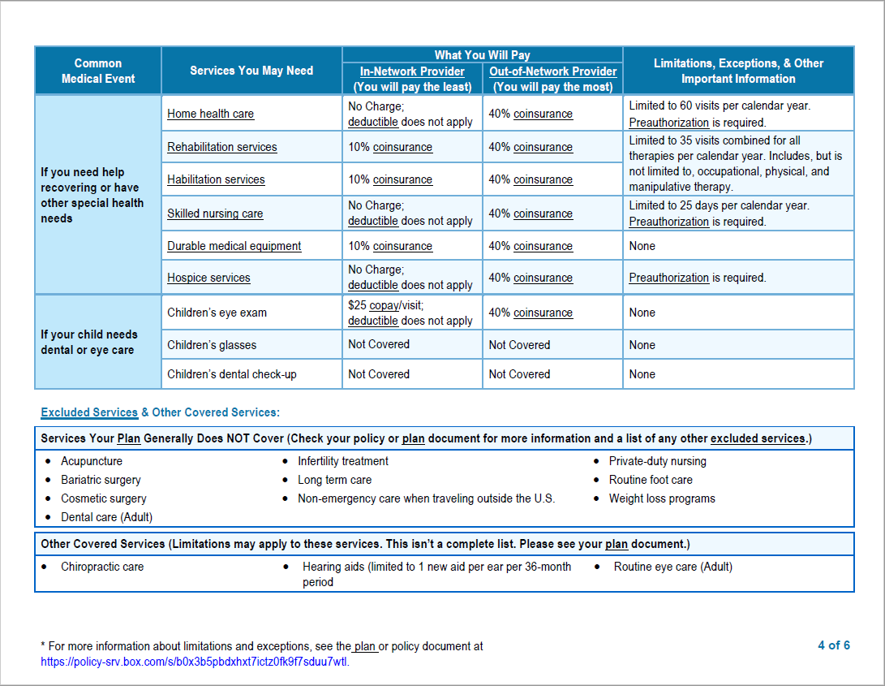

Slide 11
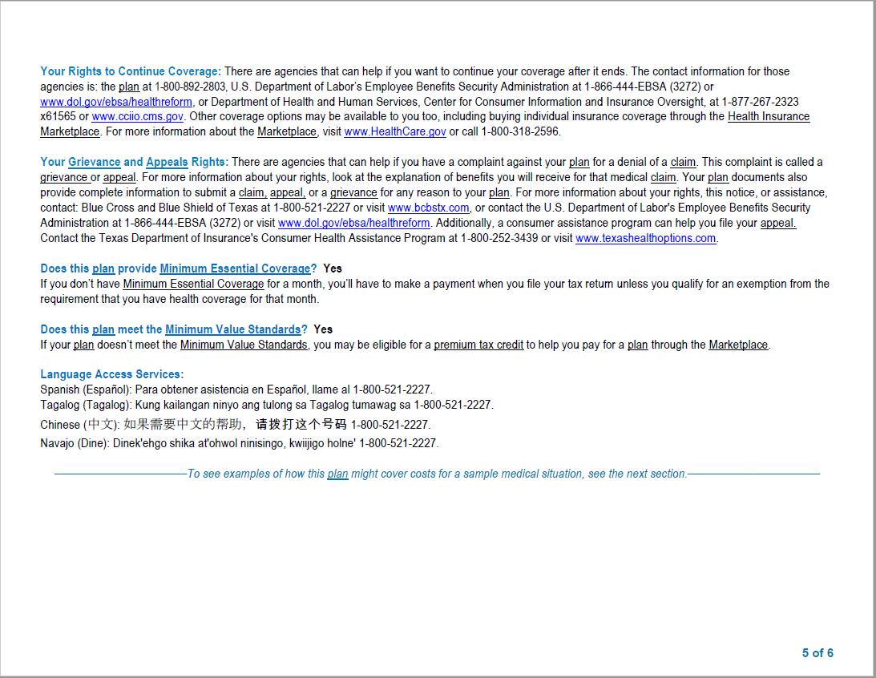

Slide 12
The following pages contain information about
your vision benefits with Avesis.
Vision Benefits

Slide 13

YOUR AVESIS VISION PLAN
TTUHSC – EL PASO
Your vision health is an important part of complete wellness. Avesis is pleased to present your vision benefits which are designed to give you and your covered family members the care, value and service to help maintain good vision and overall health.
In-Network Benefits
Vision Examination Your vision exam is covered in full after a co-pay.
$200* When choosing the frames
Group Details
Effective Date: 7/1/2017
Group Number: 10775-87
Plan Number: 962
Benefit Frequency
Every:
Vision Exam: 12 Months
Spectacle Lenses: 12 Months
Frames: 24 Months
Contact Lenses: 12 Months
Co-Pays
Vision Examination: $10.00
Materials: $25.00
Rates
100% paid by TTUHSC – El Paso
average
retail
and spectacle lenses package!
FRAMES
SPECTACLE LENSES
Standard lenses are covered in full.
Providers typically charge between
$60 - $120* for standard lenses.
Providers typically charge between $100 - $150* for frames covered in full by your plan allowance.**
AND
Contact Lenses
In lieu of frames and spectacle lenses, members receive an allowance up to $130 for materials and fit and follow-up exam
Medical necessity contact lenses are covered in full (prior authorization is required)
LASIK Surgery
Members receive a one-time/lifetime allowance of $150
AND
Out-of-Network
Reimbursement
Up to:
Exam $35.00
Standard Single Vision $25.00
Standard Bifocal $40.00
Standard Trifocal $50.00
Standard Lenticular $80.00
Progressive $40.00
Specialty Lenses Corresponding Standard Lens Reimbursement
Frame $45.00
Contact Lenses $130.00
elective
Contact Lenses $250.00
medically necessary
LASIK Surgery $150.00
Additional Discounts
Specialty Lenses
Are discounted up to 20% off retail in addition to the corresponding standard lens allowance
Progressive Lenses
Are discounted up to 20% off retail in addition to a $50 allowance
Lens Options, Non-Covered Items and Additional Purchases
Are discounted up to 20% off retail
LASIK Surgery
5% - 25% off retail
* Values provided may be more or less depending on the providers retail pricing.
** Provider wholesale frame pricing for your plan is $50. Participating Wal-Mart locations cover frames up to a $68 retail value.
Avesis
A National Vision and Dental Company
www.avesis.com

Slide 14
Your Avesis Vision Plan
Limitations and Exclusions
Using your Vision Benefit
Some provisions, benefits, exclusions or limitations listed herein may vary depending on your state of residence.
Limitations: This plan is designed to cover eye examinations and corrective eyewear. It is also designed to cover visual needs rather than cosmetic options. Should the member select options that are not covered under the plan, as shown in the schedule of benefits, the member will pay a discounted fee to the participating Avesis provider. Benefits are payable only for services received while the group and individual member’s coverage is in force.
Exclusions: There are no benefits under the plan for professional services or materials connected with and arising from: 1) Orthoptics of vision training; 2) Subnormal vision aids and any supplemental testing; 3) Plano (non-prescription) lenses, sunglasses; 4) Two pair of glasses in lieu of bifocal lenses; 5) Any medical or surgical treatment of eye or support structures; 6) Replacement of lost or broken lenses, contact lenses or frames, except when the member is normally eligible for services; 7) any eye examination or corrective eyewear required by an employer as a condition of employment; 8) Services or materials provided as a result of Workers Compensation Law, or similar legislation, required by any governmental agency whether Federal, State or subdivision thereof.
When you need to see an eye care professional, simply visit www.avesis.com or contact Avesis’ Customer Service Monday through Friday, 7 AM to 8 PM (EST) at 1-800-828-9341 to receive a listing of providers in your area.
1 Select a provider
3 Visit provider for service
2 Contact provider for an appointment
4 Pay any co-pays or additional uncovered expenses
Important Information
Avesis Website: avesis.com
Customer Service Number: 1-800-828-9341
LASIK Provider Number: 1-888-314-4619
Notes and Disclaimers
Notes and Disclaimers: Dilation is covered in full based on the following conditions: central vision loss, photopsia, floaters, history of ocular surgery, history of ocular trauma, history of ocular disease high myopia or diabetes. If the following conditions do not apply, members will receive Avesis’ Preferred Pricing (20% off retail).
The contact lens allowance may be used all at once or throughout the plan year as needed or may be applied toward contact lenses only, or both contact lenses and professional services (fitting fees).
Laser vision correction is considered Refractive Surgery, an elective procedure, and may involve potential risks to patients. Avesis is not responsible for the outcome of any refractive surgery.
Only one co-pay applies to either frames or lenses.
Termination Provisions: Coverage will end on the earliest of: the date the policy ends, the date the employee’s employment ends, or the date the employee is no longer eligible.
Using Out-Of-Network Providers
Members who elect to use an out-of-network provider must pay the provider in full at the time of service and submit a claim to Avesis for reimbursement. Reimbursement levels are in accordance with the out-of-network reimbursement schedule previously listed. Out-of-network benefits are subject to the same eligibility, availability, frequency of benefits, and limitation and exclusion provisions of the plan; and are in lieu of services provided by a participating Avesis provider. Out-of-network claim forms can be obtained by contacting Avesis’ Customer Service Center, your group administrator or by visiting www.avesis.com.
Avesis
A National Vision and Dental Company
Product underwritten by National Guardian Life insurance Company. National Guardian Life is not affiliated with Guardian Life Insurance Company of America, a/k/a The Guardian or Guardian Life.
Insured benefits are administered by Avesis Third Party Administrators, Inc., Phoenix, AZ

Slide 15
The following pages contain helpful information regarding
Eligibility Requirements for Dependents

Slide 16
Eligibility Requirements for Dependents
Eligibility Items Required
Marriage Certificate – Required if spouse has a different last name than the employee.
Dependent Verification Form – Required if a child has a different last name than the employee.
Social Security Numbers for all employees, spouses and children – If a participant does not have a Social Security Number, they must provide proof of temporary citizenship.
Certificates of Creditable Coverage – Obtained from prior insurance carrier; Creditable coverage reduces the pre-existing period
Dependent Information
Only spouses and children that meet the following will be considered eligible under the plan.
The Participant's legal spouse. Such spouse must have met all requirements of a valid marriage contract in the state of marriage of such parties. A marriage license may be required.
The Participant's child who meets all of the following conditions:
  Is a Natural Child, stepchild, legally adopted child, child for whom legal adoption proceedings have been initiated if such child has been placed in your home or a child who has been placed under the legal guardianship of the Participant. A Natural Child qualifies as a Dependent at the time of birth. A Natural Child means a child that is related by birth and is not an adopted child, a stepchild, a foster child, niece, nephew, or grandchild.
  Is less than twenty-six (26) years of age. This requirement is waived for any mentally retarded or physically handicapped child provided that the child is incapable of self-sustaining employment and is chiefly dependent upon the Participant for support and maintenance. Proof of incapacity must be furnished to the Company, and additional proof may be requested from time to time.
As required by the federal Omnibus Budget Reconciliation Act of 1993, any child of a Plan Participant who is an Alternate Recipient under a Qualified Medical Child Support Order (QMCSO) and has a right to enroll in the Plan as a Dependent of a Participant.
Those situations specifically excluded from the definition of a Dependent are:
A spouse who is legally separated or divorced from the Participant. Such spouse must have met all requirements of a valid separation or divorce contract in the state granting such separation or divorce;
Any person on active military duty;
Any person eligible for coverage under this Plan as an individual Participant;
Any person who is covered as a Dependent by more than one Participant of the same Company.
** PLEASE NOTE **
If you choose NOT to cover yourself or your eligible dependents as corresponded above during the current Open Enrollment Period, you will not be able to add yourself or your eligible dependents until the following Open Enrollment Period or unless there is a qualifying event, “special enrollee/enrollment,” (noted below). As communicated above, all supporting documentation will be required at the time of the addition.

Slide 17
A Dependent will be considered eligible for coverage on the date the Participant becomes eligible for Dependent Coverage, subject to all limitations and requirements of this Plan, and in accordance with the following:
A spouse will be considered an eligible Dependent from the date of marriage, provided the spouse is properly enrolled as a Dependent of the Participant within thirty (30) days of the date of marriage.
A Newborn Natural Child will be eligible from the moment of birth for Injury or Illness, including the necessary care or treatment of medically diagnosed congenital defects, birth abnormalities or prematurity, provided the child is properly enrolled as a Dependent of the Participant within thirty (30) days of the child's date of birth. This provision shall not apply nor in any way affect the normal maternity provisions applicable to the mother.
If a Dependent is acquired, other than at the time of birth for a Natural Child, due to a court order, decree, marriage, adoption or Placement for Adoption, that Dependent will be eligible from the date of such court order, decree, marriage, adoption or Placement for Adoption for Injury or Illness, including the necessary care or treatment of medically diagnosed congenital defects, birth abnormalities or conditions related to prematurity, provided that this new Dependent is properly enrolled as a Dependent of the Participant within thirty (30) days of the court order, decree, marriage, adoption or Placement of Adoption.
4. A child may become eligible for Dependent Coverage as set forth in a qualified medical child support order (QMCSO). The Plan Administrator shall have sole discretion to determine whether a medical child support order is qualified and for administering the provision of benefits under the Plan pursuant to a qualified medical child support order. The Plan Administrator may seek clarification and modification of the order, up to and including the right to seek a hearing before the court or agency which issued the order.
No Dependent shall be denied enrollment in the Plan due to his confinement in a hospital or other
health care institution or inability to engage in normal life activities.
DEPENDENT EFFECTIVE DATE
A Dependent of a Participant who makes written request for Dependent Coverage hereunder, on a form approved by the Plan Administrator, shall be subject to the provisions of this article, becomes covered as follows:
If the Participant makes such written request on or before the date he becomes eligible for
Dependent Coverage he shall become covered, with respect to those persons who are then his Dependents, on the date he becomes eligible for Participant Coverage.
Except as otherwise provided under “Dependent Eligibility” (i.e., for Newborn, adopted, and newly acquired Dependents) or as provided under the “Special Enrollment Effective Date” below. If the Participant makes such written request after the date on which he is eligible for Dependent Coverage those persons who are then his Dependents shall be Late Enrollees, and coverage for

Slide 18
SPECIAL ENROLLEE
The term “Special Enrollee” means an Employee or Dependent who is entitled to and who requests Special Enrollment:
1. Within thirty (30) days of losing other Creditable Coverage; or
2. For a newly acquired Dependent, within thirty (30) days of the marriage, birth, adoption, or placement for adoption.
SPECIAL ENROLLMENT EFFECTIVE DATE
Eligible Employees and Dependents are permitted to enroll in this Plan upon loss of other group health coverage if enrollment is requested by the Employees within thirty (30) days of loss of coverage. The Special Enrollee must meet the following conditions:
The Employee or Dependent had other Creditable Coverage or was covered by another group health plan or under a COBRA continuation provision at the time coverage was offered by this Plan and the Employee stated in writing that coverage under another plan was the reason for declining enrollment; and
. The Employee or Dependent lost such coverage due to divorce, legal separation, death, termination of employment, reduction of hours, termination of employer contribution, or established COBRA coverage exhausted. Loss of coverage because of non-payment of premium is not a condition to qualify for Special Enrollment.
An Employee who is already enrolled in a benefit option may enroll in another benefit option under the Plan if a dependent of that Employee has a special enrollment right in the Plan because the dependent lost eligibility for other coverage. The Employee must make written application for special enrollment in the new benefit option within 30 days of the date the other health coverage was lost.
The effective date for the above Special Enrollee shall be the day following the loss of other group
health coverage provided proper enrollment is completed within thirty (30) days of loss of coverage.
DEPENDENT SPECIAL ENROLLMENT EFFECTIVE DATE
Newly acquired Dependents of eligible Participants shall be Special Enrollees and eligible to enroll without a Waiting Period if enrollment is requested within thirty (30) days of the following:
1. A Natural Child’s date of birth; or
2. Date of final legal adoption; or
3. Date of Placement for Adoption; or
4. Date of marriage.
The effective date of coverage for the above Special Enrollee shall be the Natural Child’s date of birth, date of final legal adoption, date of Placement for Adoption, or date of marriage provided proper enrollment is received within thirty (30) days.
The eligible Employee and/or Employee’s Spouse of the newly acquired Dependent that are not covered
by the Plan shall also be a Special Enrollee eligible to enroll with the newly acquired Dependent. The
effective date of coverage will be same as that of one Dependent being added as explained above.

